Slide 1
The Greek economy in 2019:
Outlook, risks and major challenges
Dimitris Malliaropulos *
Bank of Greece
January 2019
Presentation at FitchRatings Seminar “Credit Outlook 2019”, Athens, 22 January 2019.
* Chief Economist, Head of Economic Analysis and Research
Disclaimer: The views expressed here are my own and do not necessarily reflect the views of the Bank of Greece or the Eurosystem.
Notes:
1

Slide 2
Global business cycle at a critical turning point
Developments in the global economy and financial markets set the stage for Greece in 2019.
Global growth has peaked in 2018. Global economy is heading towards a slowdown which may develop into a global recession.
Market volatility has shot up, risky asset markets have experienced a major correction in December.
Global monetary policy normalization continues, despite large asymmetry among major central banks.
But if risk of global economic downturn materializes, global central banks will be forced to loosen monetary policy further.
QE will be back on the agenda as the zero lower bound remains binding for most major central banks.
What are the implications for global sovereign bond yields?
  Overall, global sovereign yields will likely remain low. But effects will be asymmetric, depending on sovereign credit ratings.
  Higher-rated sovereigns may see yields declining (“flight to safety”).
  Lower-rated sovereigns may see spreads increasing.

Slide 3
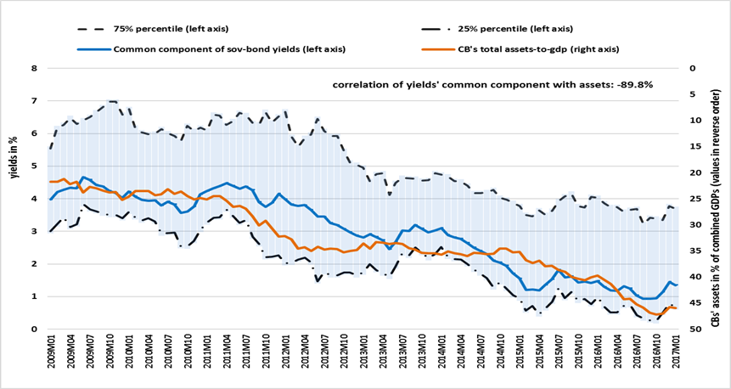
Sovereign bond yields: QE is a global risk factor driving yields lower
Size of aggregate balance sheet of four major central banks and global sovereign bond yields
Aggregate balance sheet of the four major central banks is strongly correlated with the first principal component of ten-year sovereign bond yields of 45 sovereigns across all rating classes.
Graph suggests a long-run relationship between size of CBs’ balance sheets and global bond yields.
Empirical findings:
QE has led to a permanent decline in sovereign bond yields globally, ranging from 250 bps for AAA-rated bonds to 330 bps for B-rated bonds. Euro area periphery countries which participated in APP have benefitted more (600-750bps, depending on sovereign ratings).
Implications:
CBs’ balance sheets will remain adequately large in order to provide the necessary supply of safe short-term assets to the financial system.
As a result, average global yields will remain low for the foreseeable future.
Source: Malliaropulos and Migiakis (2018): Quantitative Easing and sovereign bond yields: a global perspective (Bank of Greece Working Paper 258, November 2018).

Slide 4
How will the global backdrop affect Greece?
How is Greek economy positioned to weather the global slowdown?
How will GGB spreads and sovereign be affected?
Positive GDP growth trajectory expected to continue, as catching up effect from a long depression may counterbalance effect of global slowdown.
  But, risks for growth point to the downside.
Greek sovereign spreads will likely remain under pressure due to “flight to safety” effects.
Does this impose higher risk for refinancing and debt sustainability? Two mitigating factors:
  25bn fiscal buffer provides insurance that refinancing of maturing debt can occur independently of market conditions.
  More than 80% of public debt is fixed-rate debt, hence, higher interest rates will have only limited effects on debt dynamics in the medium term.
  But there are risks to debt dynamics.

Slide 5
  Economic adjustment during the crisis has eliminated major imbalances and increased flexibility of the economy
Notes:
5

Slide 6
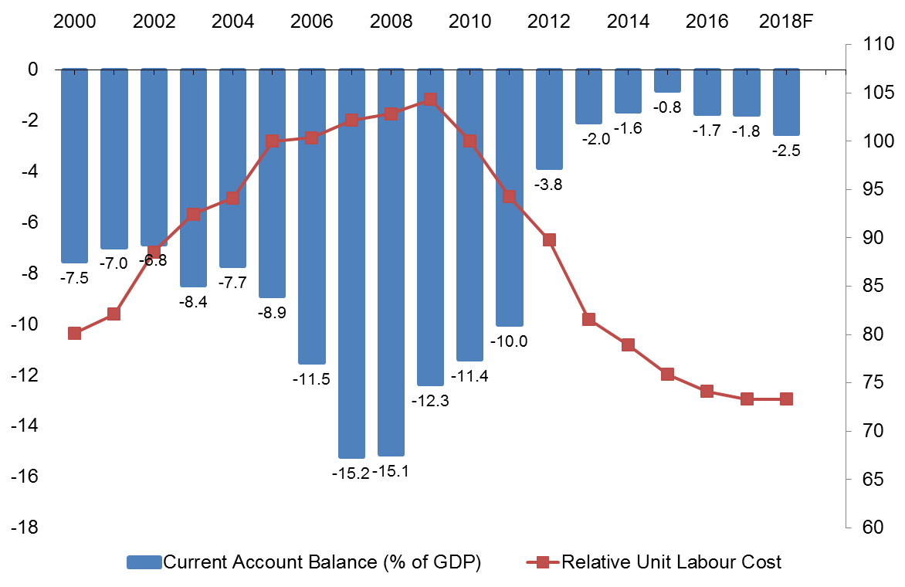
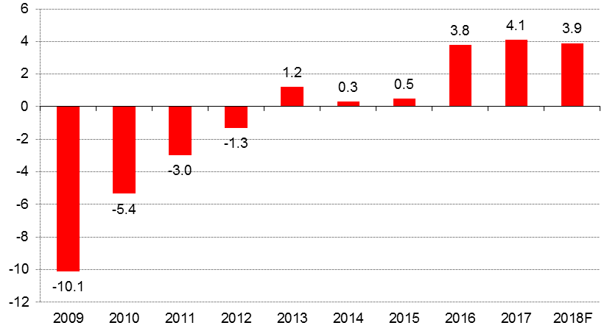
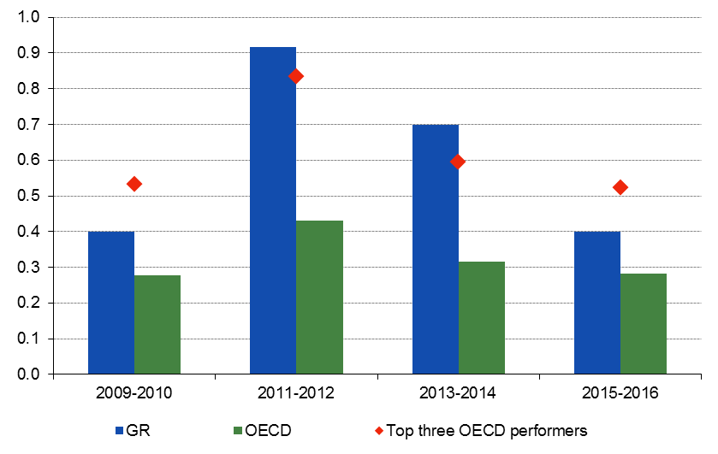
Twin deficits eliminated, cost competitiveness restored, reforms have made the economy more flexible
General Government primary balance
(% of GDP, programme definition)
Current Account balance (% of GDP) and Wage Competitiveness (Index)
OECD Reform Responsiveness Indicator
(Index)
Source: Ministry of Finance
Source: Bank of Greece, Ameco. Increase in CA deficit
in 2016-18 is partly due to changes in methodology.
Source: OECD Going for Growth
Notes:
Left-hand chart: The programme definition of the primary budget balance deviates substantially from the EDP. Most notably, it excludes the cost of the banking support, SMP/ ANFA profits-related transfers from Member States and some privatisation revenues.
\\KKFILE01\DOM-Common\Note on the Greek economy\Weekly note CHART_BOOK.xlsx (chart 39a)
Right-hand chart: Z:\Note on the Greek economy\Presentation CHART BOOK.xlsx
6

Slide 7
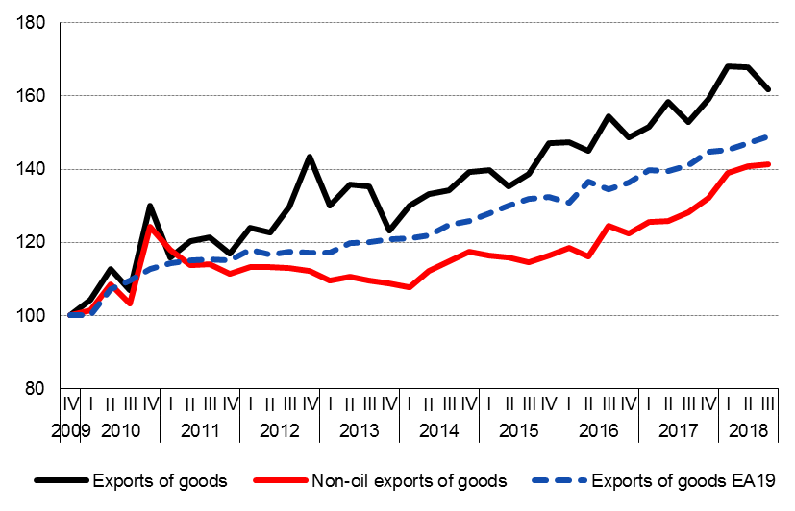
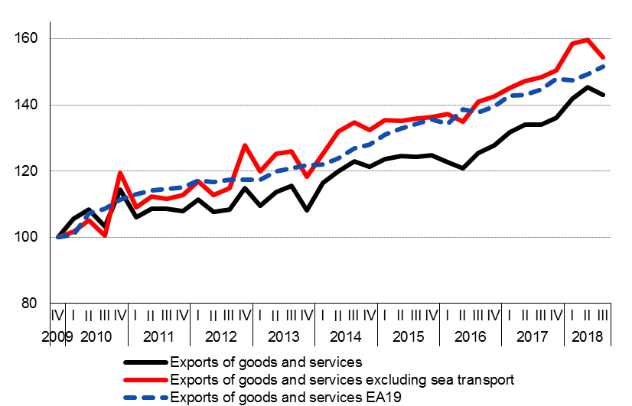
As a result, exports increased substantially, outperforming Euro area
Real exports of goods
(index 2009q4=100, sa)
Real exports of goods and services
(index 2009q4=100, sa)
Openness of Greek economy – (Ex+Im)/GDP -- increased from 47% in 2009 to 69% in 2017.
Greece’s share in world trade increased by 13% since 2015.
Source: Bank of Greece (BoP statistics) and Eurostat (for EA 19).
Notes:
7
\\KKFILE01\DOM-Common\Note on the Greek economy\Weekly note CHART_BOOK.xlsx (Chart 31)
7

Slide 8
  Current state of economy,
  outlook and risks
Notes:
8

Slide 9
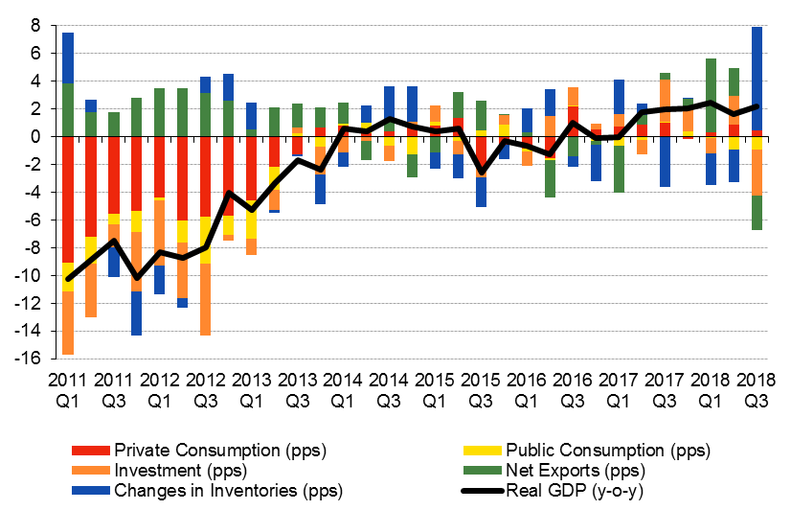
Following three years of stagnation, economy is finally growing again since Q1 2017
Real GDP growth decomposition
(annual % change, pp contributions)
Recession
2008-2013
Stagnation
2014-2016
Recovery
2017-2018
But growth rates remain modest at ca 2% (“credit-less recovery”).
  Main drivers of 2018 Q1-Q3 growth:
    Exports (+8.3%).
    Private consumption (+0.8%).
    Investment declined and inventories increased in Q3 due to base effects.
Source: ELSTAT
Notes:
9
LHS: Z:\Note on the Greek economy\Weekly note CHART BOOK.xlsx (Chart 1)
9

Slide 10
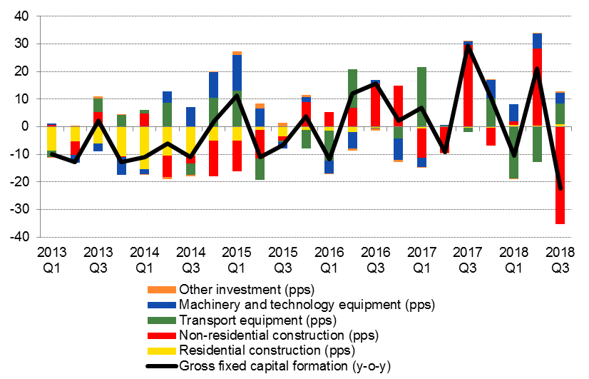
Investment: distorted by base effects related to defense expenditure and road-construction
    Data distorted in 2018:Q3 due to base effects related to public works (non-residential construction).
    But, underlying trend in investment seems to remain positive despite higher volatility.
Completion of highways increased
non-residential construction
and decreased inventories in Q3 2017.
Due to base effect,
non-residential construction declined
and inventories increased in Q3 2018.
Source: ELSTAT
Notes:
10
LHS
Z:\Note on the Greek economy\Weekly note CHART BOOK.xlsx (chart 19)
10

Slide 11
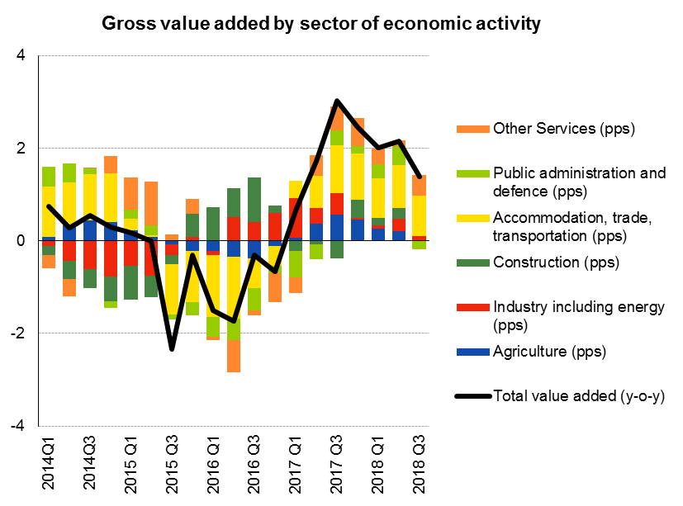
Economic recovery is broad-based. But services are the main driver
Source: ELSTAT
Notes:
11
LHS
Z:\Note on the Greek economy\Weekly note CHART BOOK.xlsx (chart 19)
11

Slide 12
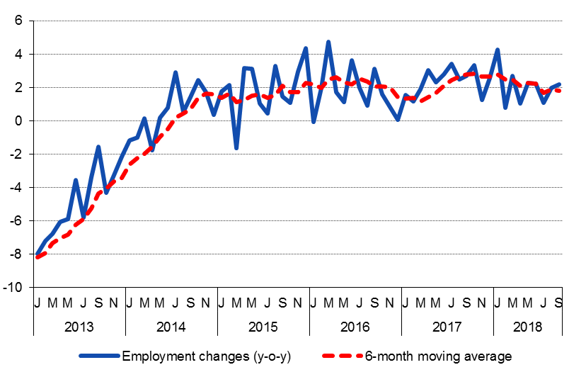
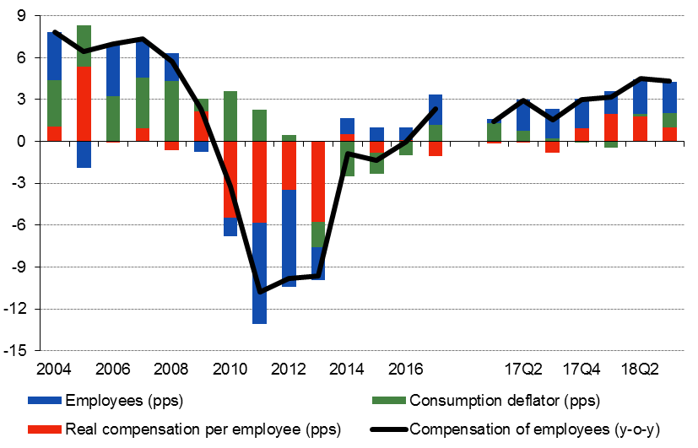
Labour market recovery continues for the fifth year
Net job creation is to a large extent due to increased labour market flexibility
  Nevertheless, unemployment remains very high (18.3% in 2018:Q3).
Employment
(y-o-y growth)
Compensation of employees
(y-o-y growth)
Source: ELSTAT, Labour Force Survey
Notes:
12
LHS
Z:\Note on the Greek economy\Weekly note CHART BOOK.xlsx (chart 19)
12

Slide 13
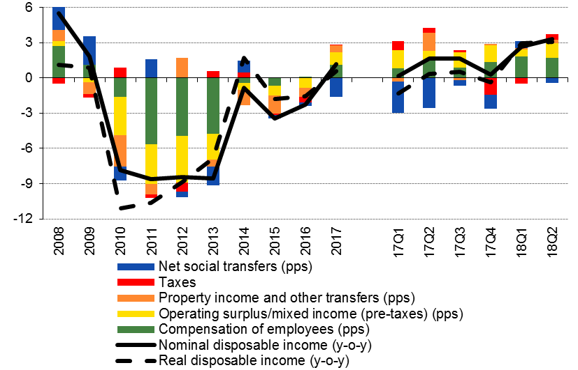
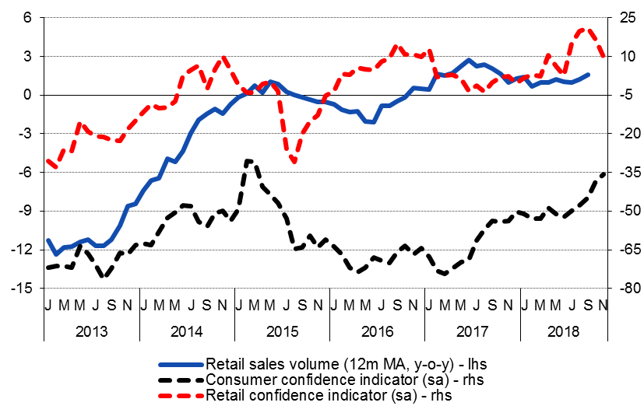
Consumers: improving income and confidence
    Disposable income growing at the highest rate since 2008.
Household disposable income (y-o-y)
Retail sales (y-o-y), consumer and retail confidence
Source: ELSTAT
Notes:
13
LHS
Z:\Note on the Greek economy\Weekly note CHART BOOK.xlsx (chart 19)
13

Slide 14
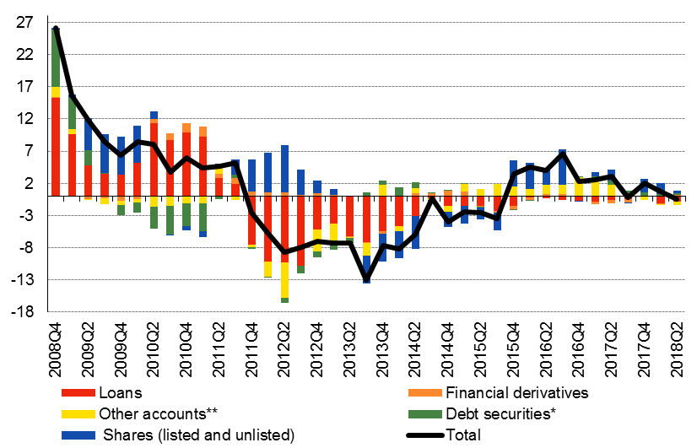
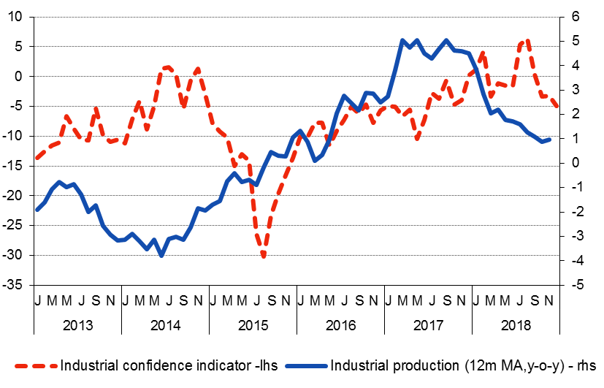
Non-Financial Companies: deteriorating financing conditions and industrial production
Financing conditions of NFCs deteriorating Industrial production decelerating
despite SMEs’ improved access to bank credit (SAFE survey) along with confidence in the sector
and increase in gross loan flows to NFCs in 2018.
*Does not include corporate bonds issued by Greek companies' subsidiaries residing abroad.
In the period Dec. 2012-Sept. 2018 these amount €8 bn.
** Includes trade credit and advances and other accounts receivable/payable.
Source: ELSTAT
Notes:
14
LHS
Z:\Note on the Greek economy\Weekly note CHART BOOK.xlsx (chart 19)
14

Slide 15
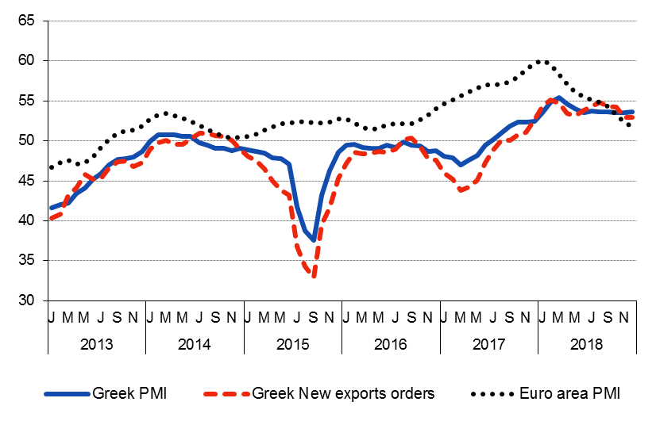
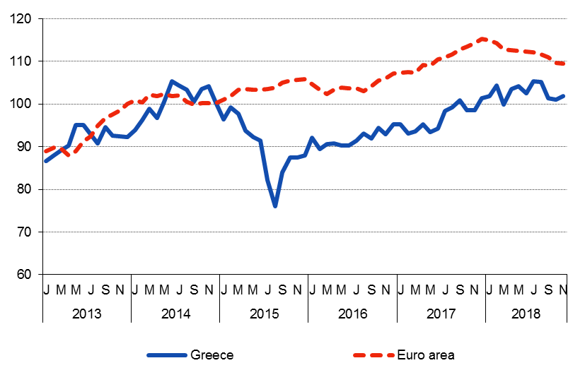
Soft data: holding well despite euro area slowdown
Purchasing Managers Index (PMI)
Economic Sentiment
Source: Markit
Source: European Commission
Notes:
15
LHS
Z:\Note on the Greek economy\Weekly note CHART BOOK.xlsx (chart 19)
15

Slide 16
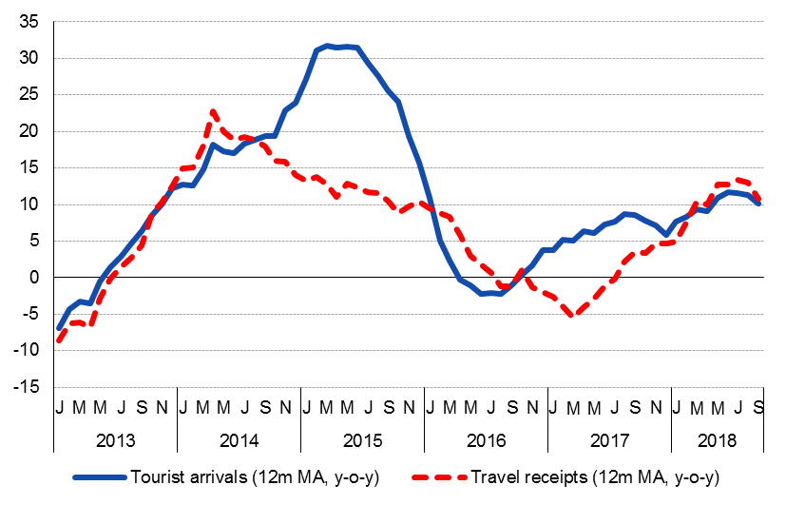
Tourism: positive trend continues
Tourist activity indicators
Source: Bank of Greece
Notes:
16
LHS
Z:\Note on the Greek economy\Weekly note CHART BOOK.xlsx (chart 19)
16

Slide 17
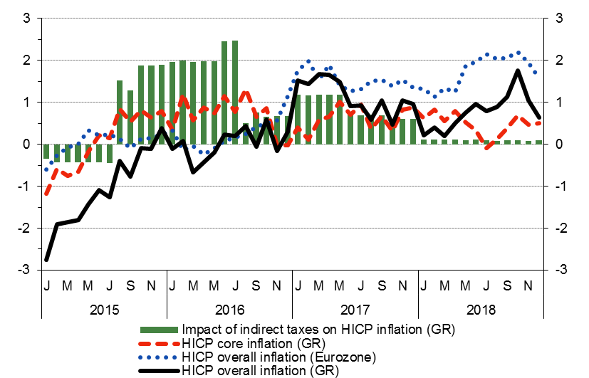
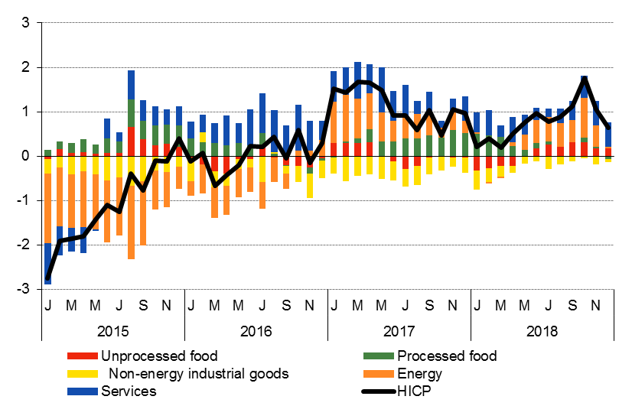
Deflation is over: good for indebted borrowers (including government), bad for consumers
HICP Inflation
Oil prices are the major driver of inflation
Source: ELSTAT
Notes:
17
LHS
Z:\Note on the Greek economy\Weekly note CHART BOOK.xlsx (chart 19)
17

Slide 18
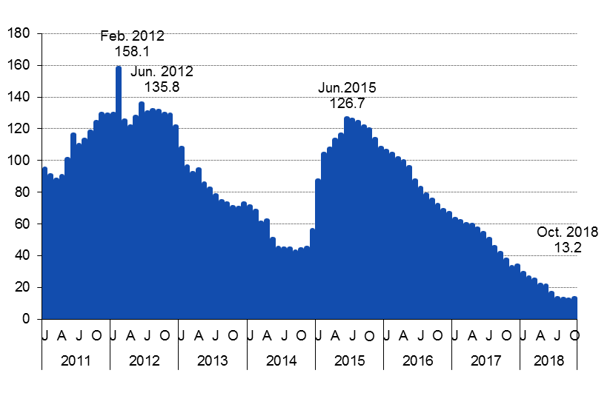
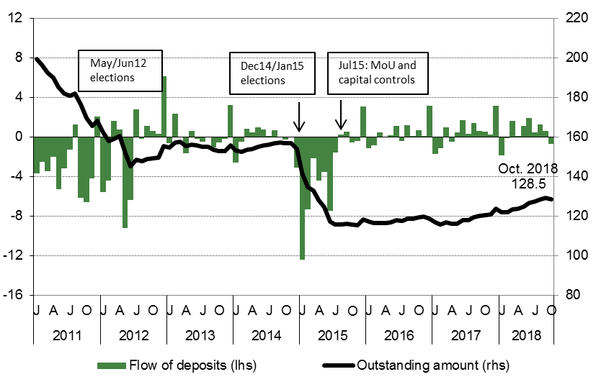
Bank funding: gradual recovery of deposits and quick decline of central bank financing
Bank deposits of households and NFCs (EUR bn)
Central bank financing to Greek commercial banks (EUR bn)
Source: Bank of Greece
Notes:
18
LHS: Z:\Note on the Greek economy\Weekly note CHART BOOK.xlsx (chart 47)
RHS: Z:\Note on the Greek economy\Weekly note CHART BOOK.xlsx (chart 49)
18

Slide 19
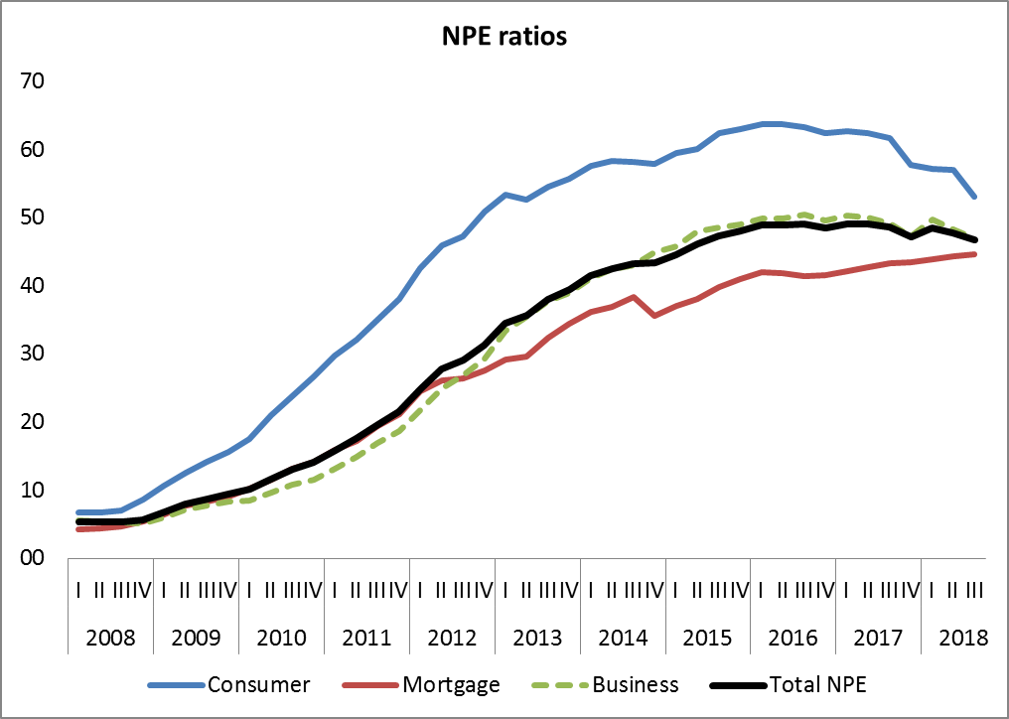
Banks’ asset quality is low: NPEs are the biggest challenge
NPEs are a structural, not a cyclical phenomenon.
Active NPE reduction strategies essential to tackle asset quality problem.
Banks plan to reduce NPEs to 20% until 2021 from 47% in 2018.
BoG made a proposal to set up an SPV which will take over ca 50% of banks’ NPEs against DTCs.
NPE reduction will allow banks to start lending again
  Otherwise, economy will continue to be trapped in a “credit-less recovery”.
Source: Bank of Greece
Notes:
19
LHS: Z:\Note on the Greek economy\Weekly note CHART BOOK.xlsx (chart 47)
RHS: Z:\Note on the Greek economy\Weekly note CHART BOOK.xlsx (chart 49)
19

Slide 20
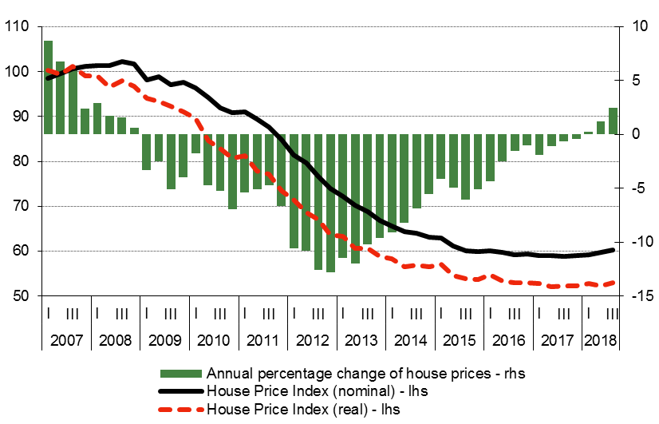
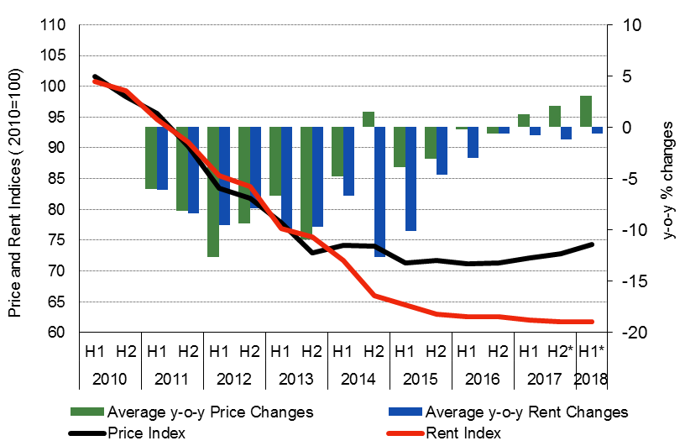
Property market: Prices started to recover
Residential house prices
Prime retail prices and rents
Source: Bank of Greece
Notes:
20
LHS: Z:\Note on the Greek economy\Weekly note CHART BOOK.xlsx (chart 47)
RHS: Z:\Note on the Greek economy\Weekly note CHART BOOK.xlsx (chart 49)
20

Slide 21
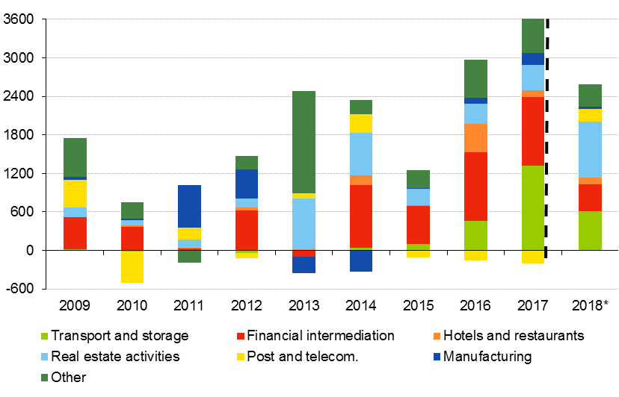
Foreign Direct Investment: Real estate sector attracts FDI
Inward FDI by sector (mn eur)
Real estate sector attracts
the largest share of inward FDI
2018*: January-September data.
Source: Bank of Greece
Notes:
21
LHS: Z:\Note on the Greek economy\Weekly note CHART BOOK.xlsx (chart 47)
RHS: Z:\Note on the Greek economy\Weekly note CHART BOOK.xlsx (chart 49)
21

Slide 22
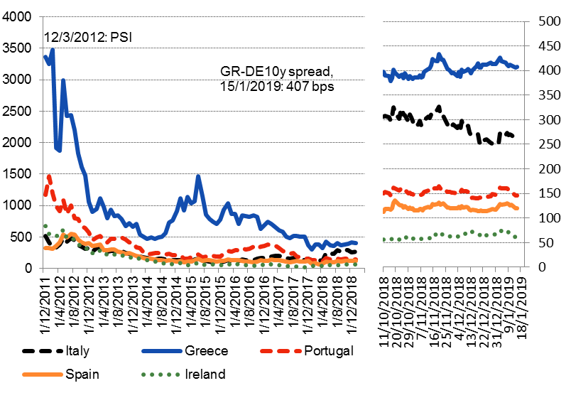
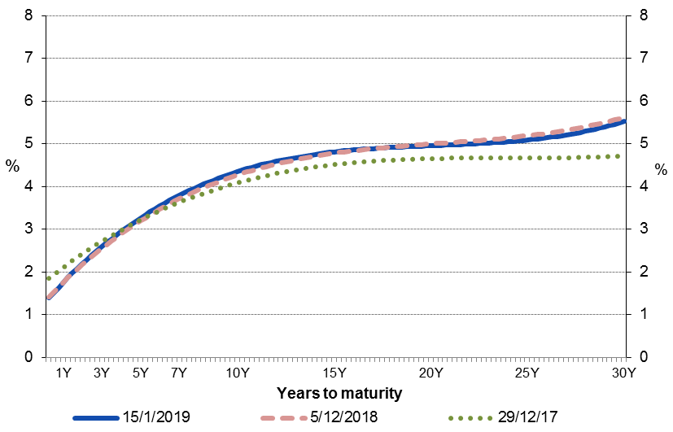
Sovereign bond yields: GGB spreads remain elevated despite compression of Italian spreads, suggesting higher idiosyncratic risk factors. Yield curve has steepened from a year ago.
Spreads vis-à-vis bunds (bps)
GGBs: Fitted yield curve
Yield curve steepening in 3m-10y maturities likely suggests:
Better growth prospects for the economy.
Lower risks to debt sustainability in the medium term.
Source: Bank of Greece
Notes:
22
LHS: Z:\Note on the Greek economy\Weekly note CHART BOOK.xlsx (chart 47)
RHS: Z:\Note on the Greek economy\Weekly note CHART BOOK.xlsx (chart 49)
22

Slide 23
Short-to-medium term growth outlook and risks
Positive growth momentum to continue in 2019.
  Tailwinds:
  improving labour market conditions and increase in disposable income support consumption.
  Slightly expansionary fiscal stance.
  Acceleration in NPE reduction improve bank lending and investment.
  Headwinds:
  Slowdown of global economy, leading to a deceleration in export growth.
  Fiscal mix not growth-friendly.
Downside risks:
  Sharp correction in global financial markets will increase cost and availability of funding.
  Global slowdown/recession will affect exports.
  Backtracking of reforms, delays in privatizations and political uncertainty will affect confidence and investment.
  Fiscal risks due to ongoing court rulings on pension and wage cuts – political business cycle.
Upside risks:
  Acceleration of NPE decline will improve financing conditions for companies and households.
Notes:
23
23

Slide 24
  Economic policy challenges after the end of the Adjustment Programs
  Regain market access for the sovereign
  Accelerate rebalancing of economy towards a new growth model
  Attract private investment and FDI
  Tackle NPEs – revitalize bank lending
  Adopt a growth-friendly fiscal policy mix
Notes:
24

Slide 25
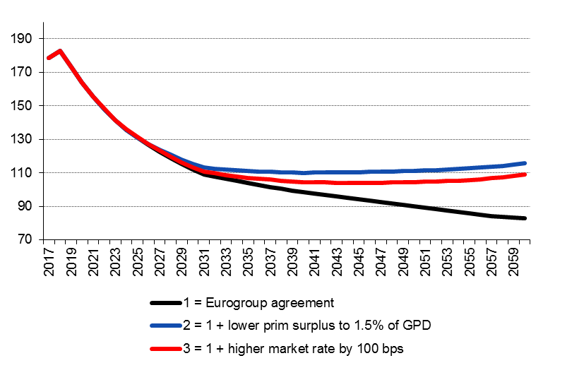
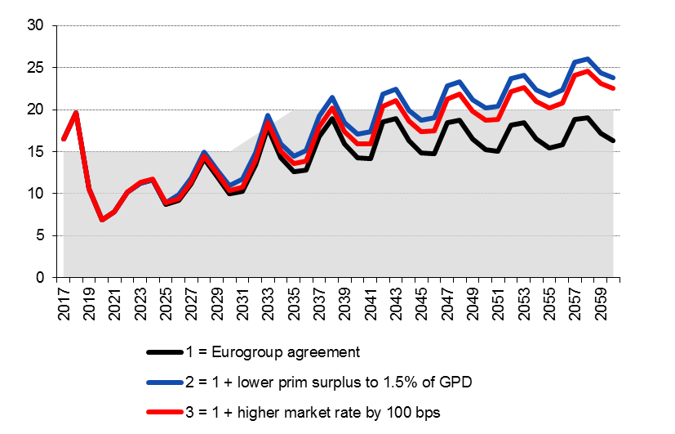
Public debt is sustainable up to early 2030s
Public debt is high but manageable
  Long average maturity (17 yrs), low average interest rate (2%).
  ¾ of Greek debt held by the official sector.
  Low debt servicing costs (Less than 3% of GDP vs 4.5% on average for Euro Area periphery countries).
Public debt to GDP ratio
1: baseline
2: lower primary surplus to 1.5% of GDP gradually from 2022 onwards
3: 100bps higher GGB yields from 2019 onwards
Greek debt is insured against interest rate shocks in the medium term…
  With more than 80% of Greek debt at fixed rates, medium term debt and GFN trajectories are quite independent of interest rate developments.
  Debt dynamics up until the early 2030s depend mainly on nominal GDP growth and the size of primary fiscal surpluses.
  Interest rates become relevant in the longer term (after early 2030s) as maturing debt (including currently fixed-rate ESM loans) must be refinanced at GGB market rates.
…but not against macro and fiscal risks
  Medium-to-long-term risks:
  Lower potential growth due to ageing of population and backtracking of reforms.
  Short-term risks:
  Fiscal burden due to ongoing court rulings on past pension cuts and wage cuts for public servants.
Gross Financing Needs to GDP ratio
Source: BoG calculations.
Notes:
25
LHS: Z:\Note on the Greek economy\Presentation CHART BOOK.xlsx
25

Slide 26
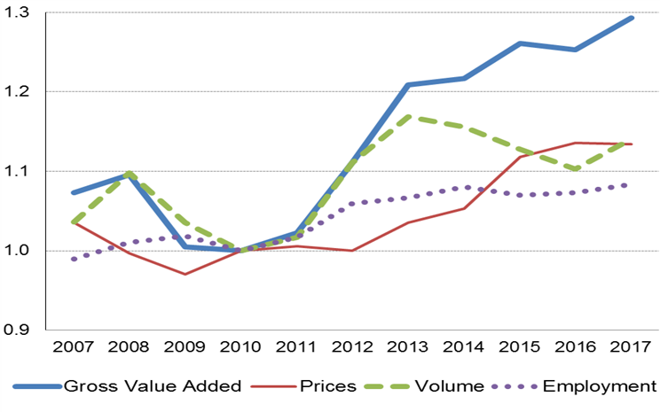
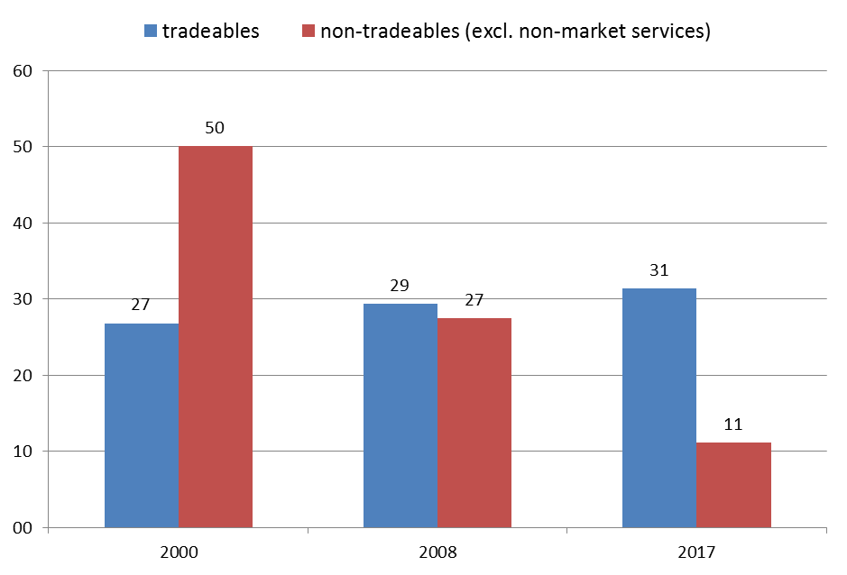
Rebalancing of the economy towards a new growth model has already started. Conditions are positive for process to accelerate
Tradeable sector gained a higher share in the economy
Net profit margins of tradeables are currently 3x higher compared to non-tradeables, supporting rebalancing of economy
Relative size of tradeable vs non-tradeable sector
(Index, 2010=1)
Sources: Eurostat and BoG calculations.
Note: Net profit margins are calculated as Net Operating Surplus/GVA, adjusted for labour income of self-employed.
Sources: Eurostat and BoG calculations.
Notes:
26
LHS: Z:\Note on the Greek economy\Presentation CHART BOOK.xlsx
26

Slide 27
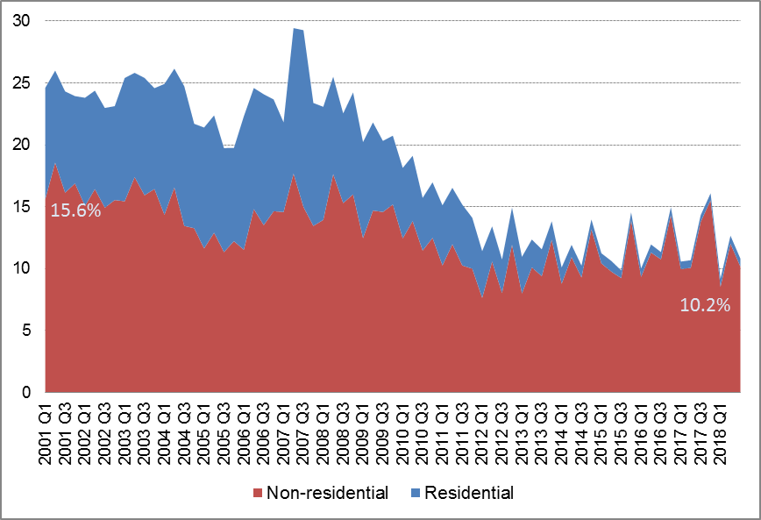
But further rebalancing of the economy requires investment …
and financing
Private investment has declined dramatically during the crisis
Non-residential investment has been relatively more resilient
Domestic savings are not sufficient to finance investment. In part because higher fiscal surpluses subtract resources from the private sector.
Need to:
lower taxes and SS contributions to allow increase of private saving and financing of private investment
  BoG estimates: Lowering PIT rate and SS contributions by 1pp each would increase real GDP by 3.5% in the long run. Lowering corporate tax rate has similar effects.
Increase public investment
  Increase of PI to 8bn from 6.2bn currently would increase real GDP by 1%.
attract FDI
Accelerate NPE reduction to revitalize bank credit
Total gross investment (private and public), % of GDP
10%
8%
16%
11%
13%
Source: ELSTAT
Notes:
27
\\KKFILE01\DOM-Common\Note on the Greek economy\Presentation CHART BOOK.xlsx
27

Slide 28
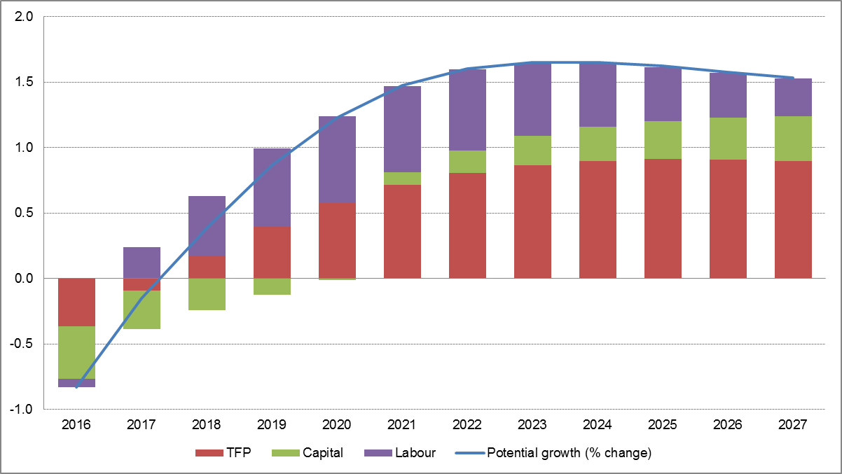
Potential growth to gradually converge to 1.5%.
Drivers differ across time
Large pool of unemployed provides initial space for economy to grow.
Capital stock to continue to decline due to negative net investment until 2020.
TFP growth to gradually increase as capital stock increases and structural reforms start to pay dividends.
Potential growth projections
(%; bars pp contributions)
Structural reforms improve growth potential.
OECD estimates that implemented and planned reforms are expected to boost real GDP by 13% over a 10-year horizon. BoG has similar estimates.
Source: Bank of Greece
Notes:
28
Z:\Note on the Greek economy\Presentation CHART BOOK.xlsx
28

Slide 29
Fiscal policy mix must change: lower taxation
  Greece has one of the biggest informal sectors in the EU (as % of GDP)
  Fiscal consolidation since 2010 was based mainly on tax increases.
  This has led to a significant increase of the informal sector, as economic activity immigrated to the shadow economy (tax evasion).
  Government was forced to further increase taxes on official sector.
  Result: Vicious circle of increasing tax evasion and deepening recession.
  Simulation results of a DSGE model with an informal sector:
  Increase in shadow economy explains the size of the fiscal effort and the depth of the Greek recession.
  Had Greek governments put informal economy under control, fiscal adjustment would have been achieved with much lower taxation and less recession.
  Fiscal mix must change in favor of lower taxes to provide incentives to work and invest. This is a great challenge.
Notes:
29

Slide 30
Summary
Economic recovery to continue in 2019
  Momentum is positive due to catching up effect from a long-lasting depression.
But risks are elevated
  Global slowdown and increased market volatility.
  Increased political uncertainty, risk of fiscal derailment and backtracking of reforms.
Long-term outlook is positive
  Improved competitiveness.
  Structural reforms.
  Economic rebalancing.
But vulnerabilities remain (high public debt, NPLs, unemployment)
Economic policy must now focus on growth
  Change fiscal policy mix in order to boost economic growth.
  Speed up privatizations to encourage investment and attract FDI.
  Implement growth enhancing reforms.
Banks must tackle NPLs and start lending again
  Otherwise, economy will be permanently trapped in a low-growth equilibrium.
Notes:
30
30

Slide 31
Thank you for your attention
Notes:
31

