Slide 1
EBRD’s Environmental and Social Requirements for Financial Institutions
Anne Maria Cronin
Associate Director
OFFICIAL USE

Slide 2
EBRD commitment to Sustainability
EBRD seeks to ensure that it finances activities that:
  are socially and environmentally sustainable
    respect the rights of workers and
    communities
  comply with applicable regulatory
    requirements
EBRD seeks to minimise E&S risk to both EBRD and its financial partners

Slide 3
EBRD Performance Requirements
EBRD’s E&S Policy 2014 has defined 10 Performance Requirements
PR1 | Assessment and Management of Environmental and Social Impacts and Issues (Management Systems)
PR2 | Labour & Working Conditions
PR3 | Resource Efficiency and Pollution Prevention and Control
PR4 | Health and Safety
PR5 | Land Acquisition, Involuntary Resettlement & Economic Displacement
PR6 | Biodiversity Conservation & Sustainable Management of Living Natural Resources
PR7 | Indigenous Peoples
PR8 | Cultural Heritage
PR9 | Financial Intermediaries
PR10 | Information disclosure & stakeholder engagement
OFFICIAL USE

Slide 4
Project Categorisation
Category A Projects
Category B Projects
Category C Projects
Potentially significant adverse future environmental and/or social impacts which, at the time of categorization, cannot readily be identified or assessed | → | Require a formalised and participatory environmental and social impact assessment process
Potential site-specific adverse future environmental and/or social impacts, and/or readily identified and addressed through mitigation measures | → | Environmental and social appraisal requirements may vary depending on the size and context of the project and will be determined by the EBRD on a case-by-case basis.
Likely to have minimal or no potential adverse future environmental and/or social impacts | → | Can readily be addressed through limited environmental and social appraisal
Notes:
Categorisation: done by EBRD ESD at Concept Review stage. In case insufficient information is available at the time of categorisation Initial Environmental and Social Examinations (IESEs) may be performed to determine the appropriate category and scope of appraisal.
At Due Diligence stage, Bank’s consultant may be required to confirm categorisation.

Slide 5
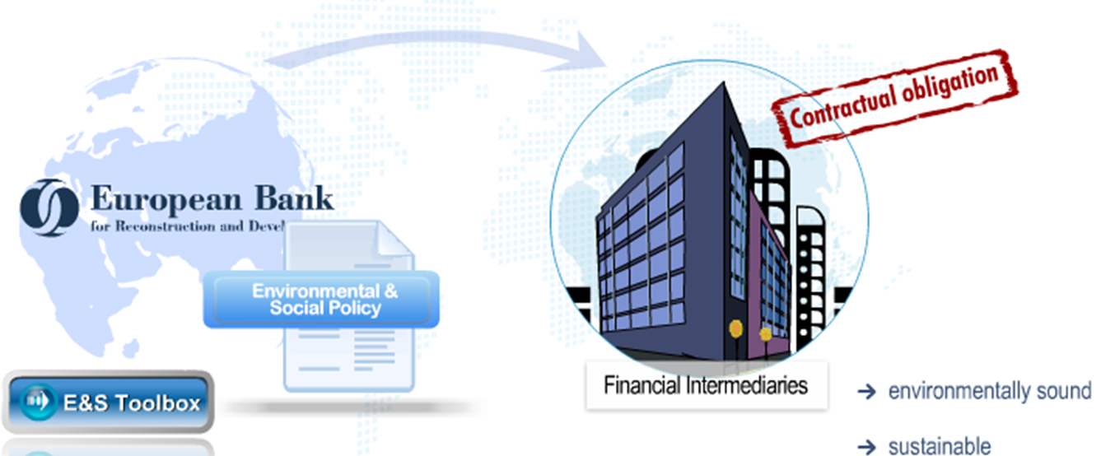
EBRD Relationship with FIs
→ Socially and environmentally sound
→ Sustainable
OFFICIAL USE
Notes:
EBRD relies on FIs to fulfill its contractual obligations in order to meet its mandate and E&S goals
FI are key instrument for promoting sustainable financial markets through the finance of sustainable projects

Slide 6
PR 2: Labour & working conditions
Aim of PR2:
  Promote good HR management; and
  Comply with ILO core labour standards and national labour laws
Main issues for FIs:
  Non-discrimination and equal opportunity
  Grievance mechanism
  Labour policies of contractors (e.g. cleaners, caterers)
  Redundancies /retrenchment
  FIs have relatively low labour risks compared to some sectors
Notes:
The principles and standards embodied in the ILO conventions 2 relate to:
abolition of child labour
elimination of forced labour
elimination of discrimination related to employment
freedom of association and collective bargaining.

Slide 7

PR 4: Health & Safety
Aim of PR4 for FIs:
  Promote safety and health of workers
Main issues for FIs:
  Safe and healthy workplace
  Safe and healthy workforce
  FIs have relatively low labour risks compared to some sectors
Notes:
PR4 – only the Occupational health and safety aspect applies to FIs.

Slide 8
PR 9: Financial Intermediaries
Five main requirements:
1. FI Organisational capacity
    FIs will have human resources policies and management systems in line with PR2 and PR4 at the FI level
    FIs will designate senior management responsibility for E&S
2. FI Practices on E&S Risk Management
    FIs will have a clearly defined Environmental & Social Management System (ESMS) which includes appropriate policies and procedures
    ESMS procedures must cover:
      screening against the EBRD E&S Exclusion List,
      categorisation of E&S risk (Low/Medium/High)
      checking that subprojects meet national regulatory standards and monitoring continued compliance
      checking that Category A subprojects meet PRs1-8 and 10
      keeping E&S records on subprojects
Notes:
PR9:
FI ORGANISATIONAL CAPACITY
FIs will maintain human resources policies, management systems and practices in accordance with EBRD PR 2 – Labour and Working Conditions and the relevant occupational health & safety requirements of PR4 – Health and Safety.
Fis will designate a senior management representative to be responsible for environmental, social, and health and safety matters, including the implementation of PR2, 4 and 9.
FI PRACTICES ON ESRM
The ESMS must be commensurate with the nature of the FI, the level of E&S risks associated with its business activities and the types of sub-projects.
If an ESMS is already in place, the FI must provided documented evidence of such an ESMS.
The ESMS must contain procedures (relevant to type of EBRD facility in question – corporate/SME loan , equity etc) around risk assessment and monitoring including
screening against the EBRD E&S Exclusion List, and excluding any that are on the list
categorisation of E&S risk (Low/Medium/High) using EBRD’s E&S Risk Categorisation List or the E&S Toolkit
checking that subprojects meet national regulatory standards and monitoring continued compliance, and where necessary, requiring clients to implement corrective action plans
checking that Category A subprojects meet PRs1-8 and 10
keeping E&S records on subprojects

Slide 9
PR 9: Financial Intermediaries
3. Stakeholder engagement
    FIs will put in place a system for stakeholder engagement and respond to queries in a timely manner
    FIs are encouraged to publish their corporate E&S Policy or a summary of their ESMS on their website
    Where possible, link any E&S Impact Assessment reports to Category A subprojects
4. Reporting to the EBRD
    FIs will submit annual E&S reports using the Sustainability Index to EBRD on:
      the implementation of its ESMS, PR2, 4 and 9
      E&S performance of its portfolio of subprojects
Notes:
STAKEHOLDER ENGAGEMENT
Fis will put in place a system for dealing with external communication on E&S matters, e.g. by establishing a point of contact for dealing with public enquiries.

Slide 10
PR 9: Financial Intermediaries
  5. Voluntary initiatives
    FIs encouraged to follow good international practice on E&S management by
      Extending E&S procedures to all business activities
      Develop financial products with high E&S benefits
      Join existing international initiatives that promoted best practice
Notes:
VOLUNTARY INITIATVES
FIs are encouraged to:
Roll out the ESMS and E&S risk procedures to all their business activities even when not strictly required by this PR9
Identify opportunities for developing financial products with high E&S benefits, e.g. financing energy efficiency projects, renewables, or products targeting women entrepreneurs
Join existing international initiatives that promote best practice, e.g. the Equator Principles, UNEP Finance Initiative and the Principles for Responsible Investment

Slide 11
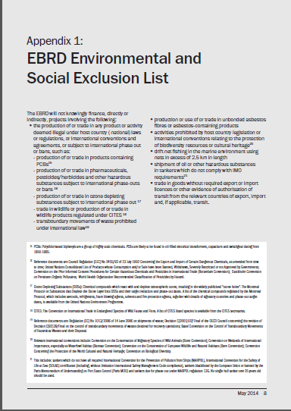
E&S Exclusion List – excluded from EBRD financing
  Activities or products that deemed illegal under host country laws
  Production or use of or trade in unbonded asbestos fibres or asbestos-containing products
  Prohibited impacts on biodiversity resources or cultural heritage
  Drift net fishing
  Shipments that do not comply with IMO requirements
  Goods are traded without licence
11
Notes:
11

Slide 12
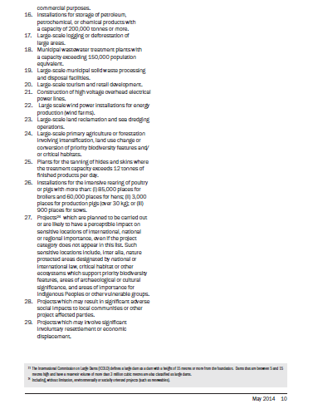
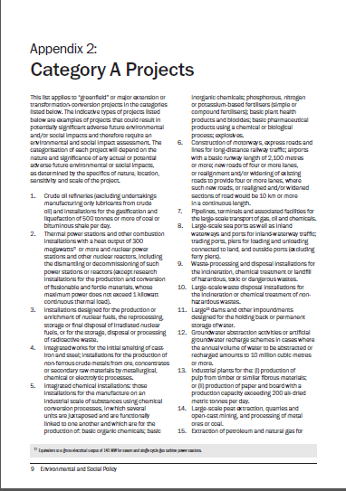
Category A projects
  Projects with potential significant adverse E&S impacts.
  Typically greenfield or major expansion/conversion projects.
  An E&S Impact Assessment (ESIA) is required, as well as the application of Performance Requirements 1-8 and 10, where applicable to the project.
  Examples: crude oil refineries, large scale municipal solid waste processing, large-scale logging or deforestation, construction of motorways, long distance railway lines.

Slide 13
PRs 1-8 and 10 for Cat A sub projects
  PR1 – requires an E&S impact assessment of the project’s potential impacts. Depending on the results of this assessment, the following PRs will apply:
  PR2 – on labour and working conditions
  PR3 – on resource efficiency and pollution prevention and control.
  PR4 – on health and safety
  PR5 – on land acquisition, involuntary resettlement and economic displacement
  PR6 – on biodiversity conservation and sustainable management of living natural resources
  PR7 – on indigenous peoples
  PR8 – on cultural heritage
  PR10 – on information disclosure and stakeholder engagement
  Encourage publication of ESIA
Notes:
Instructions to trainer
Explain the PRs at a high level and refer details in E&S Policy if required. Give some examples of projects where different PRs may apply:
e.g. All Cat A sub projects would require PR2 and PR4 since all would have employees. PR3 would be relevant for a chemicals factory or a power plant. PR5 would be relevant for a motorway project which require land acquisition and the relocation of local communities away from the planned motorway). PR6 would be relevant for oil & gas drilling which would impact on biodiversity (Virunga National Park in Congo). PR7 only when indigenous peoples are impacted (e.g. Yanacocha gold mine, e.g. aluminium mine in Niyamgiri Hills, mining in Sami territory in Scandinavia). PR8 example – building a pipeline through areas of cultural heritage (e.g. pipeline through Bulgaria). PR10 will apply to all sub-projects that are “likely to have adverse E&S impacts” so, likely to be all projects.

Slide 14
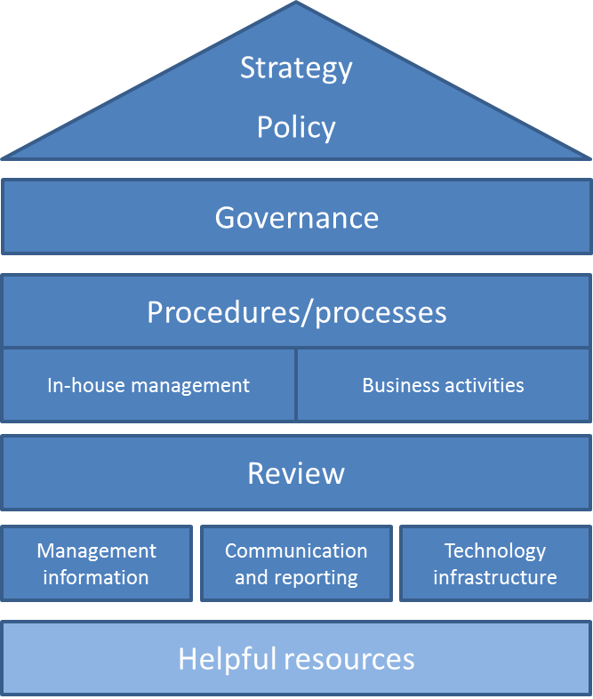
Elements of an ESMS
Strategy:
Overall approach to sustainability for the organisation considering current status and future goals
Clearly articulated strategic priorities, goals and milestones
Policy:
Commitments on how E&S will be managed in-house and in business activities
Provides the framework for a consistent approach to E&S management
Governance:
Board member with accountability for E&S Performance
Identification of team with E&S responsibility and training needs
Procedures / Processes:
Risk Assessment E&S impacts, risks to the FI and stakeholder concerns
In house and transactions
Review:
Internal review to understand effectiveness
Report to lenders and investors
Report to external stakeholders
Supporting infrastructure and data:
Management information – performance data at transaction and team level
Communication and reporting
Technology infrastructure for data capture
Notes:
Strategy: An ESMS must be founded on an overarching strategy that outlines the FI’s overall approach to sustainability in its business. The strategy should be supported by clearly articulated strategic priorities, goals and milestones. This needs to be developed with / agreed / signed-off by senior management.
Policy : FIs should develop and adopt a policy on E&S management that reflects the FI’s commitment to managing these factors. The policy (or policies) should outline the FI’s approach to E&S factors in its own operations as well as in its business activities. This needs to be developed with / agreed / signed-off by senior management.
Governance : in this context refers to direction and oversight for management of E&S factors within the FI.
FIs should implement key components of good governance practice, such as establishing a clear organisation structure and accountability, defining roles and responsibilities, setting organisation wide objectives and monitor progress, and ensuring adequate resource management.
In-house management: FIs are encouraged to work towards applying best practices in in-house environmental and human resource management.
Procedures with E&S requirements: work towards applying best practices in in-house environmental and human resource management.
Build on capacity to implement the EMS – provide adequate training on E&S management to help staff understand their role in managing E&S issues in the workplace and in relation to the FI’s business activities (e.g. transaction due diligence).
FIs should adopt and implement systematic E&S risk management procedures for business activities, commensurate with the level of E&S risk associated with them.
Review: FIs should regularly review the performance of the ESMS (e.g. on an annual basis). The review should, among other aspects, focus on:
Performance against targets, monitored through Key Performance Requirements (KPIs);
Gaps in implementation of the ESMS;
Level of E&S risk exposure in direct operations and in business activities;
Key actions to improve E&S performance in direct operations and in business activities
Management information FIs should regularly review management information that summarises key data points on E&S performance, such as the KPIs defined to track progress against objectives
Communication and reporting on environmental and social matters . EBRD encourages its FIs to disclose information on E&S management to stakeholders. FIs should put in place a system for dealing with external communication on environmental and social matters, for example a point of contact for dealing with public enquiries and concerns.
Technology infrastructure: Technology infrastructure, such as information systems to capture energy data or document E&S due diligence results, is important for implementing the ESMS and also for meeting stakeholder expectations for information.
What is an E&S Policy
• Articulates commitment to managing E&S risks, direct and indirect impact as well as integrating E&S considerations throughout FI activities for both external and internal audiences
• Unique - there is no one size fits all. A policy must be fit for purpose within each Financial Institution, its ways of working, and the E&S impacts and risks to its business
Why is an E&S Policy needed
• A crucial part of developing an Environmental and Social Management System
• Aligns public commitment with strategic E&S goals and objectives which may be set or revised alongside policy development, review and updates
• Business Imperative for FIs to minimise financial, legal and reputational risks
• Industry best practice: recognising the significance posed to business activities by E&S impacts and risk has become standard throughout financial industry. Not unique requirement of EBRD or other International Financial Institutions

Slide 15
EBRD E&S Procedures
  Aim
  Control and minimise EBRD and FI exposure to E&S risk
  Identify and develop E&S opportunities
  Integration of E&S procedures into transaction appraisal is a condition of EBRD finance
Notes:
15
Explain that the aims of the procedures are help minimise and control E&S risks to Fis and EBRD.
The E&S procedures allow FIs to take a balanced approach to assessing and managing E&S risks associated with EBRD credit lines and or when EBRD has an Equity stake (only point out where EBRD has such a stake in the Bank).

Slide 16
Integration into transactions
Example transaction process and E&S management
Origination / Application
Initial Review
Due Diligence, Appraisal, Recommendations
Review and Approval
Regular Monitoring
Exit / Completion
Transaction Process
Screen for exclusions
Categorise level of risk to inform due diligence approach
E&S due diligence scaled to level of risk
Use external experts if necessary
Evaluate risk
Include management measures in contracts
Agree post-DD action plan if necessary
Agree monitoring indicators and reporting schedule
Review and evaluate performance
Act if commitments not fulfilled
Example E&S Procedure
ILLUSTRATIVE
Notes:
An illustration of one procedure which is an element of the E&S Management System focused on a single transaction ie an external investment – not the whole management system.
So consider a generic credit / investment process – need to identify when to introduce E&S risk management actions

Slide 17
EBRD E&S risk management procedures for corporate lending
E&S risk assessment activity | E&S risk level of loan
 | Low | Medium | High
Regulatory compliance check | Confirm compliance from the client through warranties and covenants | Confirm compliance from the client through warranties If concerned check compliance, e.g. review permits/licenses, speak to regulator, etc. | *Confirm compliance from the client through warrantee AND check compliance e.g. review permits/licenses, speak to regulator, etc.
Evaluate company management of E&S risk |  | Engage company to assess commitment, capacity and track record in managing E&S risk | Engage company to assess commitment, capacity and track record in managing E&S risk
Conduct an operational site visit |  |  | Conduct an operational site visit to check areas of concern
Notes:
Depending on whether your transaction is H/M/L risk, you will need to perform further risk assessment activities in accordance with the above table.
Instruction to trainer
Ask participants the appraisal approach for the case study.
L – regulatory compliance can be confirmed through loan covenants and warranties, e.g. on EHS regulations, planning permission, operating licences and permits.
M – requires further compliance review if there is concern, e.g. by reviewing the permits or speaking to the regulator. Additionally, you will have to engage with the company to assess its commitment, capacity and track record in managing E&S risk.
H – compliance must be confirmed through covenants/warranties and review of permits/licences etc. You will have to engage with the company, as for M risk transactions. In addition, you will have to conduct an operational site visit to check areas of concern. This is typically done by engaging an E&S consultant with the specialist technical skills required.
The good news is that the E&S Toolkit will guide you through all of these steps if required.

Slide 18
E&S Regulation: FI Requirements
  FIs must require customer compliance with E&S laws and regulations in areas such as:
  Environment (e.g. waste, water, land, air, biodiversity)
  Labour rights and working conditions
  Occupational health and safety
  Public health and safety
  Public disclosure and consultation
  Community disturbance (e.g. transport, noise)
  Resettlement and displacement
Notes:
PR9 states that FIs will require all clients to comply with national regulations and standards related to (i) the environment, (ii) public consultation, and (iii) employment, including without limitation, occupational health and safety, child labour, forced labour; non-discrimination related to employment, and freedom of association and collective bargaining.

Slide 19
Environmental and social risk monitoring
Include E&S issues in the regular, documented monitoring of active transactions
Take proper account of E&S risk in entering, amending, and exiting any transaction
Monitor E&S risk associated with a loan or other transaction on a regular basis throughout its lifetime
Ensure that E&S risk is managed upon the re-negotiation or foreclosure of a loan, especially if the bank (or agents of the bank) takes possession of physical collateral (land, building, equipment)
Risk may change due to change in legislation, client activities and legal action.
Supporting
tools
Regular contact with EBRD through periodic reporting
OFFICIAL USE
Notes:
19
Explain that Step 4 is essential to ensure that the Bank understands how the customer is performing in terms of the environmental and social elements of the loan agreement during the loan period.

Slide 20
EBRD resources to help FIs
Financial Intermediary
Face to face training
E&S Reporting Toolkit
E-module learning
EBRD Support
Sustainability Index
Face-to-Face Training
Practical training on E&S risks and EBRD’s procedures
E&S Reporting Toolkit
Excel format and tools to support FI assessment of E&S risk
E-learning
14 modules on E&S lending and investment procedures
EBRD Environment & Sustainability Department
+44 (0) 20 7338 6000
Sustainability Index
Annual Reporting for EBRD
Notes:
These are the different forms of EBRD support for FIs.
The training day forms just one part of this support.
Tell participants a bit about the e-manual and e-learning but these can be shown online at the end of the day.
EBRD’s Environment and Sustainability Department is based in London and staff there are ready to respond to any questions you might have about environmental and social risk management and the application of the Bank’s Environmental and Social Procedures to your activities.

Slide 21
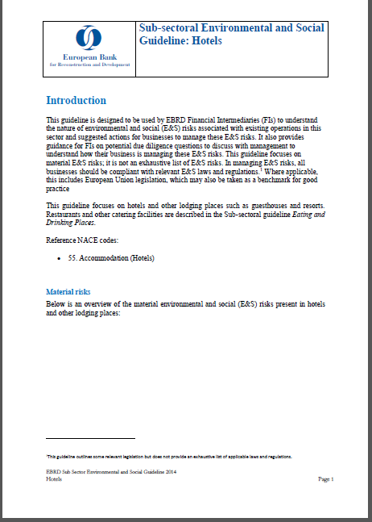
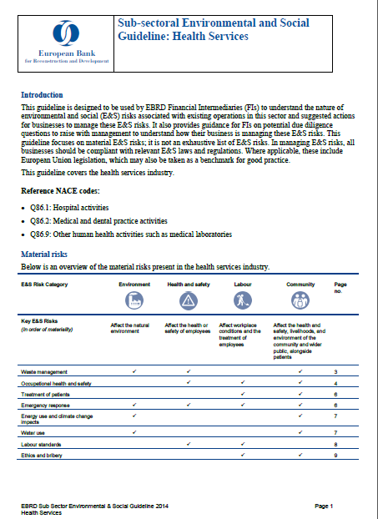
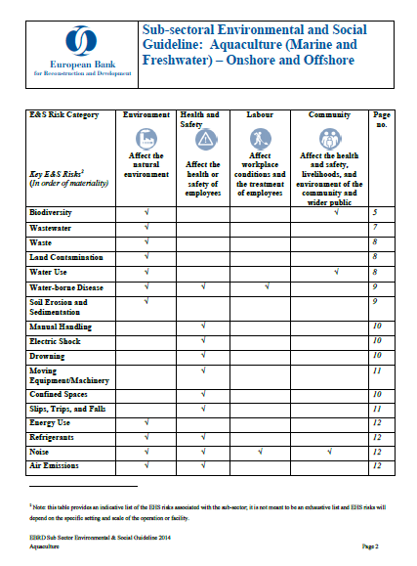
Industry Sub-sectoral Guidelines
OFFICIAL USE

Slide 22
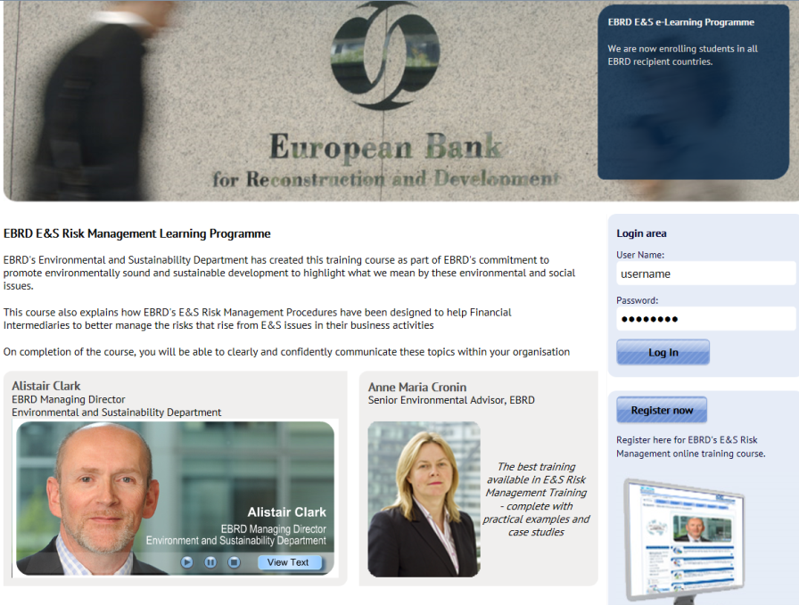
E&S E-modules
E-learning modules provide:
  step by step guidance for appraisal of environment and social risks
  how and why financial intermediaries should carry out environmental and social investigations
  supporting reference materials to assess the environmental and social aspects of a transaction
What you do:
  register to access the materials
  select training relevant to the products you work with (eg loans, equity investment)
  work through case study material and examples
  assess what you have learned to help you demonstrate value
  http://ebrd.coastlinesolutions.com/GUI_loginEBRD_ES.asp
Notes:
Modules (including case studies and assessment):
Overview for Senior Management
Corporate Lending
SME Lending
Micro Finance
Leasing
Insurance
Equity Investments
Mortgage Lending
Case Studies (including for Category A projects)

Slide 23
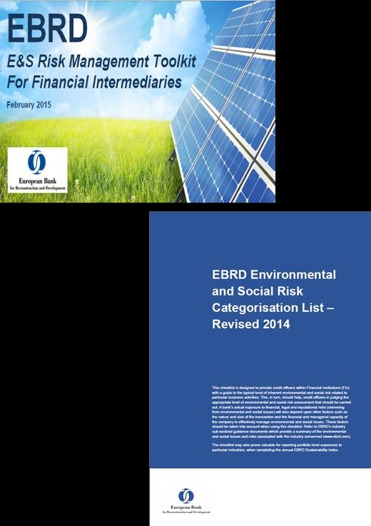
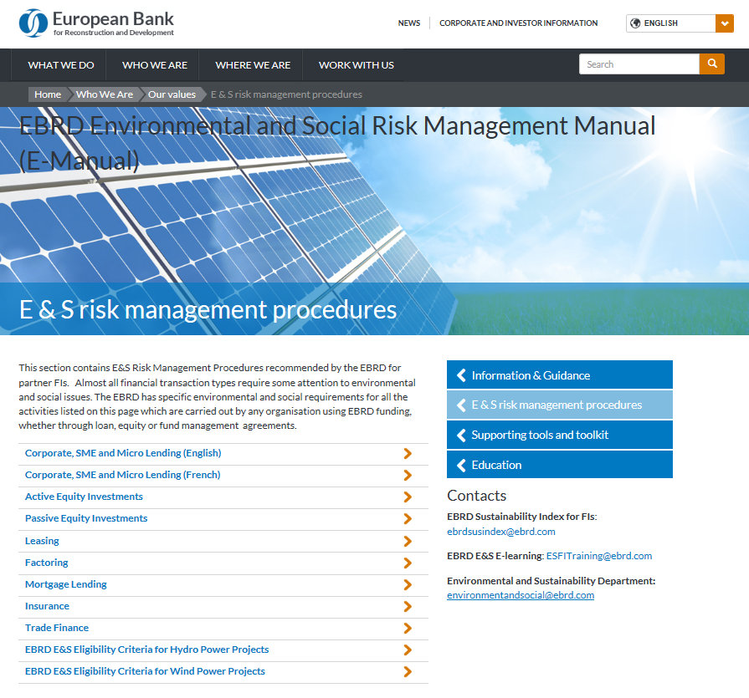
EBRD E&S Risk Management
Can be found at: http://www.ebrd.com/who-we-are/our-values/environmental-emanual-risk.html
23
OFFICIAL USE

Slide 24
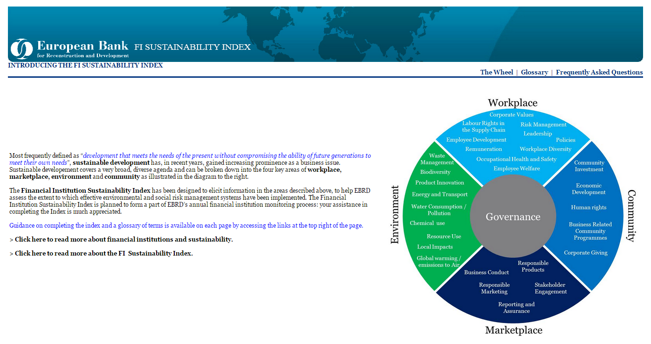
Annual E&S reporting to EBRD
The Sustainability Index
OFFICIAL USE
Notes:
24

Slide 25
Section 1
This summary report provides a statistical summary in which you and EBRD can understand how your Financial Institution is responding to the risks and opportunities associated with responding to Environmental and Social (E&S) risks.
FI Name: FI ABC |  | Date Completed:
FI: Address: |  | Reporting Period:
No. of branches: |  | No of employees:
International Operations: |  | Date of signing loan agreement:
Currency used: |  | Operate Internationally:
Summary – Environmental and Social Risk Management Scores
The maximum and good practice scores are based on good international practice and EBRD’s knowledge and experience within the Financial Institution community.

Slide 26


Additional Information
Project summary documents
http://www.ebrd.com/work-with-us/project-finance/project-summary-documents.html
EBRD Sustainability Report :
http://www.ebrd.com/news/publications/sustainability-report/sustainability-report-2015.htmlver
EBRD Governance Policies
Environment and Social Policy
Public Information Policy
Project Complaint Mechanism
http://www.ebrd.com/what-we-do/strategies-and-policies/approval-of-new-gonance-policies.html
OFFICIAL USE

Slide 27

Contacts
For further enquiries, please contact:
Name: Anne Maria Cronin
Title: Associate Director
Department: Environment and Sustainability Department
Tel: + 44 20 7338 6605
Email: Cronina@ebrd.com
EBRD, One Exchange Square
London, EC2A 2JN
United Kingdom
www.ebrd.com

Slide 28
Thank you!
OFFICIAL USE

