Slide 1
Overview of Sustainable Banking : The Perspective of an International Development Financial Institution Anne Maria Cronin Associate Director

Slide 2
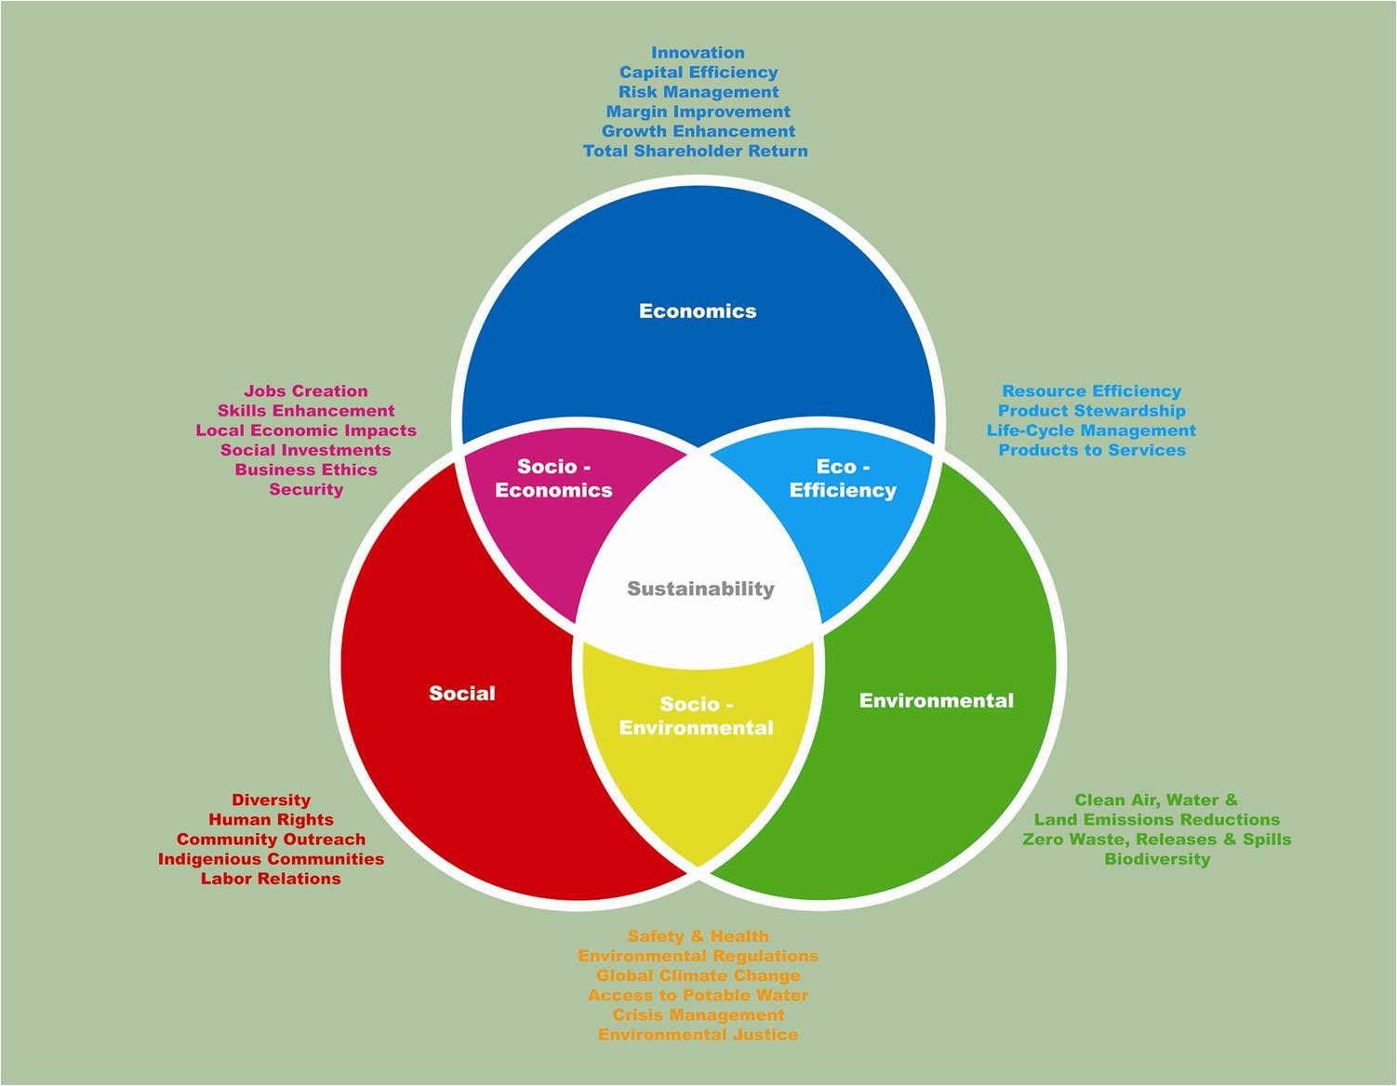
Sustainability and Finance
Financial Institutions as providers of finance have a pivotal role to play in sustainability by:
promoting sustainability across sectors, industries, communities.
improve FIs own products and services
Managing social and environmental risks in the loan or investment appraisal process.
Identifying opportunities for innovative products (renewable energy, energy efficiency, cleaner production, biodiversity, access to finance for women, low-income housing).

Slide 3
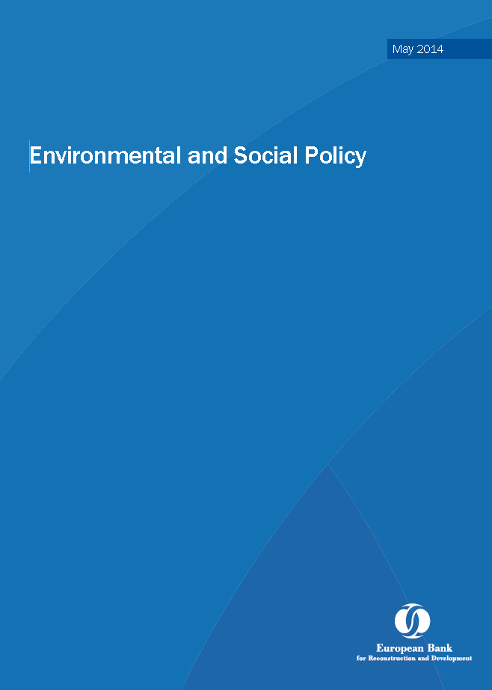
EBRD’s Environmental and Social Policy
EBRD is the first MFI to have Environmental requirements in the founding documents of the Bank
Finance development which is environmentally sound, socially responsible, and sustainable in the long term
Minimise environmentally and socially derived risks to both EBRD and its clients/partners:
Financial - Legal -Reputational
Notes:
EBRD objectives:
Environmental and social risk is managed such that EBRD’s partners and the EBRD are protected from financial, legal and reputational damage as a result of irresponsible and unsustainable client practices
EBRD has updated its Environmental and Social Policy and Performance Requirements. EBRD expects its FI intermediaries to be compliant with these policies in the course of their own business operations.
EBRD is committed to promoting “environmentally sound and sustainable development” in the full range of its investment and operation activities and believes that sustainable development is a fundamental aspect of sound business management.
EBRD ensures that the projects it finances directly are socially and environmentally sustainable, respect the rights of workers and communities and are carried out in compliance with applicable regulatory requirements.
To achieve this, in 2008 EBRD released its updated Environmental and Social Policy outlining E&S risk management procedures for a broad range of financial transactions.
In the interest to contribute to regional economic development, EBRD provides lending to enterprises for which financial, environmental and social due diligence has been carried out, safeguards have been put in place, and an investment can be considered sustainable over the long run.
When EBRD participates in financing through Financial Intermediaries (FIs) it must rely on its financial partners to ensure that the activities funded are environmentally sound and sustainable.
Achieving minimum standards of E&S risk management is a contractual obligation of banks that are supported by EBRD funding or investment.

Slide 4
Environmental & Social Policy (cont-d)
Policy addresses environmental, labour and community aspects
Current Policy and related Performance Requirements were approved by the EBRD Board of Directors on 7 May 2014
Main 2014 Policy updates address climate change, resource efficiency, human rights and gender aspects
For all projects considered for financing, expectations are:
to identify and mitigate Environmental and Social risks
to meet all applicable Environmental and Social Performance Requirements (requirements to developer/project)
“to promote in the full range of its activities, environmentally sound and sustainable development”

Slide 5
Environmental & Social Policy (cont-d)
Recognises the responsibility of clients and their business activities to respect Human Rights
Believes that Gender Equality is a fundamental aspect of a modern, well-functioning market economy and democratic society.
Recognises the importance of addressing both the causes and the consequences of Climate Change in its countries of operations.
Commits to the principles of Transparency, Accountability, and Stakeholder Engagement.
Categorises each project to determine the nature and level of environmental and social investigations, information disclosure and stakeholder engagement required.

Slide 6
ENVIRONMENTAL & SOCIAL POLICY
Main policy: the EBRD’s commitment
Principles
‘Upside’ projects
& partnerships
Integrating E&S in mainstream projects
Annexes: Performance Requirements for EBRD clients/projects
E&S Assessment
& Management
Labour &
Working Conditions
Resource Efficiency &
Pollution Prevention
Health & Safety
Resettlement
Biodiversity
Indigenous
Peoples
Cultural Heritage
Stakeholder
Engagement
FIs
PR 1
PR 2
PR 3
PR 4
PR 5
PR 6
PR 7
PR 8
PR 9
PR 10
GUIDANCE FOR CLIENTS
EBRD INTERNAL Environmental & Social Procedures
PUBLIC INFORMATION POLICY
(60/120 day disclosure requirement for EIAs/SIAs)
Notes:
Use this slide as a simple visual to show that the E&S Policy is the umbrella policy and that the Performance Requirements support the E&S Policy
This slide will appear again later

Slide 7
Key sustainable development challenges pursued by the EBRD
Support market transition and provide access to capital.
More efficient use of energy and other resources.
Replacing obsolete with modern technologies and processes.
Introducing best industrial and resource extraction practices.
Improving public participation in decision making.
Supporting development of economic instruments for reform.
Notes:
Mainstreaming Sustainability
Investing Responsibly
Innovative initiatives
Improving investment climate
Political dialogue
Promoting dialogue
Working in partnerships
Today, the EBRD's commitment to environmental and sustainable development means much more than simply being a responsible and accountable lender. Sustainability issues are integral to the way that we help to support competitive businesses, foster entrepreneurship and job creation, and achieve far-sighted sector reform. This is a dynamic landscape where the Bank must continue to learn, adapt and lead in response to the lessons of experience, changing client requirements, and new strategic priorities

Slide 8
COP21 – Intended Nationally Determined Contributions (INDCs)
Set out national GHG emission targets; more than 150 countries, comprising more than 80 percent of global GHG emissions, have now submitted their INDCs to the United Nations
Examples of potential impacts that could lead to portfolio risk and opportunity:
Cost of carbon emissions will become material through the 2020s
Renewables will become a growing source of power, backed by quotas and targets
Forestry and land use will be in the spotlight to halt deforestation that has become a major source of GHG emissions

Slide 9
Climate Change Challenges
Economies in the region are among most energy intensive in world
Target: Low carbon growth & energy efficiency (Sustainable Energy Initiative)
Key: less demand & more efficient
COP 21, Paris 2015
21st yearly session of the Conference of the Parties (COP)
Global agreement on the reduction of the global warming, consensus of the representatives of the 196 parties attending it
Set a goal of limiting global warming to less than 2 degrees Celsius (°C) compared to pre-industrial levels
EBRD climate strategy aligned with COP21 goals: 40% of Bank’s investments directed to climate finance.
Notes:
2 mins
EBRD’s Sustainable Energy Initiative (SEI) addresses climate change by developing specific projects with carbon reduction impacts in all sectors of the economy in the EBRD’s countries of operations. EBRD invests in projects, provides technical assistance and undertake policy dialogue to support governments develop strong institutional and regulatory frameworks that incentivise sustainable energy investments.
Climate change in EBRD region
Emerging markets remain one of the most energy intensive and energy wasteful in the world
The EBRD region has various are issues around distorted pricing and lack of standards (e.g. energy efficiency)
Energy intensive industries will continue and EBRD is financing them – the key is making them less energy demanding and more efficient
Target is to promote low carbon growth and energy efficiency (Sustainable Energy Initiative)
EBRD Environmental & Social Policy, Para 13: Recognises issue and commitment to engage in innovative investments and technical assistance to support no/low-C investment and Climate-Change Mitigation and Adaptation opportunities and identify opportunities to reduce emissions in ERBRD supported projects.
Ties to resource inefficacies and PR3, Para’s 14 and 15 focus on GHG and requirements

Slide 10
EBRD Requirements: Climate Change Adaptation
Climate Change Adaptation
Anticipation of adverse effects of Climate Change (CC)
Taking appropriate action to prevent or minimise the potential damage or taking advantage of opportunities that may arise
EBRD Requirement
Local Experience
Need to consider climate change adaptation as part of ESDD. Issues include:
How does adaptation influence project in this country?
Infrastructure project integrity
Water scarcity
Coastal retreat
Extreme events
Working temperatures
Overall efficiency
Notes:
10 mins
EBRD requires clients to consider climate change adaptation in project design and for consultants carrying out DD to consider this in assessments.
Note – the answers appear separately on click – so the discussion can be held and then reinforced with types of issues.
Participation in Plenary:
Ask the audience to discuss any projects/infrastructure or environmental issues which they think will be impacted by climate change (water scarcity and extreme events are likely talking points) – some are around structural integrity, others impact on process assumptions, some might be H&S e.g. working temperatures or the ability for systems to cool and affects on efficiency.
If time (another 5 mins) lead this on to a discussion about project lifecycle and assumptions the project might have on a continuous water supply for 20 years…assumptions they might want to test during a ESDD project.

Slide 11
Human Rights in Policy
Responsibility of clients to:
Respect human rights⁷
Avoiding infringement human rights of others
Address adverse human rights impacts that business causes, or contributes to
⁷ - HR definition guided by International Bill of Human Rights, the UN Declaration of Human Rights, and eight core conventions of the ILO
Notes:
± 5 minutes
Notes to presenter: Main point is to highlight what the EBRD Environmental and Social Policy actually says.
Key points:
“Human rights” has a footnote! When EBRD used the term human rights, it has a footnote that is the italic text on the slide – this is how they frame it.
Those eight core conventions are the same as those covered in PR2.
The Environmental and Social Policy is specific about “respecting” human rights. For participants who have not discussed this topic before, this should be a chance to put “respect” into the PRR framework (to be discussed on the next slide).
Group questions (optional):
TBD
Additional information:
Actual EBRD text in full:
EBRD recognises the responsibility of clients and their business activities to respect human rights⁷ and that this is an integral aspect of environmental and social sustainability. This responsibility involves respecting human rights, avoiding infringement on the human rights of others, and addressing adverse human rights impacts that their business activities may cause, or to which they may contribute.
± 3 minutes
Notes to presenter: Main point is to introduce the Ruggie Framework.
Key points:
The three words – Protect, Respect and Remedy are part of the Ruggie Framework.
The origin of this is from the long title: PROMOTION AND PROTECTION OF ALL HUMAN RIGHTS, CIVIL, POLITICAL, ECONOMIC, SOCIAL AND CULTURAL RIGHTS, INCLUDING THE RIGHT TO DEVELOPMENT Protect, Respect and Remedy: a Framework for Business and Human Rights Report of the Special Representative of the Secretary-General on the issue of human rights and transnational corporations and other business enterprises, John Ruggie (April 2008).
Nobody expects EBRD clients to become champions of “protecting” human rights (role of governments), but they very much expect them to respect human rights, which includes doing their part in providing access to remedy.

Slide 12
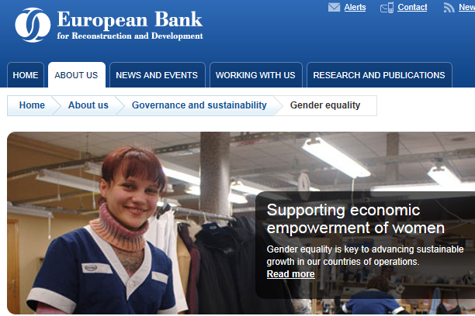
Gender in EBRD E&S Policy
Gender equality essential to well-functioning economy & democratic society
Expects clients to identify gender-specific & disproportionate impacts & mitigate/reduce
May request enhanced positive impact: access to finance, services & employment
Notes:
± 3 minutes
Notes to presenter: Main point is to introduce the text from the policy.
Key points:
(Speaking to the bullets).
The Environmental and Social Policy is clear about what the EBRD “expects” – note this is not a “requirement, which may be an observation to generate discussion.
Group questions (optional):
Is this “expectation” enough to be taken seriously? Why/why not?
Additional information:

Slide 13
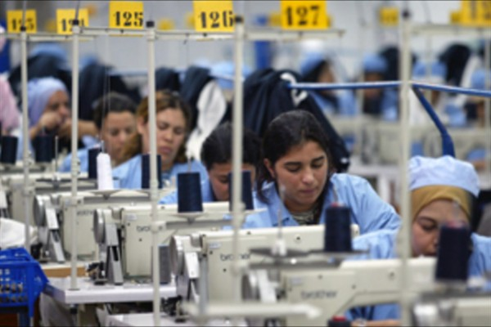
EBRD Gender Strategy
EBRD’s Strategy for the Promotion of Gender Equality 2016 - 2020
Encourages advancement of equal opportunities for women and men in all activities of the Bank
Overall objective: increase women’s economic empowerment and equality of opportunities in the EBRD Countries of operation
Specific objectives during the Strategy period:
Increased access to finance and support for women-led businesses
Increased access to employment opportunities and skills for women
Improved access to services
Notes:
± 3 minutes
Notes to presenter: Main point is to introduce the text from the policy.
Key points:
(Speaking to the bullets) – this is what EBRD wants.
The Environmental and Social Policy is clear about what the EBRD “expects” – note this is not a “requirement, which may be an observation to generate discussion.
Group questions (optional):
Is this “expectation” enough to be taken seriously? Why/why not?
Additional information:

Slide 14
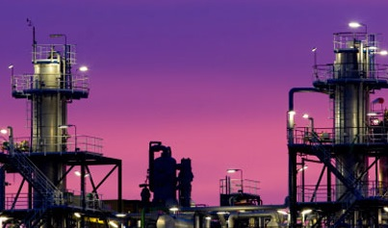
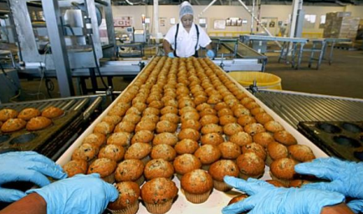
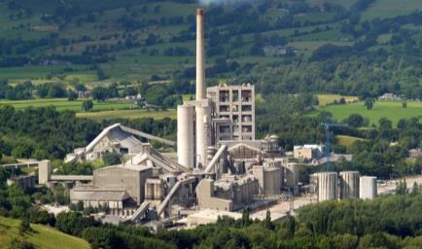
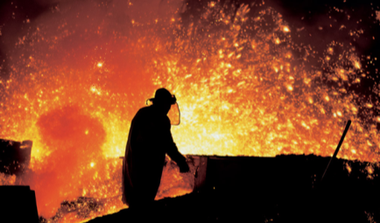
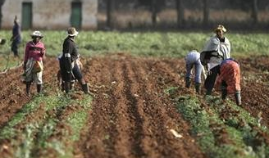
Environmental and Social Risks – Consequences and Opportunities
Chemicals manufacture
Food processing
Cement
Telecoms
Accountancy
Iron & Steel
Cosmetics manufacture
Agriculture
Computer Services
Notes:
Quiz in plenary
Engage in discussion on what E&S issues they think are applicable to these sectors.

Slide 15
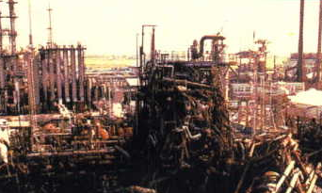
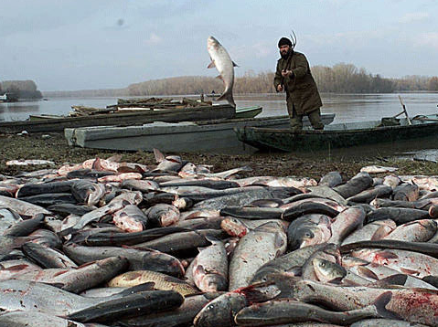
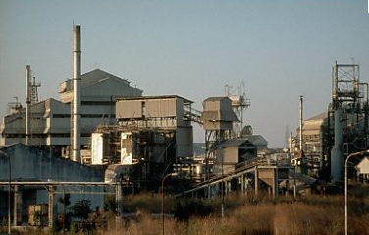
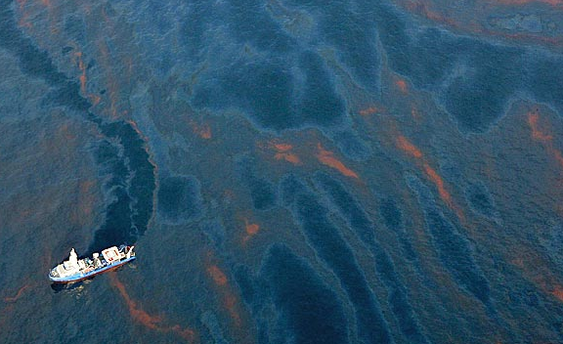
E&S disasters
Disasters – sudden impact on workers, communities or environment
Seveso
Danube cyanide spill
Bhopal, Union Carbide
BP Gulf disaster
Notes:
Disasters – sudden impact on workers, neighbours or the environment.
Example:
Seveso, Bhopal, Danube cyanide spill, Gulf of Mexico, Texas fertiliser explosion
- Gradual pollution resulting in major illness or death or sudden emissions causing death and injury
- Long term exposure of workers or neighbours to air contaminants
- Pollution of land, rivers, food or groundwater
- Many serious E&S impacts will arise as a result of disasters.
Seveso was a serious explosion in a factory in Northern Italy that killed many workers and resulted in a change to European Union laws on health and safety associated with storage of materials
Bhopal was a serious release of gases to atmosphere that resulted in many neighbours to the factory being killed.
Another form of pollution can be gradual and occurs over time to pollute rivers, food and groundwater.
There can be E&S impacts from a product, for example, when electronic products are disposed, there are end of life impacts. These can be environmental (e.g. leakage of toxins into the soil) and social (e.g. exposure to toxins, downstream impacts)

Slide 16
E&S risks differ by sector – environment
Lower environmental risk
Higher environmental risk
High risk:
Chemicals
Energy
Cement
Pulp & paper
Iron & steel
Mining
Medium risk:
Food processing
Cosmetics
Textiles
Wood products
Brewing
Agriculture
Low risk:
Retail shops
Financial Services
Computer Services
Telecoms
Lawyers
Accountants

Slide 17
E&S issues impact customers and FIs
E&S issues
Impacts on customers
Risks for FIs
Air emissions
Land contamination
Water pollution
Health and safety
Forced/Illegal/migrant labour
Community displacement
Delays or business interruptions
Financial cost
Litigation
Clean up costs
Association with controversy
Loss of social/regulatory licence to operate
Reputational cost
Financial cost (e.g. delayed revenues)
Litigation
Reputational damage
Reduced access to DFI capital
Notes:
Risks to Clients:
Project delays or business interruptions - failing to manage safety can result in shutdowns and lost production, such as in Texas with BP. Increased frequency of extreme weather events is impacting business, e.g. hurricanes in the Gulf Of Mexico affecting North American supply
Association with controversy - Sustainability issues when poorly managed or neglected, can link the company or project to controversy and cause reputational damage. Sakhalin is a well-known and highly controversial example of a project that failed to appropriately assess and mitigate its impacts.
Strategic business decisions - Sustainability issues can impact the viability of a business.
Risks for FIs
Financial cost - Operational delays or disruptions can affect the customer’s finances and its ability to re-pay debt
Litigation – FIs can be held liable if they are deemed to be the owner of asset that have caused E&S damages, if the original owner is not found. In another example, three environmental groups took legal action over RBS investments in carbon-intensive industries.
Reputational risk - Oil companies are already a target for campaigning NGOs and there is also pressure on financial institutions who finance projects. This can relate to specific environmental or human rights issues, as well as the overarching climate change issue

Slide 18
Consequences of failing to manage E&S issues
Companies that fail to manage E&S issues can face:
Financial costs
Legal action
Reputational damage
Financial costs for business can include:
Clean up costs
Compensation payments
Production delays
Operational disruption
Inability to pay creditors
Fall in share price and company value
Loss of talented workforce
In extreme cases, business failure
Impact on FIs
Customer unable to meet repayments
Litigation
Reputational damage
Reduced access to DFI capital
Notes:
Companies can face any number of financial, environmental or social threats which can impact their revenue stream and subsequently their ability to repay a bank loan.
Example: if a meat-processing plant is found to have brought to market contaminated meat, and is forced to recall the meat in question, the company faces an unforeseen cost which may not only affect revenue over the duration of the recall, but may have wider financial impacts, which limit its repayment ability. Equally, if a company’s manufacturing site is found to be contaminated, its value as collateral against the loan places the bank at far greater risk should the company be forced to default on its loan.
Impacts on FIs:
This can result from legal, financial and reputational damage to the customer.
Banks are increasingly finding that risk extends beyond financial liability alone and that E&S risks also present liabilities to portfolio management.
For example, FIs can face potential direct liability for bank (to pay for clean-up of contamination caused by a customer) through control of client company or possession of assets
The FI’s risk may extend beyond the value of the loan. Should the manufacturing plant in this example default, transferring the collateral asset to the bank, it could hold legal responsibility for the site’s clean-up.
Remember! E&S risk should also be considered at a portfolio level.
A bank should manage its exposure to particular industries with high environmental / social risks.

Slide 19
Consequences of failing to manage E&S issues
Companies that fail to manage E&S issues can face:
Financial costs
Legal action
Reputational damage
Legal costs for business can include:
Regulatory fines and penalties
Civil action by stakeholders or other businesses
Loss of permits and regulatory licences
Impact on FIs
Customer unable to meet repayments
Litigation
Reputational damage
Reduced access to DFI capital
Notes:
Companies may face legal action from stakeholders and other businesses as a result of poor E&S practices. For example, a contamination onsite that leaked and had implications for other businesses or the community.
Impact on FIs
This can result from legal, financial and reputational damage to the customer.
Banks are increasingly finding that risk extends beyond financial liability alone and that E&S risks also present liabilities to portfolio management.
For example, the customer may be unable to make loan re-payments because it is facing financial difficulties as a result of stakeholder protest stopping or delaying production.
Remember! E&S risk should also be considered at a portfolio level.
A bank should manage its exposure to particular industries with high environmental / social risks.

Slide 20
Consequences of failing to manage E&S issues
Companies that fail to manage E&S issues can face:
Financial costs
Legal action
Reputational damage
Reputational damage for business can include:
Loss of customers
Fall in revenue
Negative media coverage
Loss of talent and inability to attract talented staff
Loss of social licence to operate
Impact on FIs
Customer unable to meet repayments
Litigation
Reputational damage
Reduced access to DFI capital
Notes:
Companies (and FIs) face reputational risk if these companies are seen to be ‘unethical’ or engaged in poor E&S practices or controversial activities. These risks can be related to the sector in which the company operates, (e.g. high environmental and social risk sectors such as oil, pulp and paper, alcohol and tobacco), or on the basis of the company’s corporate practices (e.g. related to its community relations, engagement of employees, relationship with customers).
Impact on FIs:
Remember that reputational impacts on customers can have financial, legal and reputational impacts on FIs
For example, FIs can face reputational damage through:
Customers with poor or unethical practices are associated with the FI
Seen to be supporting controversial activities
Negative media coverage and stakeholder protest
Remember! E&S risk should also be considered at a portfolio level.
A bank should manage its exposure to particular industries with high environmental / social risks.

Slide 21
E&S risks differ by sector – social
Higher social risk
Lower social risk
High risk:
Construction
Mining
Energy
Agriculture
Pulp & paper
Iron & steel
Healthcare
Medium risk:
Agriculture
Fishing
Food processing
Meat processing
Wood products
Healthcare
Low risk:
Retail/supermarket shops
Financial Services
Telecoms

Slide 22
Social Issues
Social issues can affect the workplace and communities:
Workplace
Occupational health and safety
Labour issues
Discrimination
Child labour
Labour organisation
Forced/illegal/migrant labour
Redundancy/retrenchment
Community
Public health and safety
Displacement/resettlement
Stakeholder engagement
Community ‘nuisance’
Impacts on livelihoods
Influx of workers
Impacts on community assets
22
Notes:
22

Slide 23
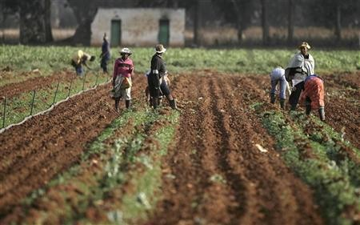
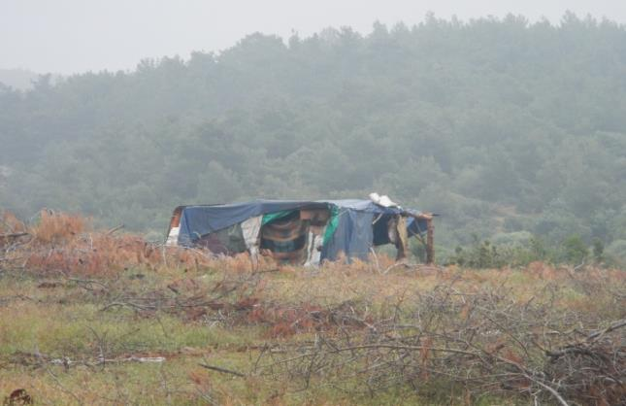
Social Issues – Labour/Human Rights
Treatment of migrant workers
Legality of migrant workers
Workplace conditions
Poor quality accommodation

Slide 24
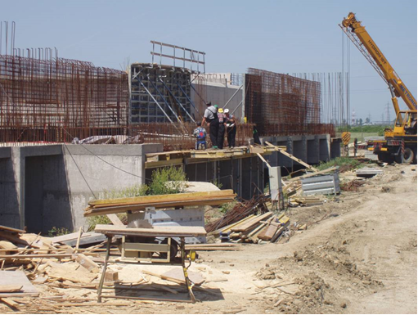
Social Issues – Construction
Note absence of PPE on site
Absence of safety signage
Absence of fencing
Fall hazards
Drop hazards

Slide 25
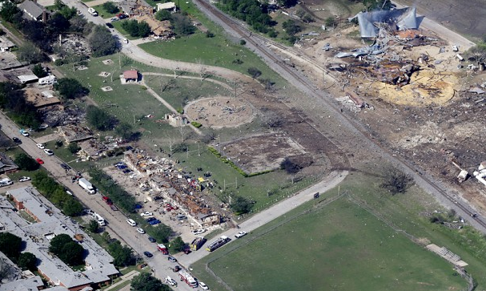
Social issues – community
"We didn't realise it was that dangerous, nobody did…the factory has been there for a long time and nobody gave it much thought." (Local Resident)

Slide 26
Social Consequences - Example
Likely involuntary displacement of 16,000 -40,00 people | Social
Change lifestyle and livelihoods of indigenous people around Xingu River | Social
Inward migration | Social
Deforestation, flooding, reduction in fish stocks | Environmental
Loss of Biodiversity | Environmental
Notes:
Belo Monte a large hydroelectric dam project in Brazil that is currently under construction. When completed, it will be the third largest hydroelectric dam in the world.
The dam has faced serious opposition from environmental and social movements for over 20 years and is likely to generate serious E&S issues.
The dam’s construction is likely to result in the involuntary displacement of 16,000 people. Some estimate that up to 40,000 people could be forcibly moved.
The dam will directly affect the lives of indigenous communities that live around the Xingu river. Impacts include changes to their lifestyles and livelihoods.
Belo Monte is also likely to result in inward-migration of up to 100,000 people searching for work, with further negative impacts on indigenous peoples and is also expected to have serious environmental impacts, including flooding, forest clearance, and reduction in fish stocks and species loss.

Slide 27
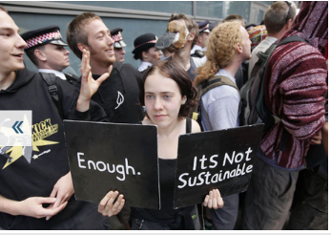
Reputational Risks for Banks
Source: Telegraph
Notes:
A bank may suffer serious damage to its reputation as a result of association with a client who creates serious environmental and social damage.

Slide 28
Learning from Experience : BTC oil pipeline
Over 1,000 letters to the Bank
Demonstration outside building (3x)
‘Occupation’ of offices by NGOs
Heavy lobbying of EBRD Directors and Governments
International NGOs more vocal and aggressive
National NGOs generally supportive
Source: Friends of the Earth
Notes:
BTC pipeline The huge pipeline stretched the whole length of Bishopsgate in London's financial district – oil pipeline through Turkey, Georgia and Azerbaijan
Friends of the Earth delivers a section of the pipeline to the European Bank for Reconstruction and Development
Friends of the Earth Georgia organised a parallel protest outside EBRD's office in Tbilisi, Georgia - one of the locations on the route of the oil pipeline.

Slide 29
It’s not all risk – E&S opportunities
Improve business performance by reducing costs:
Environmental
Minimise waste, re-use or recycle
Energy efficiency/resource-efficiency
Process efficiency – reducing emissions and raw material use
Social
Good health and safety practices and working conditions
Positive labour relations minimise lost production time
Effective community engagement minimises disruption
All can lead to lower compliance costs, operational savings and productivity increases
Notes:
The relevance of E&S issues to banks is not all about risks. Opportunities, both internal and external, also come into the equation. There are two main drivers to opportunities: (1) the first is related to cost reductions and the (2) second relates to new markets.
Environmental
Using less of something saves money.
Environmental cost savings involves process improvement where fewer resources are used.
Recycling and re-use programs can reduce waste and material expenditure, implementing power savings equipment can reduce energy bills, and conducting overall process efficiency audits can identify more streamlined operations approaches.
2. Social
Poor working conditions can increase the chance of injury and potential employee absence and company cost.
Poor corporate relationships can increase the potential for employee strike, boycott, or community disruption all of which disturb efficient corporate operations.
Good health and safety practices and working conditions minimise illnesses, injuries and fatalities
Effective labour relations minimise lost production time
Effective stakeholder engagement minimises disruption

Slide 30
E&S Opportunities for Growth
There are many initiatives by the finance industry that focus on E&S issues in lending and investing and many development banks that focus on E&S issues.
Effectively managing E&S opportunities alongside risks banks create long-term value for their business.
Banks should be aware of the opportunities that E&S issues offer their clients, for example to improve their operational efficiencies by reducing costs
waste minimisation
energy efficiency/eco-efficiency
reduction in emissions and water use
Access new markets by developing ‘responsible products’ such as organic or Fair Trade labelled goods.
Enhance reputation and brand

Slide 31
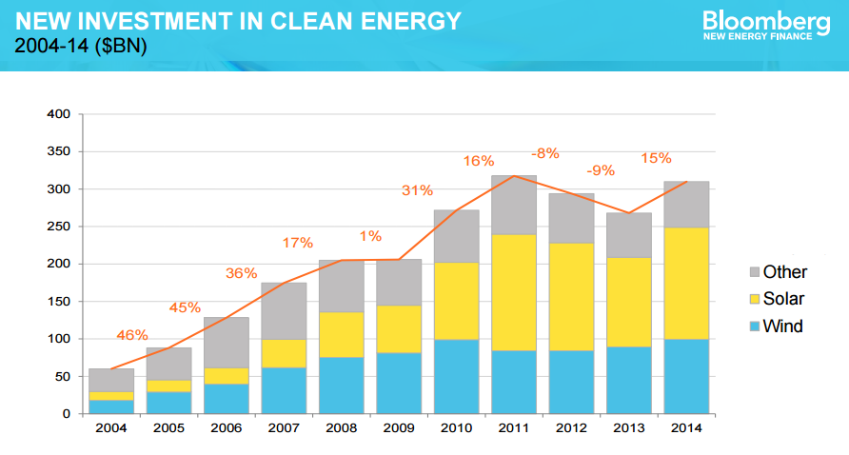
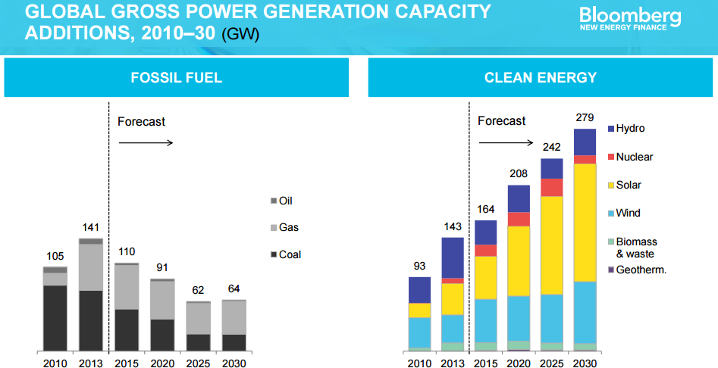
E&S opportunities in the market
Notes:
This is about new markets and opportunities. Shows the level of investment in clean energy as one example of E&S opportunity that markets are taking advantage of. Highlight the regional differences.
Clean energy investment declined in 2012 and 2013, weighed down by regulatory uncertainty and policy changes in big markets such as the US, India, Spain and Italy. Sharply lower prices of solar and wind technology also exerted downward pressure on investment volumes, though they allow higher installation levels per dollar of funding.
Total new investment in clean energy worldwide in 2014 was just over USD300bn, nearly matching the peak of 2011. Latest quarterly update (3Q 2015) shows that 2015 is on track to match 2014 figures, which is very good because the dollar has been much stronger this year. (UPDATE WITH LATEST BEFORE EACH TRAINING VISIT)
Source: New Energy Finance: http://about.newenergyfinance.com/content/uploads/sites/4/2015/10/Liebreich_BNEF-Summit-London.pdf

Slide 32
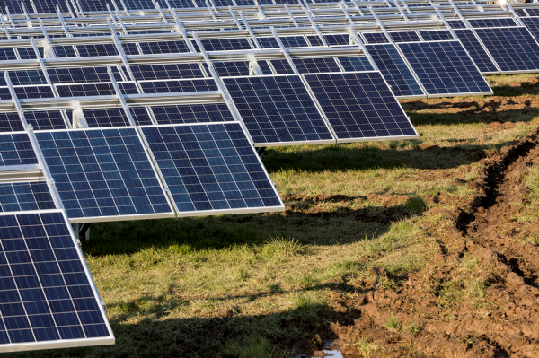
EBRD E&S opportunities
Sustainable Energy Initiative (SEI)
EUR 11 billion invested since 2006
33 countries and 602 projects
Expected to lead to over 55 million tonnes of annual CO₂ reductions
In 2012, SEI investments made up 26% of EBRD activities
Example
EUR 150m facility from EBRD for banks and leasing companies
On lend sustainable energy financing for local SMEs
One of 16 EBRD sustainable financing facilities by EBRD
Notes:
- Despite improvements, energy intensity in the EBRD region remains on average over three times higher than in the European Union.
- Several areas of the EBRD region are vulnerable to the impacts of climate change, particularly in the southern and eastern Mediterranean, Central Asia, and the Caucasus. Finding private sector-led
solutions to adaptation is therefore becoming increasingly important.
- SEI provides financing facilities through local banks in countries of operations to support industrial energy efficiency in small and medium-sized enterprises (SMEs), small-scale renewable
energy and building energy efficiency projects.
Example project through SEI
The EBRD is promoting energy efficiency in Poland with a €150 million Sustainable Energy Financing Facility (PolSEFF).
The Facility supports banks and leasing companies to on lend sustainable energy financing to local SMEs operating in the manufacturing, services, retail, agribusiness and other sectors.
- The investments include industrial energy efficiency improvements, energy efficiency and/ or renewable energy measures in commercial buildings and small-scale renewable energy production.
- PolSEFF is one of 16 Sustainable Financing Facilities (SEFF) that the EBRD has successfully launched in Armenia, Bulgaria, Georgia, Hungary, Kazakhstan, Moldova, Romania, Russia, the Slovak Republic, Turkey, Ukraine and the Western Balkans.

Slide 33
E&S opportunities: example
E&S risk management can support access to capital
Raiffeisen Bank Aval improved E&S risk management in 2004
Helped access to DFI capital
Nearly $300m from IFC
Over $150m from EBRD
1st Ukrainian bank in IFC Global Trade Finance Program
DFI capital raised credibility
Obtained guarantees from major commercial banks
Notes:
Raiffeisen Bank Aval is a large Ukrainian bank offering commercial and retail services.
In 2004, Bank Aval improved its risk management to better assess E&S risks. It developed and implemented an E&S risk management system, integrated within its credit process.
Approach to E&S risks strengthened its credibility and helped gain access to DFI finance:
Nearly $300 million from IFC
Over $150 million from EBRD
First Ukrainian bank to be included in the IFC Global Trade Finance Program
DFI investment raised the Bank’s credibility and it obtained guarantees from large commercial banks such as JPMorgan, ING Bank, Dresdner, and Bank Austria.
¹ IFC (2007), ‘Banking on Sustainability’, http://www.ifc.org/ifcext/enviro.nsf/AttachmentsByTitle/p_BankingonSustainability/$FILE/FINAL_IFC_BankingOnSustainability_web.pdf
² Raiffeisen Bank Aval (2009), Bank News, http://aval.ua/en/press/news/?id=49502

Slide 34
Environmental and Social Practices in Banks Worldwide
Notes:
There are many initiatives by the finance industry that focus on E&S issues in lending and investing.
The 1992 UNEP Statement of Commitment by Financial Institutions on Sustainable Development represents its signatories’ recognition that economic development needs to be compatible with human welfare and a healthy environment and that to ignore this is to risk increasing social, environmental and financial costs.
The Equator Principles, commonly called EP, are a set of principles that act as a framework for evaluating and managing E&S risks in project finance transactions. The principles are adopted voluntarily by financial institutions and are typically applied to projects where total capital costs exceed US$10 million.
EBRD encourages FIs to consider joining appropriate existing international initiatives that promote best practice in the financial sector such as Equator Principles, UNEP FI and Principles for Responsible Investment

Slide 35
Drivers – International Standards
Permitting processes
International Finance Corporation (IFC) Performance Standards
The European Bank for Reconstruction and Development (EBRD) Performance Requirements
EU / National Legislation
Aarhus Convention
Notes:
5 minutes
Drivers – International standards
This slide simply highlights a few of the reasons for increased standards in community engagement (and environmental and social management).
We list permitting processes because these are the basis of the standards that follow. The other standards set norms. In particular, the IFC and EBRD have become the “added standards” that go beyond national legislation. They increase the key requirement for community engagement and being able to document that “management-system” process that shows how community participate in a project or operations.

Slide 36
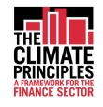
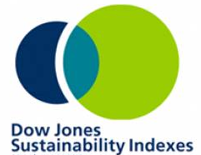
Initiatives in the financial sector
Notes:
Shows that E&S matters are considered in the FS sector. Provides an overview of leading initiatives other financial sector institutions are using to manage E&S risks
Discuss 2-3 initiatives in greater detail and mention that they have been widely adopted among the financial services landscape.
The FS sector has incorporated E&S risk management into activities for several years.
Some of the earlier efforts have related to socially responsible investments and stewardship funds where investments are screened on ethical, environmental, social and governance performance standards and policies. Equally, Barclays established in 1992 its Environmental Risk Management Unit as part of its overall risk management system.

Slide 37
IFC E&S risk management requirements of FIs
IFC requires FIs to carry out individual transaction appraisal and monitoring as well as overall portfolio management
Specifically IFC requires FIs to:
Apply IFC Exclusion List and follow national law
Categorise transactions and apply Performance Standards where applicable (higher risk)
Establish and maintain an Environmental and Social Risk Management System (ESMS) in line with Performance Standard 1
Apply Performance Standard 2 where relevant to own operations
Designate an ESMS Officer
Report annually to the IFC
IFC Policy on Environmental and Social Sustainability
IFC Environmental and Social Review Procedure
Notes:
Similar approach to EBRD – [add point that there is a lot of effort by the DFIs to harmonise approaches]
IFC reviews the business activities of financial institution clients to identify areas where the financial institution could be exposed to potential E&S risk from the FI’s transactions and the FI’s capacity to manage these risks. The outcome of this review is an important factor in IFC’s decision to finance a client or not. As a result of the review, IFC determines the scope of the environmental and social performance requirements, which are conditions of IFC financing.
The ESMS must be consistent with the IFC Policy on E&S Sustainability and E&S Review Procedure and incorporate Performance Standard 1.
The ESMS Officer will have overall responsibility for the administration of and oversight for the implementation of the ESMS.
Annual Environmental Performance Reports (AEPRs) from financial institutions must include portfolio information broken down by industry sector and transaction type; implementation of the financial institution’s ESMS; and any significant environmental and social issues or non-compliances associated with individual transactions.
Performance Standard 1: Assessment and Management of Environmental and Social Risks and Impacts
Performance Standard 2: Labor and Working Conditions
Performance Standard 3: Resource Efficiency and Pollution Prevention
Performance Standard 4: Community Health, Safety, and Security
Performance Standard 5: Land Acquisition and Involuntary Resettlement
Performance Standard 6: Biodiversity Conservation and Sustainable Management of Living Natural Resources
Performance Standard 7: Indigenous Peoples
Performance Standard 8: Cultural Heritage

Slide 38
IFC E&S risk management requirements of FIs
IFC PERFORMANCE STANDARDS
Performance Standard 1: Assessment and Management of Environmental and Social Risks and Impacts
Performance Standard 2: Labour and Working Conditions
Performance Standard 3: Resource Efficiency and Pollution Prevention
Performance Standard 4: Community Health, Safety, and Security
Performance Standard 5: Land Acquisition and Involuntary Resettlement
Performance Standard 6: Biodiversity Conservation and Sustainable Management of Living Natural Resources
Performance Standard 7: Indigenous Peoples
Performance Standard 8: Cultural Heritage
Notes:
Similar approach to EBRD.

Slide 39
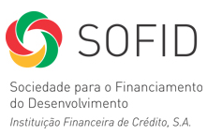
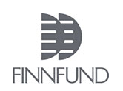
European Development FIs Principles for Responsible Financing
Aim: To have a positive impact on the local communities where we invest. We also strive to ensure respect for human rights and environmental sustainability.
Notes:
EBRD and four leading Europe-based multilateral financing institutions (MFIs) signed the European Principles for the Environment declaration in May 2006.
EBRD, the Council of Europe Development Bank, European Investment Bank, Nordic Environment Finance Corporation, Nordic Investment Bank (NIB).
Support environmental protection and promote sustainable development globally and across all sectors of their activities
Joint initiative aims to harmonise environmental benchmarks used for the financing of projects.
Promotes the EU approach to environmental sustainability and the application of EU benchmarks to projects financed by them.
European DFIs (EDFIs) are 16 bilateral investment organisations providing finance for private sector companies in developing and reforming economies. They created a harmonized approach to ensure that all EDFIs are striving for the same objectives.
BIO - Belgian Investment Company for Developing Countries
CDC - CDC Group plc
COFIDES - Compañía Española de Financiación del Desarrollo
DEG - Deutsche Investitions- und Entwicklungsgesellschaft mbH
FINNFUND - Finnish Fund for Industrial Cooperation Ltd
FMO - Netherlands Development Finance Company
IFU - The Investment Fund for Developing Countries
Norfund - Norwegian Investment Fund for Developing Countries
OeEB - The Development Bank of Austria
PROPARCO - Société de Promotion et de Participation pour la Coopération Economique
SBI-BMI - Belgian Corporation for International Investment
SIFEM - Swiss Investment Fund for Emerging Markets
SIMEST - Società Italiana per le Imprese all'Estero
SOFID - Sociedade para o Financiamento do Desenvolvimento
SWEDFUND - Swedfund International AB

Slide 40
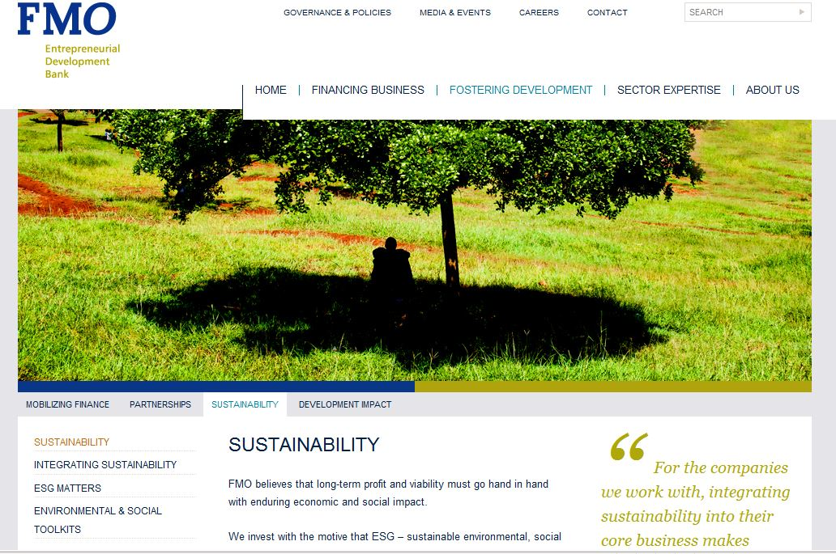
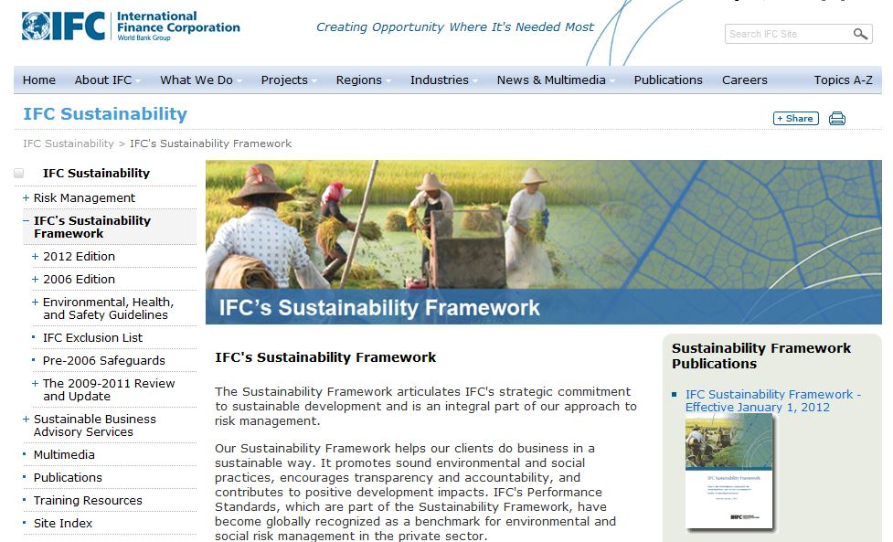
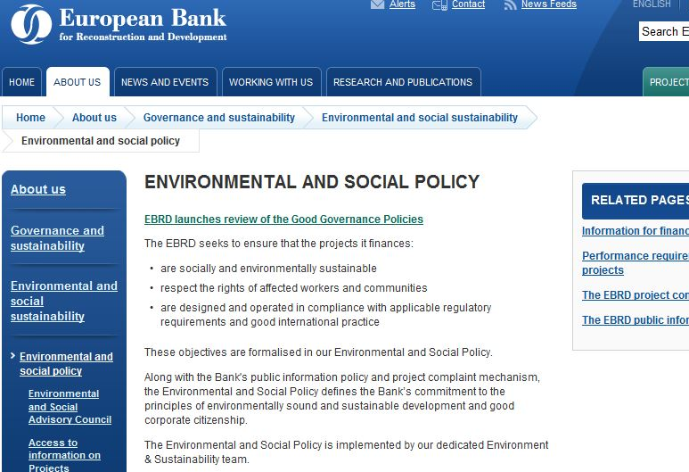
Development finance institutions
DFIs have sustainability mandates and requirements for partners/investments
i need to split case study part 1 into a and b effectively now
Notes:
Facilitator should make the point that numerous DFIs have E&S mandates and requirements, including EBRD.

Slide 41
European Development FIs Principles for Responsible Financing
Compliance with legal and regulatory requirements in local jurisdictions
Recognise E&S consequences and work towards international best practice [often refer to IFC Standards]
b. Mitigation and compensation for unavoidable negative E&S impacts
Continuous improvement to management of ESG matters
Business integrity and corporate governance
a. Preventative and precautionary approach to E&S impacts of operations
Open dialogue with stakeholders on E&S impacts
Transparent and accountable information on investment activities
Notes:
European DFIs (EDFIs) are 16 bilateral investment organisations providing finance for private sector companies in developing and reforming economies. They created a harmonized approach to ensure that all EDFIs are striving for the same objectives.

Slide 42
The Equator Principles
A set of principles for the responsible financing of projects
Over 80 financial institutions are members – banks and export finance agencies
Scope: project finance and advisory, project-related corporate or bridge loans
Updated and revised in 2013
Notes:
What they are: risk management framework, adopted by financial institutions, for determining, assessing and managing environmental and social risk in projects and is primarily intended to provide a minimum standard for due diligence to support responsible risk decision-making.
Be aware that you may be involved in a transaction where an EPFI is also a participant, and will therefore require the application of EP to the project.

Slide 43
The Equator Principles
P1: Review and Categorisation
Categorise project based on IFC definitions for A/B/C.
P2: Environmental and Social Assessment
Cat A/B projects require E&S Impact Assessment (ESIA). If project emits > 100,000 tonnes of CO2 p.a., an alternatives analysis is required.
P3: Applicable Environmental and Social Standards
Apply national laws (Designated Countries) or IFC Performance Standards (others).
P4: E&S Management System and EP Action Plan
Cat A/B projects require use of E&S Management System (ESMS), E&S Mgmt Plan (ESMP), Action Plan (AP).
P5: Stakeholder Engagement
Cat A/B projects must demonstrate effective stakeholder consultation. If indigenous peoples are impacted, Free, Prior and Informed Consent must be demonstrated.
P6: Grievance Mechanism
Cat A (and B if appropriate) projects must have a grievance mechanism.
P7: Independent Review
Cat A projects require an independent consultant to review ESIA, ESMS, E&S Plan.
P8:Covenants
Cat A/B projects must have compliance covenants (ESMP, AP, decommissioning plans, periodic reporting).
P9: Independent Monitoring and Reporting
Cat A (and B if appropriate) projects must have an independent consultant perform or review monitoring and reporting.
P10: Reporting and Transparency
Cat A Projects must provide a summary of the ESIA online. Report CO2 emissions if greater than 100,000 tonnes pa.
Notes:
Part of internal E&S review and DD – EPFI will categorise proposed projects based categorisation process of IFC (A/B/C for high/medium/low risk)
Category A & B projects– need E&S impact and risk assessment. This should propose appropriate measures to minimise, mitigate and offset adverse impacts. For all projects where aggregate scope 1 and 2 emissions are > 100,000 tonnes CO2 pa, alternatives analysis is required.
For projects in designated countries, comply with host country laws, regulations and permits. For projects in non-designated countries, IFC Performance Standards apply.
For category A & B Projects, require use and maintenance of an ESMS. An ESM Plan and EP Action Plan will be used to address identified gaps.
For category A & B projects, effective stakeholder consultation must be demonstrated. This must be commensurate with project risk. If impacting indigenous people, must obtain Free Prior and Informed Consent (FPIC).
For Category A (and B, if appropriate) Projects, a grievance mechanism must be part of ESMS – designed to receive and facilitate resolution of concerns.
Category A - requires independent E&S consultant to undertake review.
Covenant in the financing documentation to comply with all laws. For Cat A and B Projects, must covenant compliance with ESMP and EP Action Plan (from 4), periodic reporting, decommissioning plan.
For Category A (and B, if appropriate) Projects, an independent consultant must review/perform monitoring and reporting.
Project reporting: Category A – summary of ESIA must be accessible and available online. Emissions of over 100,000 tonnes CO2e / year must report scope 1 and 2 emissions during the operational phase of projects. EPFI must report at least annually to the specified minimum reporting requirements.

Slide 44
Initiatives in industry
Notes:
Shows that E&S matters are considered in industry.
This is a collection of influential industry initiatives guiding good practice in sustainability.
Touch on one or two of these initiatives.

Slide 45
Thank you!

