Slide 1
EBRD in Greece July 2016

Slide 2
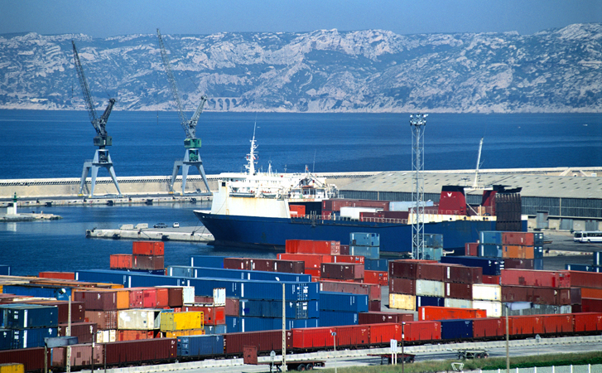
The EBRD’s investments in 2015
€9.4 billion invested through 381 projects
€320 million invested through 6 projects in Greece

Slide 3
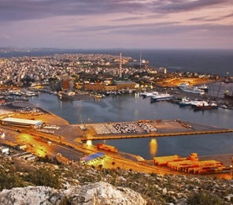
Greece as an EBRD Country of Operation
The Greek Government requested EBRD’s engagement to tackle the consequences of the financial and economic crisis and address the structural challenges imbedded in the country’s economy
EBRD’s activities are intended to strengthen the reform process of Greece’s economy and contribute to the momentum of its recovery
EBRD will work to:
encourage foreign and domestic investment
strengthen the role of the private sector
deepen regional integration

Slide 4
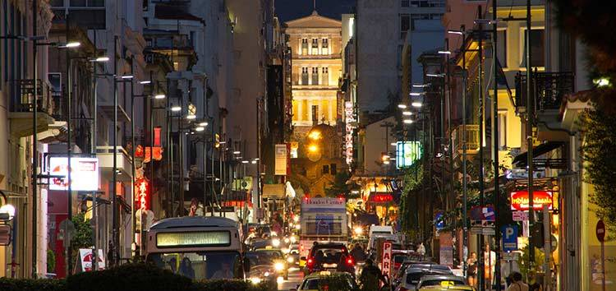
The EBRD’s envisaged priorities in Greece
Support the resurgence and enhance the resilience of the private sector through a shift to a more export-oriented growth model
Support the stabilisation of the financial sector and deepen intermediation to unlock private sector access to finance
The Bank will help address the issue of insufficient capital for Greek private companies, especially small and medium-sized enterprises
Through its Trade Facilitation Programme the Bank will provide guarantees for pre-export and post-import finance
Support private sector participation in and commercialisation of the infrastructure to enhance regional integration and improve quality of utility services

Slide 5
Key strengths of the EBRD
Operational
Extensive knowledge of local economy, business environment and practices, local presence
Engaged minority partner for business
A business partner who shares risks, including political
Catalyst to access additional equity, debt and trade finance
Provides finance to both private and public sector clients
High standards for corporate governance and compliance
Institutional
Strong, internationally recognised financial partner with long-term perspective
Close working relationships with governments and shareholders
Political leverage due to EBRD’s unique mandate and shareholder structure
Preferred Creditor Status
Triple-A credit rating
Work closely with market sources of capital to fill “market gaps”

Slide 6
EBRD Product Flexibility tailored to project needs
Loans
Senior, subordinated, convertible
Long term (up to 10yr. or more) or short term revolving
Equity
Common stock or preferred
Mezzanine debt
Floating/Fixed rates
Choice of currencies (€, US$, etc.)
Minority position only (up to 35%)
Private equity, VCs
Technical Cooperation
As a Multilateral Development Bank, EBRD brings in additional financing
and technical assistance to economically viable projects
Other: PPPs, guarantees, swaps, etc.
Potential to complement some EBRD products/programmes with those from other IFIs

Slide 7
What more can EBRD offer
Initiatives / Programmes
Since the start of EBRD’s Sustainable Energy Initiative over 13 billion were invested to address the twin challenges of energy efficiency and climate change in the region.
Market segments include: large‑scale industrial energy efficiency, sustainable energy financing facilities through financial intermediaries, power sector energy efficiency, renewable energy, municipal infrastructure energy efficiency, including district heating and public transport network rehabilitation and carbon market support.
The Trade Facilitation Programme (TFP) was developed to promote and facilitate international trade to, from and within our countries of operation.
Under the TFP, guarantees provided by EBRD to international commercial banks cover the political and commercial payment risk of transactions undertaken by participating banks (issuing banks) in the EBRD’s countries of operations.
The Small Business Initiative to provide financing to micro small and medium size enterprises to support entrepreneurship.

Slide 8
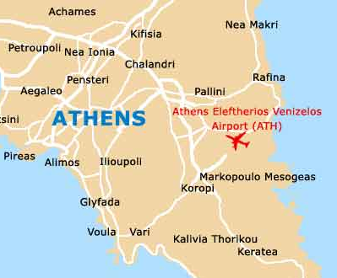
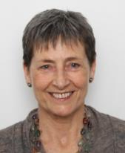
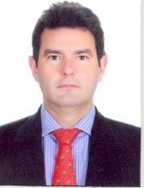
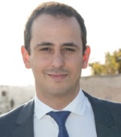
The EBRD on the ground in Greece
EBRD established its local presence in Athens in 2015
The regional office in Athens includes a multidisciplinary team of local and international bankers
Support from sector and product teams in EBRD headquarters in London
EBRD Regional Office in Athens
5th floor, Othonos 6,
Athens, 105 57
+30 211 1064 300
Athens@ebrd.com
Sabina
Dziurman
Regional Head of Greece and Cyprus
Alkis
Drakinos
Deputy Head
of Greece
Harris Damaskos
Associate Banker
Augusta Vrachnou
Associate Banker
Angeliki Kalligiannaki
Associate Banker
George Maltezos
Analyst
Dimitris
Chatziiakovou
Analyst

Slide 9
The EBRD’s investments in Greece to date
Over €430 million invested through 10 projects in Greece
Invested in
2015
Invested in
2015
Invested in
2015
Invested in
2015
Invested in
2015
€50 million
€70 million
€65 million
€65 million
€50 million
Financial package supporting recapitalisation to strengthen the banking sector
Financial package supporting recapitalisation to strengthen the banking sector
Financial package supporting recapitalisation to strengthen the banking sector
Financial package supporting recapitalisation to strengthen the banking sector
€50 million bond to support capital expenditures
Invested in
2015
Signed in
2016
Signed in
2016
Approved in
2016
Invested in
2016
€20 million
€30 million
$95 million
€10 million
€15 million
Trade Facilitation
Programme (TFP)
€20 million equity commitment to Diorama Hellenic Growth Fund to support investing in SMEs
$75 million senior debt &
$25 million subordinated debt to support ongoing investment plans
Maximum approved amount. Acquisition of a stake in European Reliance
€15 million bond to support capital expenditures
€30 million limit for
guarantees to support scaling up trade finance activities

