Slide 1


Sustainable Development
in Eurobank
Group Sustainability/Environmental & Social Affairs Division
July 2016

Slide 2

Sustainability at Group level
Management Systems
  The concept of Sustainable Development/Sustainability is included in the Management’s core strategies. In this context, the Group has established and implements the following Management Systems, certified in accordance with International Standards:
    Environment (ISO 14001/EMAS),
    Energy (ISO 50001),
    Quality (ISO 9001),
    Occupational Health & Safety at Work (OHSAS 18001),
    IT Service (ISO 20000-1),
    Social Security - Business Continuity (ISO 22301), and
    Information Security (ISO 27001).
  Their implementation contributes to the Organization’s Sustainability and focuses on the continuous improvement of services, with respect and responsibility towards the environment, the society, the employees, and all stakeholders.
  Transition to an Environmental & Social Management System :
    As a natural “maturing” phase of existing systems and approaches
    To ensure compliance with requirements and expectations of international investors, and the rest of the interested parties and stakeholers.
  Strategic direction and high-level monitoring of Sustainability issues, has been entrusted to the Group Sustainability Committee (GSC) whose main responsibilities are to:
    Review and authorise policies, strategies and major inititaives,
    Review progress against policy objectives and annual targets,
    Ensure that all sustainability formal/informal, international/national, mandatory/voluntary commitments are fulfilled.
    Provide resources and top-down support when and as necessary

Slide 3

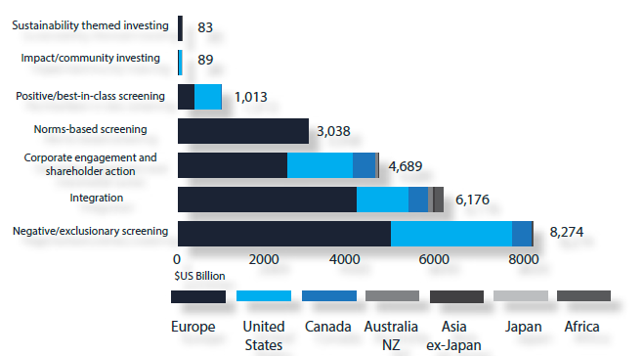
Sustainability at Group level
Corporate Sustainability Assessments
Increasingly, investors are diversifying their portfolios by investing in companies that set industry-wide best practices with regard to Sustainability, due to:
Attractiveness
  Sustainability aims to increase long-term shareholder value
  Sustainability performance financially quantified – investable corporate sustainability concept.
Superior performance and risk/return profiles
  A growing number of investors is convinced that Sustainability is a catalyst for enlightened and disciplined management, and, thus, a crucial success factor.
Socially Responsible Investment (SRI)
or ESG Integration in Investing:
$13.6 trillion worth of professionally managed assets incorporate environmental, social and governance (ESG) concerns into their investment selection and management (21,8% of the total assets managed professionally)
Europe is the largest region with about 65% percent of the known global sustainable investing assets under management
Europe, the United States, and Canada—together account for 96% percent of such assets.
    (Source: Global Sustainable Investment Review 2012)
Figure 1: Global sustainable investments by strategy and region

Slide 4
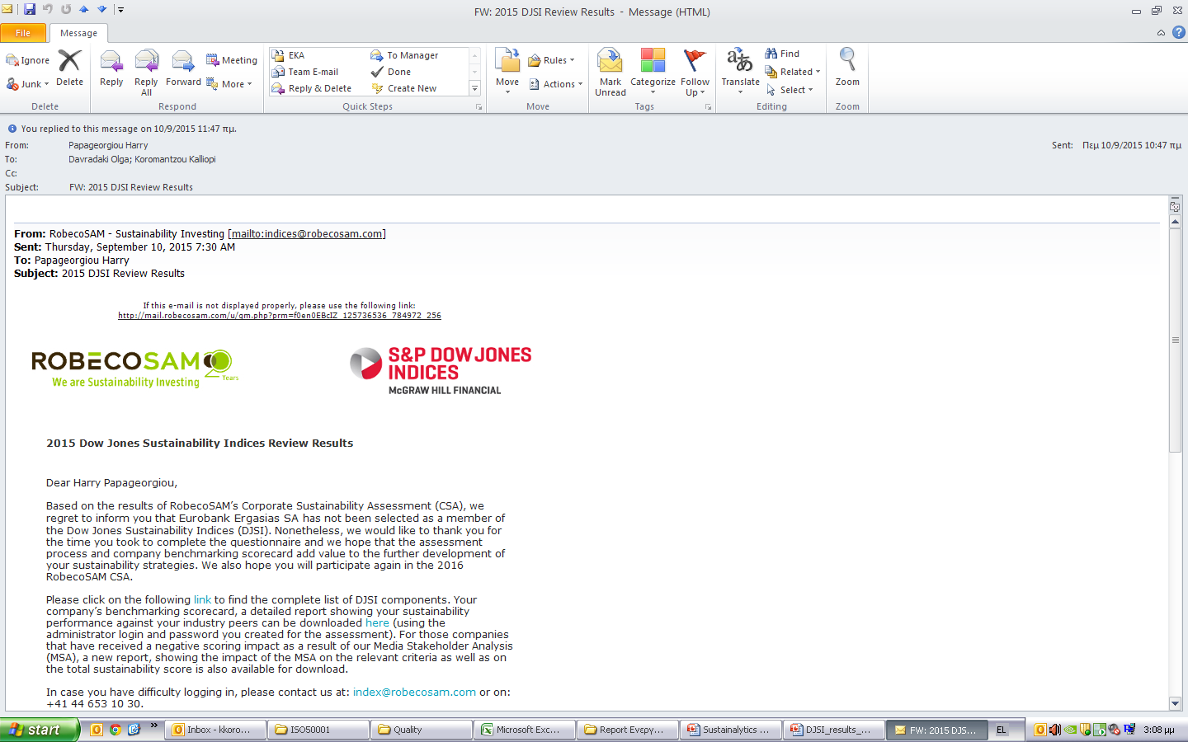

Sustainability at Group level
Corporate Sustainability Assessments
Dow Jones Sustainability Index (DJSI)
A part of the family of indexes evaluating the sustainability performance of the largest 2,500 companies listed on the Dow Jones Global Total Stock Market Index.
The longest-running global sustainability benchmarks worldwide and the key reference point in sustainability investing for investors and companies alike.
The evaluation Criteria have Economic, Environmental and Social dimensions through:
    Detailed assessment of corporate’s public evidence
    Completion of extensive questionnaires per pilar
    Verification by the company, expert networks, media & stakeholder analysis
FTSE4Good
Key prerequisite for ERB’s inclusion is the successful results during assessment of liquidity, free-float market capitalization etc., at the time of assessment for the index

Slide 5


Sustainability at Group level
Environmental & Social Management System (ESMS) – re-Deployment Strategy
  The Issue:
  Further integration of Sustainability within operation systems model.
  We do not finance clients engaged in any of the activities on the Exclusion List such as:
    Production or trade in any product or activity deemed illegal under national laws or regulations or international conventions and agreements or subject to international phase out or bans,
    Production or trade in weapons and munitions, in radioactive materials, in unbounded asbestos fibers & drift net fishing in the marine environment in certain conditions.
  Identify and help mitigate Credit – Legal –Reputational & Operational Risks resulting from our clients’ E&S performance
  Why:
  Global Investor-led sustainability Indices and benchmarking analyses (DJSI, FTSE4Good, Sustainalytics), but also clear IFC and EBRD prerequisites for participation in any SCI
  The Group Sustainability E&S Affairs Division:
  The Unit with the mandate to ensure that:
  No good deal is adversely affected by E&S issues
  E&S risks and opportunities are better understood and embedded in core business strategies and systems by upgrading and coordinating the implementation of the ESMS and pertinent procedures
  Eurobank remains a key player in Sustainable Finance and the thriving of a Green Economy

Slide 6
Environmental & Social Management System (ESMS)
Data Streams
Abroad
Greece
Non-Banking
Subsidiaries
Banking
Subsidiaries
Bank
Subsidiaries
International Function
Group SE&SA Division
Sustainability Indices
Institutional Investors (IFC/EBRD )
Other Stakeholders

Slide 7
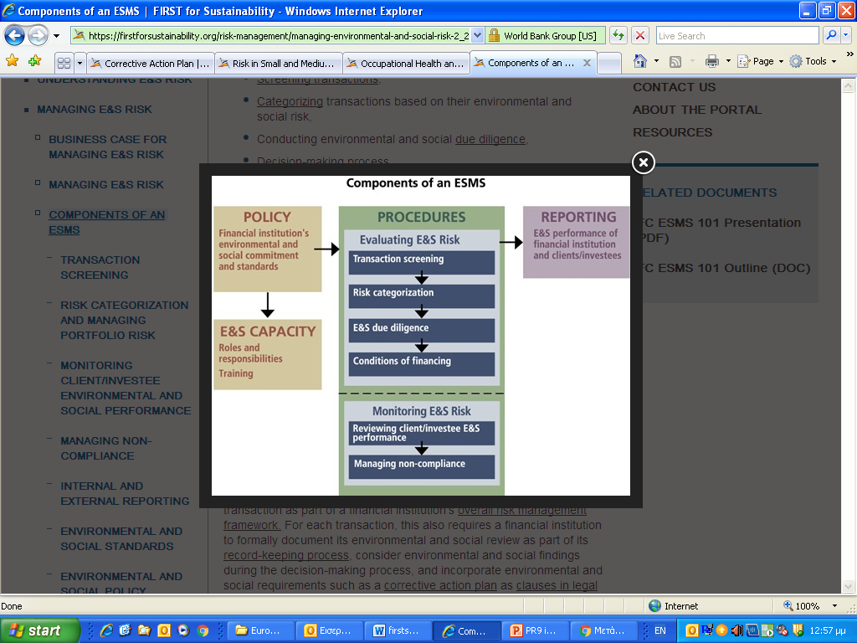
Sustainability at Group level
Environmental & Social Management System (ESMS)
Upgrading the ESMS
Core elements of Eurobank Group’s ESMS
  Group Sustainability Policy Statement
  Roles and Responsibilities for implementing the ESMS
  Group Environmental & Social Policy outlining the framework of general principles and requirements for the Management of E&S Affairs at the Eurobank Group
  Integration of E&S requirements into the existing credit approval process
  Monitoring and Record Keeping
    ESMS Review and continuous Improvement
    External Communications (including grievance mechanism) & Reporting
    Staff training implementation on E&S

Slide 8
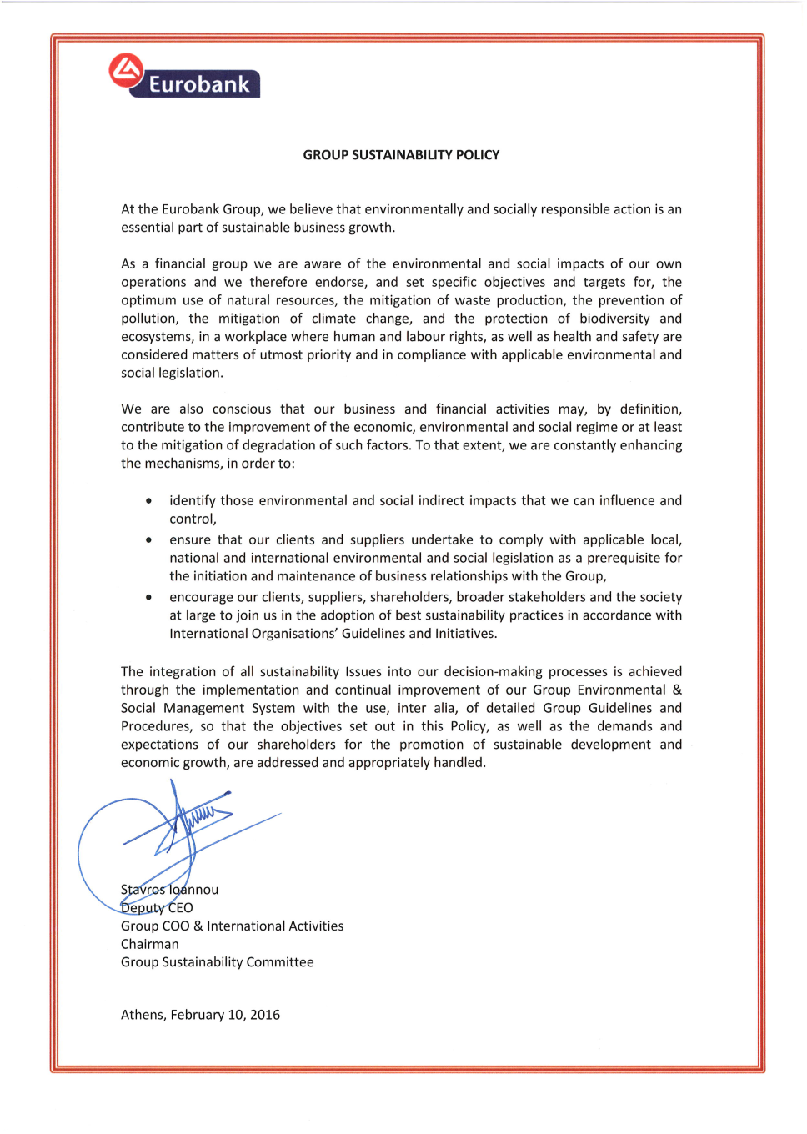

Sustainability at Group level
Environmental & Social Management System (ESMS)
    The Group Sustainability Policy Statement refocuses on E&S risks and depicts Group’s commitment to promote sustainable development integrating environmental and social issues into our decision-making processes through the implementation of an Environmental & Social Management System based on international best practices
    The Group Sustainability Policy Statement is supplemented by the Group Environmental & Social Policy, detailing the framework of general principles and setting the foundations of Eurobank Group’s ESMS, in order to achieve and maintain compliance with existing applicable legislation and regulations as well as with commitments to, among others, its shareholders, stakeholders, and the society.
    GSE&SA Division is responsible for the systematic deployment and implementation of this Policy.

Slide 9
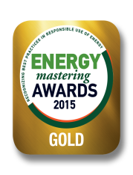
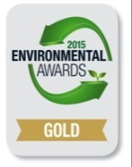
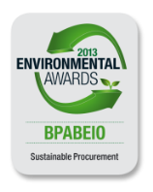
Sustainability at Group level
Achievements
  Awards / Distinctions
  Winner of the 1st prize at the European EMAS Award 2011 contest, in the category of large organizations, the 1st and only bank in Europe to have achieved such a distinction
  Winner of consecutive National Awards on the Bank’s Environmental Management Practices
    Energy Mastering Awards 2015: “Energy Conservation”, “Energy Efficiency Management” and “Energy Efficiency Certification”
    Environmental Awards 2015: “Energy Efficiency in Business”
    Environmental Awards 2013: “Sustainable Procurement” and “Climate Protection-GHG Footprinting”
    National EMAS Award 2009 - 2011 (national representative to the European Contest)
  External Relations / Representation on Sustainability Affairs
  Member of the United Nations Environment Program Finance Initiative (UNEP FI)
    Chairing of the European Task Force (2010-2014)
    Member of the Banking Commission and the Global Steering Committee,
    Sustainable finance engagement & outreach delegate (European Banking Federation, W/E Savings Banks Institute, European Commission, Eurosif etc)
  Member of a permanent European Commission expert working group (Energy Efficiency Financial Institutions Group - EFFIG)
  Membership in various Environment Ministry expert Committee on the review of the Environmental Legislation and initiatives
  Participation in Sustainability Initiatives with key market players such as the Greek Strategy for CSR (NGOs, Unions, Industry, CSR Network etc.) and Sustainable Greece 2020 (QualityNet Foundation).

