Slide 1
Environmental & Social Compliance in PROJECT FINANCING
Konstantinos Venetsanos
Director of Project Finance, NBG
National Bank of Greece S.A.
12 July 2016.

Slide 2
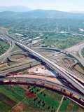
PROJECT FINANCING: A COMPLEX STRUCTURE…..
Model Auditor
Shareholders
Legal
Technical
Insurance
Market
Dividends/ Interest
Share Capital/Sub debt
Lenders’ Advisors
Public Authority
Concession
Agreement
Loan
Loan
Agreement
Payments
Special Purpose Vehicle (SPV)
Lenders
Capital & interest Payments
Construction
Agreement
Operation
Agreement
Insurance
Policy
Direct
Agreements
Payments
Guarantees
Payments
Insurers
Construction JV
Operator

Slide 3
….BUT WITH KEY EVALUATION PARAMETRES
Stages in structuring Project Financing
Environmental
Impact
Study
Environmental
Management
Plan
Compliance with
Environmental laws & regulation
Tender
Documentation
…….
Risk
Assessment
…….
Cash Flow
Analysis
…….
Loan
documentation
Risk Analysis & Allocation
Feasibility Study
Construction
Operation
Market /
Demand
Debt Service Ratios – social security
payments in Opex
Political
FX
Interest
Time Schedule - Permits
Environmental risks
Force Majeure
Sensitivity Analysis – Cost overruns

Slide 4
ENVIRONMENTAL & SOCIAL COMPLIANCE
Tender documentation (Environmental Impact Study and environmental terms)
Assessment of design and construction risk
Internal Rating Model
Loan documentation
Lenders’ Advisors reports

Slide 5
TENDER DOCUMENTATION
In motorway concession projects, the Concessionaire has organized a Quality Assurance and Quality Control System ISO 9001
1
Environmental terms and detailed Environmental Impact Study (EIS) carried out by Public Authority
2
Tender procedure according to EU and local legislation
3
Draft Concession Agreement:
Development of Environmental Management Plan by the private sector
Compliance with Health and Safety Regulations
List of Events of Defaults= Adherence to laws and regulations including the health & safety and environmental legislation

Slide 6
ASSESSMENT OF DESIGN & CONSTRUCTION RISK
In motorways projects, LTA has carried out independent review of compliance with Equator Principles
1
Obligations under the applicable local and European environmental legislation are undertaken by the Concessionaire (private sector)
2
Concessionaire has successful track record in mitigating social and environmental risks
3
Lenders’ Technical Advisor (LTA) reports: Initial Due Diligence Report (at financial closing) and Construction/ Operating Reports provide information on compliance with environmental and social regulation during construction and operation phase

Slide 7
INTERNAL RATING MODEL
Project Finance Scorecard – Risk Analyst tool
There is a section “Environmental issues” which includes two sub-categories “Compliance with EU principles” and “Environmental Warranty”
There is a section “Transaction Characteristics” which includes the category “Permits and Clearances” with the lowest risk level to be given when all permits including environmental are obtained

Slide 8
LENDERS’ ADVISORS REPORTS
Technical
environmental and social risks and how these are mitigated
Legal
risk allocation of environmental and social risks
Insurance
Environmental risks are covered by insurance policy
adherence to laws and regulations including the health & safety and environmental regulation

Slide 9
LOAN DOCUMENTATION
Positive
undertaking of the Borrower
adherence to laws and regulations including the health & safety and environmental regulation
Events of Default:
- risk allocation of environmental and social risks. Concession agreement may be terminated in case of violation of environmental legislation

Slide 10
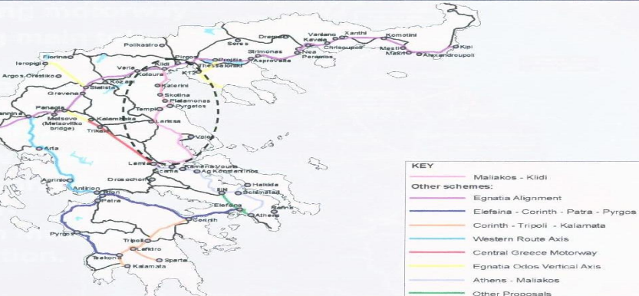
CASE STUDY MALIAKOS KLEIDI MOTORWAY
Environmental policy
An Environmental Management Plan (EMP) for the Project has been developed which includes the organisational structure, planning actions, duties’ allocation, technical methods, procedures as well as processes for the development, implementation, revision of the Concessionaire’s environmental policy as well as the compliance with the Project’s environmental terms;
Key actions include:
- reduction of traffic noise and vibrations;
- saving natural resources (reduced consumption of raw materials, energy, water etc);
- reducing the waste and by-products process and disposal cost;
monitoring air quality;
- Submission of semi annual environmental management report
The project
Landmark toll road transaction project in Greece, connecting Athens with Northern Greece - Thessaloniki; The motorway under construction goes through the environmentally protected Tempi Valley and Pinios River Estuary
Project Cost: €1,3bn
Senior Bank Debt: €375m
NBG’ Loan participation: €30m
Technical/ Environmental Lenders’ Advisors: Mott MacDonald
Upon completion (est. 03/2017), the road will be considered among the safest routes in EU since it will comply with most recent European health and safety standards
A consortium led by Hochteif and Aktor constructs a state of the art 257km road with significant tunneling works (and valley bridges) in order to minimise environmental impact;
Environmental due diligence on behalf of the lenders to ensure compliance with environmental laws;

Slide 11
CASE STUDY MALIAKOS Korinthos Power CCGT
Environmental policy
An Environmental Report (ER) for the Project has been developed which includes the organisational structure, planning actions, duties allocation, technical methods, procedures as well as processes for the development, implementation, revision of the Concessionaire’s environmental policy as well as the compliance with the Project’s environmental terms and the relevant regulation;
Key actions include:
- Control of noise and vibrations;
- Monitoring of air pollution
- Waste management reducing the waste and by-products process and disposal cost
LTA: Semi annual operating report with information for: a) environmental performance and b) Health & Safety
The project
IPP plant covering the Southern Greece;
Project Cost: €250m
Senior Bank Debt: €155m
NBG’ Loan participation: €44m
Technical/ Environmental Lenders’ Advisors: Scott Wilson
Environmental Advisor to the Sponsor: Enviscan
Construction completed in April 2012;
Sponsors are Mytilineos Group and Motor Oil constructs a state of the art gas fired power plant with limited environmental impact;
Environmental due diligence on behalf of the lenders to ensure compliance with environmental laws;

Slide 12
PROJECT FINANCING
Thank you
Konstantinos Venetsanos

