Slide 1

Piraeus Bank Sustainability Profile
Mavica Iliou - Head,
Green Banking Operations, Piraeus Bank
Alexandros Panagiotakis - Director, Group Structured Finance,
Piraeus Bank
Piraeus Bank
Athens, 12 July 2016

Slide 2
Piraeus Banks’ Sustainable Development framework
01
1.1
Social & Environmental Components
Health & Insurance
Legislation & Regulations
Climate Change
Risk Management
Sustainable Development
An integrated approach to environmental, social and economic issues that leads to long-term, sustainable profitable growth
SOCIETY
ECONOMY
Consistency
Equal opportunities
Human Rights
Profitable growth
Responsible Management
Reduce Greenhouse Emissions
Natural Resources Management
ENVIRONMENT
Adequate Dividend
Social & Economic Components
Jobs
Education & Development
Entrepreneurship
Governance & Society
Financing
Environmental & Economic Components
Natural Resources Efficiency
Energy Efficiency
Energy Security

Slide 3










Sustainability Timeline
01
1.3
Evolution of Piraeus Bank’s subsidiary, ETVA VIPE, to an R&D center for green investments and practices.
Positive Impact
Appointment of a BoD member as responsible for environmental issues
Corporate Responsibility Committee of the Bank.
Design of new green products for businesses and individuals.
Gradual incorporation of newly acquired banks’ facilities in Piraeus Bank’s Environmental Management System
Estimating climate change impact on SMEs (EU co-funded project)
First Annual Corporate Responsibility Report of Piraeus Bank
First Green Banking product for private individuals and businesses.
Establishment of the Environment Unit
Business and Biodiversity (EU co-funded project)
Creation of Green Services for enterprises
2004 | 2005 | 2006 | 2007 | 2008 | 2009 | 2010 | 2011 | 2012 | 2013 | 2014 2015
Approval of the Environmental Management Policy by the BoD
Development of Environmental Management System & Green Banking product (EU co-funded project)
Environmental clauses incorporated in the Bank’s amended Articles of Association
Revised Environmental Policy and the Climate Change Strategy approved by the BoD
Launching of the HFSD FUND for circular economy projects.
Notes:
2004:The Bank acknowledges that energy sources are not inexhaustible and should, therefore, be used responsibly.
2007:By establishing the Committee, Piraeus Bank Group aims to contribute to sustainable development through actions that support society and the environment.
2010:The Bank incorporates environmental criteria in its business procedures and develops strategies aiming to continually improve its environmental performance.
The impacts and opportunities from climate change on the economy, society and environment are recognized and addressed.

Slide 4
New Environmental & Social steps and achievements of Piraeus Bank Group
01
1.4
Environmental & Social Policy
Piraeus Bank revises its Environmental and Social policy to set the principles, strategies and Group’s commitments for developing the economy, strengthening the society, protecting the environment and preserving cultural heritage.
2016
Environmental and Social Management System (ESMS)
The ESMS is being expanded to cover the total business loan portfolio of the Group. Environmental and social criteria are incorporated into the Bank’s revised Credit Policy.
Risk Capital Strategy
The revised R&C Strategy emphasizes social and environmental risks.

Slide 5

Piraeus Bank’s Environmental Management System (EMS)
02
2.1
Today Piraeus Bank, with more than 800 buildings (503,457 m²) all over Greece and over 1,000 employees directly involved in the EMS, is one of the largest organizations in Europe which has such a strict environmental certification (EMAS).

Slide 6
Economic Evaluation of Environmental Programs
02
2.2
In 2015, a study was conducted by an independent consultancy in order to economically evaluate 18 implemented environmental programs, including:
Energy saving in buildings
Reduction in consumables
Internal operating procedures automation and promotion of electronic banking
Business and educational travel
According to the study, the Bank saves €5 million per year in operational costs by implementing environmental programs

Slide 7



Green Banking Structure and Products
03
3.1
Businesses
Green Banking Operations
«Piraeus Green Businesses»
Loans for Small Businesses that wish to invest in their energy retrofitting
Net Metering
Photovoltaic Park Insurance
Services
Green Key Certification for tourist enterprises
Energy studies
Environmental Monitoring (ISO 14001 & ISO 50001 or/and the EMAS regulation)
Water management
Bank has also taken up the initiative and is implementing a financing plan for developing the biogas energy market in Greece with quite successful results
Green clientele
Customer Support in Green Business
In-house support
Assessing green investment proposals
Environmental & Social Due Diligence (ESMS)
Individuals
Green Mortgage Loan
Green Consumer Loan for Green Purchases
Green Home Improvement Loan (with collateral/ collateral-free)
Insurance of Photovoltaic System for Householders
The market
Analyzing green portfolio
Assessing the market developments
Notes:
«Product Award for sustainable development»
Piraeus Bank was awarded the first prize in the category “Product Award” (Product Award for Sustainable Development) of the European Business Awards for the Environment 2013-2014 in Greece, for its Green Products and Green Services among many domestic peers.
«Committed to Excellence - EFQM»
«Adoption of Business Excellence Principles»
Green Banking Operation participated in and successfully met all the criteria of the international certification EFQM “Committed to Excellence” as well as the criteria of the Hellenic Management Association (EEDE) in Adoption of Business Excellence Principles”.

Slide 8







Piraeus Bank Group Green Financing
03
3.2
Green customers financing
2.0%
green loans share in the total Group portfolio in Greece
20,786 green clients
Green financing (mil. €)
Renewable Energy
Energy Efficiency
Waste and water management
Green Business - Sectors
Organic and sustainable farming
Green Transportation
Ecotourism - Agrotourism
Green Chemistry

Slide 9












Social and environmental impact from green financing
03
3.3
Piraeus Group RES Projects (2015)
Social
Hydro
50
Biomass
10
7,000 jobs were created and preserved through targeted
Green Banking loans in the
2011-2015 period
2011
2012
2013
2014
2015
975
MW
Wind parks
378
P/V
537
Environment
The total capacity of RES projects that have been funded by Piraeus Bank averted the annual emission of 2.125 mn tons of CO₂ , a quantity that would require 160 mn trees to be absorbed
2.125
1.707
1.701
Market share (2015)
19.6%
2015 2014 2013
of the total RES
market in Greece
160
128
128
Method of calculating jobs: ITUC (International Trade Union Cofederation) - Millennium Institute Methodology (2012), http://www.ituc-csi.org/ituc-green-jobs-assessments

Slide 10
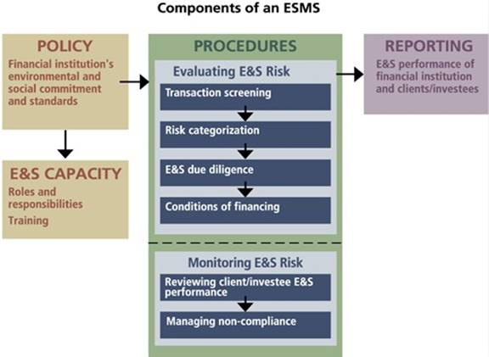
Compliance with the commitments to shareholders
03
3.4
The end of 2015 was a turning point for Piraeus Bank, since the last recapitalization along with the participation of international institutional investors, has highlighted the need for further development of an integrated Environmental and Social Management System (ESMS).
The ultimate goal is to reduce the overall environmental and social risk in the loan portfolio of the Group.
The new ESMS will operate consistently in the context of the Environmental and Social Policy adopted by the Bank.

Slide 11
Compliance with the commitments to shareholders
03
3.5
ESMS:
Evaluation - Mitigation & Prevention - Avoidance of E&S risks, as part of the overall credit risk. Integration of Bank’s policy to the receivables and investments’ portfolio (EMS+ESRA=ESMS)
Main objectives:
Limitation and control of E&S risk increases portfolio’s total yield and eventually returns.
Easier access to capital markets on more favorable terms.
E&S risk management awareness to be spread throughout the market (under our FI’s influence).
Implementation:
Senior management commitment.
Incorporation to the Credit Policy & Administration procedures.
Main component of Corporate Culture (transpiring BANK’s operational layers and divisions).
Fiduciary duty.
Dynamic - non static process, evolving and improving over time, following the market pace/needs/progress.
Core elements:National E&S legislation
Performance Standards/Requirements and International Best Practices (depending on risk level)
Due Diligence
Inclusion of proper terms and covenants in the loan agreement.

Slide 12






Corporate Responsibility Distinctions
03
3.6
Piraeus Bank was the only company based in Greece to be selected as an index component of the Dow Jones Sustainability Index and the Sustainability Yearbook 2016.
CDP rated with 97C Piraeus Bank’s initiatives to tackle climate change.
Piraeus Bank received the PLATINUM distinction for its Corporate Responsibility from the Corporate Responsibility Index.
Piraeus Bank has been selected for inclusion in the Ethibel EXCELLENCE Investment Register.
More than 8,000 organisations compose their Corporate Responsibility Reports according to the GRI Sustainability Reporting Framework. Piraeus Bank’s 2014 CRR follows the GRI G4 guidelines and its content is externally assured.
The sustainability research and analysis firm Sustainalytics assessed Piraeus Bank’s actions regarding environmental, social and corporate governance issues and graded it with 69 out of 100 points, ranking it 38th out of 222 banks assessed globally. (Assessment: February 11, 2015)
The rating agency oekom research AG rated the Bank’s performance regarding environmental and social issues with D+, thus recognising its integrated approach to the implementation of the Environmental Policy and emphasizing the need for fuller integration of environmental and social factors into management of its assets.

Slide 13
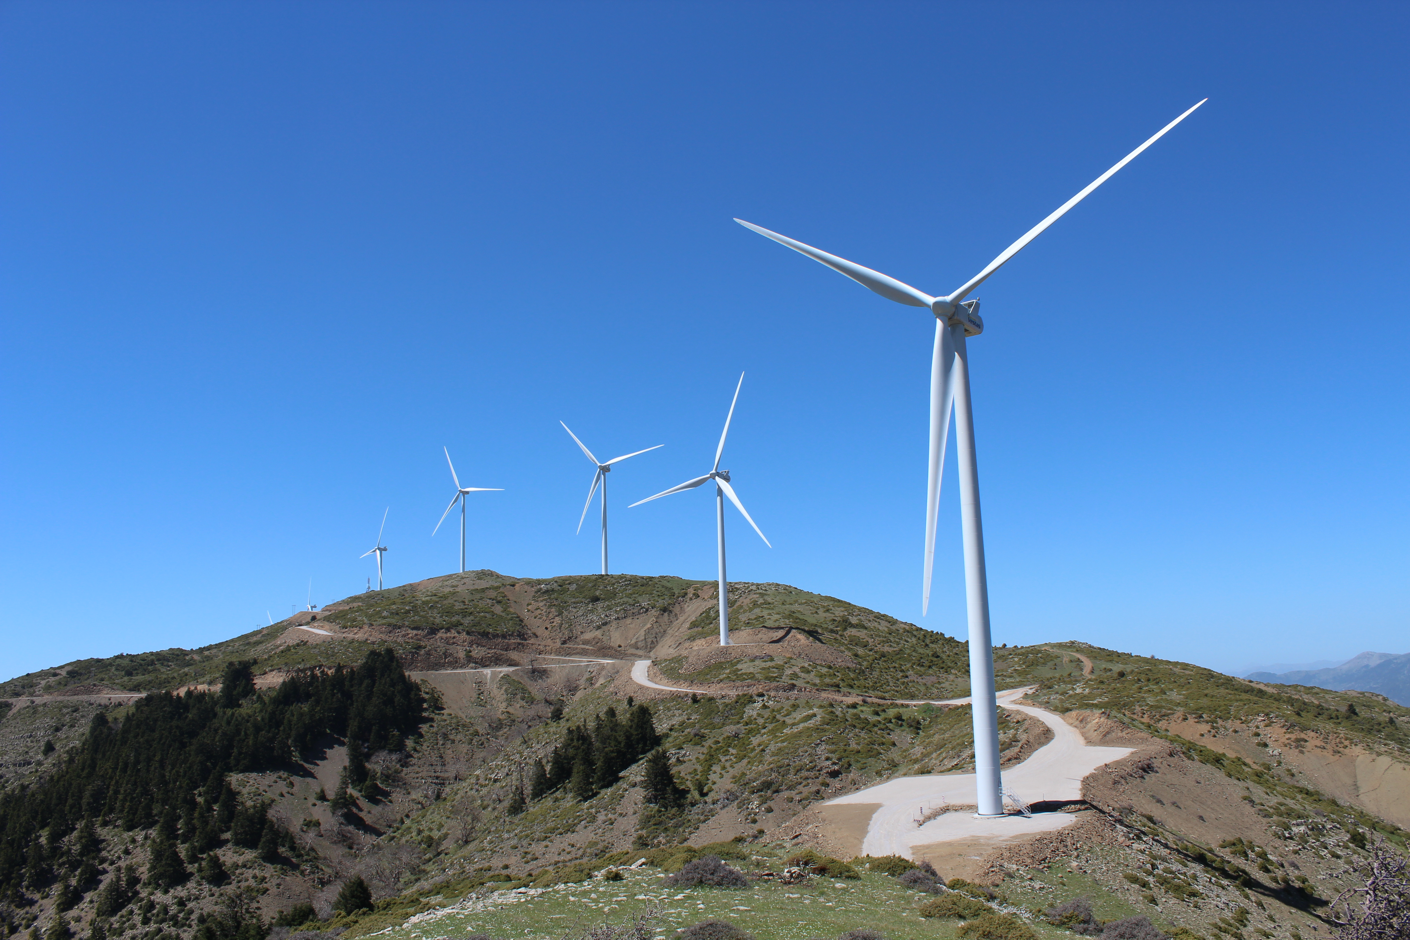
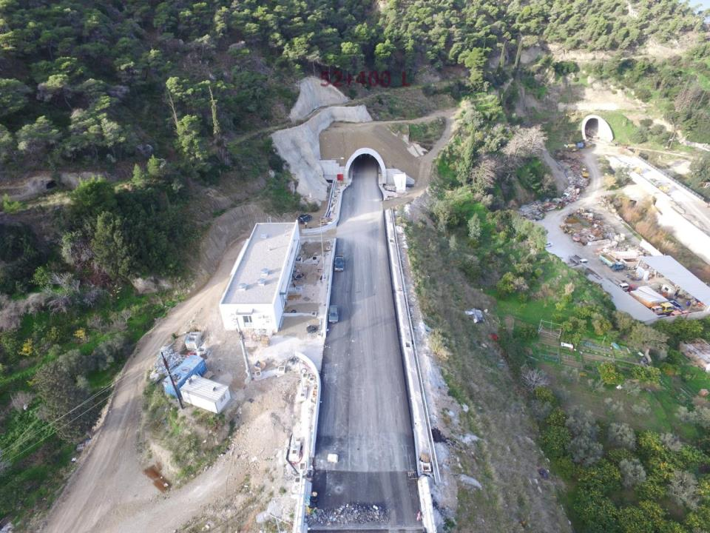
Group Structured Finance (“GSF”)
04
4.1
Infrastructure
leading bank financing the motorways across Greece (Moreas, Olympia Odos, Nea Odos, Central Greece, Aegean Motorways and Egnatia Odos)
€0.5bn commitments, equals to 1/3 of the total financing
Energy Financing
Developing all CCGT, wind farm, biofuel and biogas projects of the Bank
Developing photovoltaic parks above 1 MW
Strong track record in RES as stated by Green Banking and strong pipeline in view of the 2020 long term targets for energy generation from wind
leading role in the financing of 3 of the main thermal power plants constructed in Greece
Bank implements a financing plan for developing the biogas energy market in Greece with quite successful results
Other energy efficiency projects (eg lightning of Salonica Munic.)
Real Estate
Financing the development of real estate projects, having secured all Environmental Impact licensing in the areas of :
Tourism (hotels)
Commercial Real Estate in both Office and retail buildings (malls)
Notes:
«Product Award for sustainable development»
Piraeus Bank was awarded the first prize in the category “Product Award” (Product Award for Sustainable Development) of the European Business Awards for the Environment 2013-2014 in Greece, for its Green Products and Green Services among many domestic peers.
«Committed to Excellence - EFQM»
«Adoption of Business Excellence Principles»
Green Banking Operation participated in and successfully met all the criteria of the international certification EFQM “Committed to Excellence” as well as the criteria of the Hellenic Management Association (EEDE) in Adoption of Business Excellence Principles”.

Slide 14
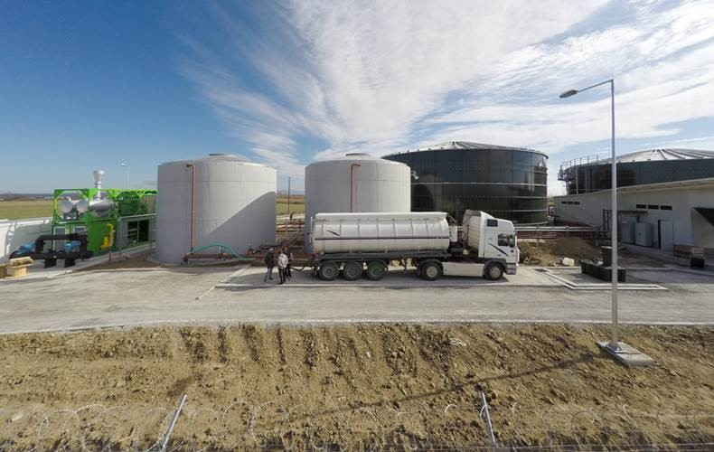
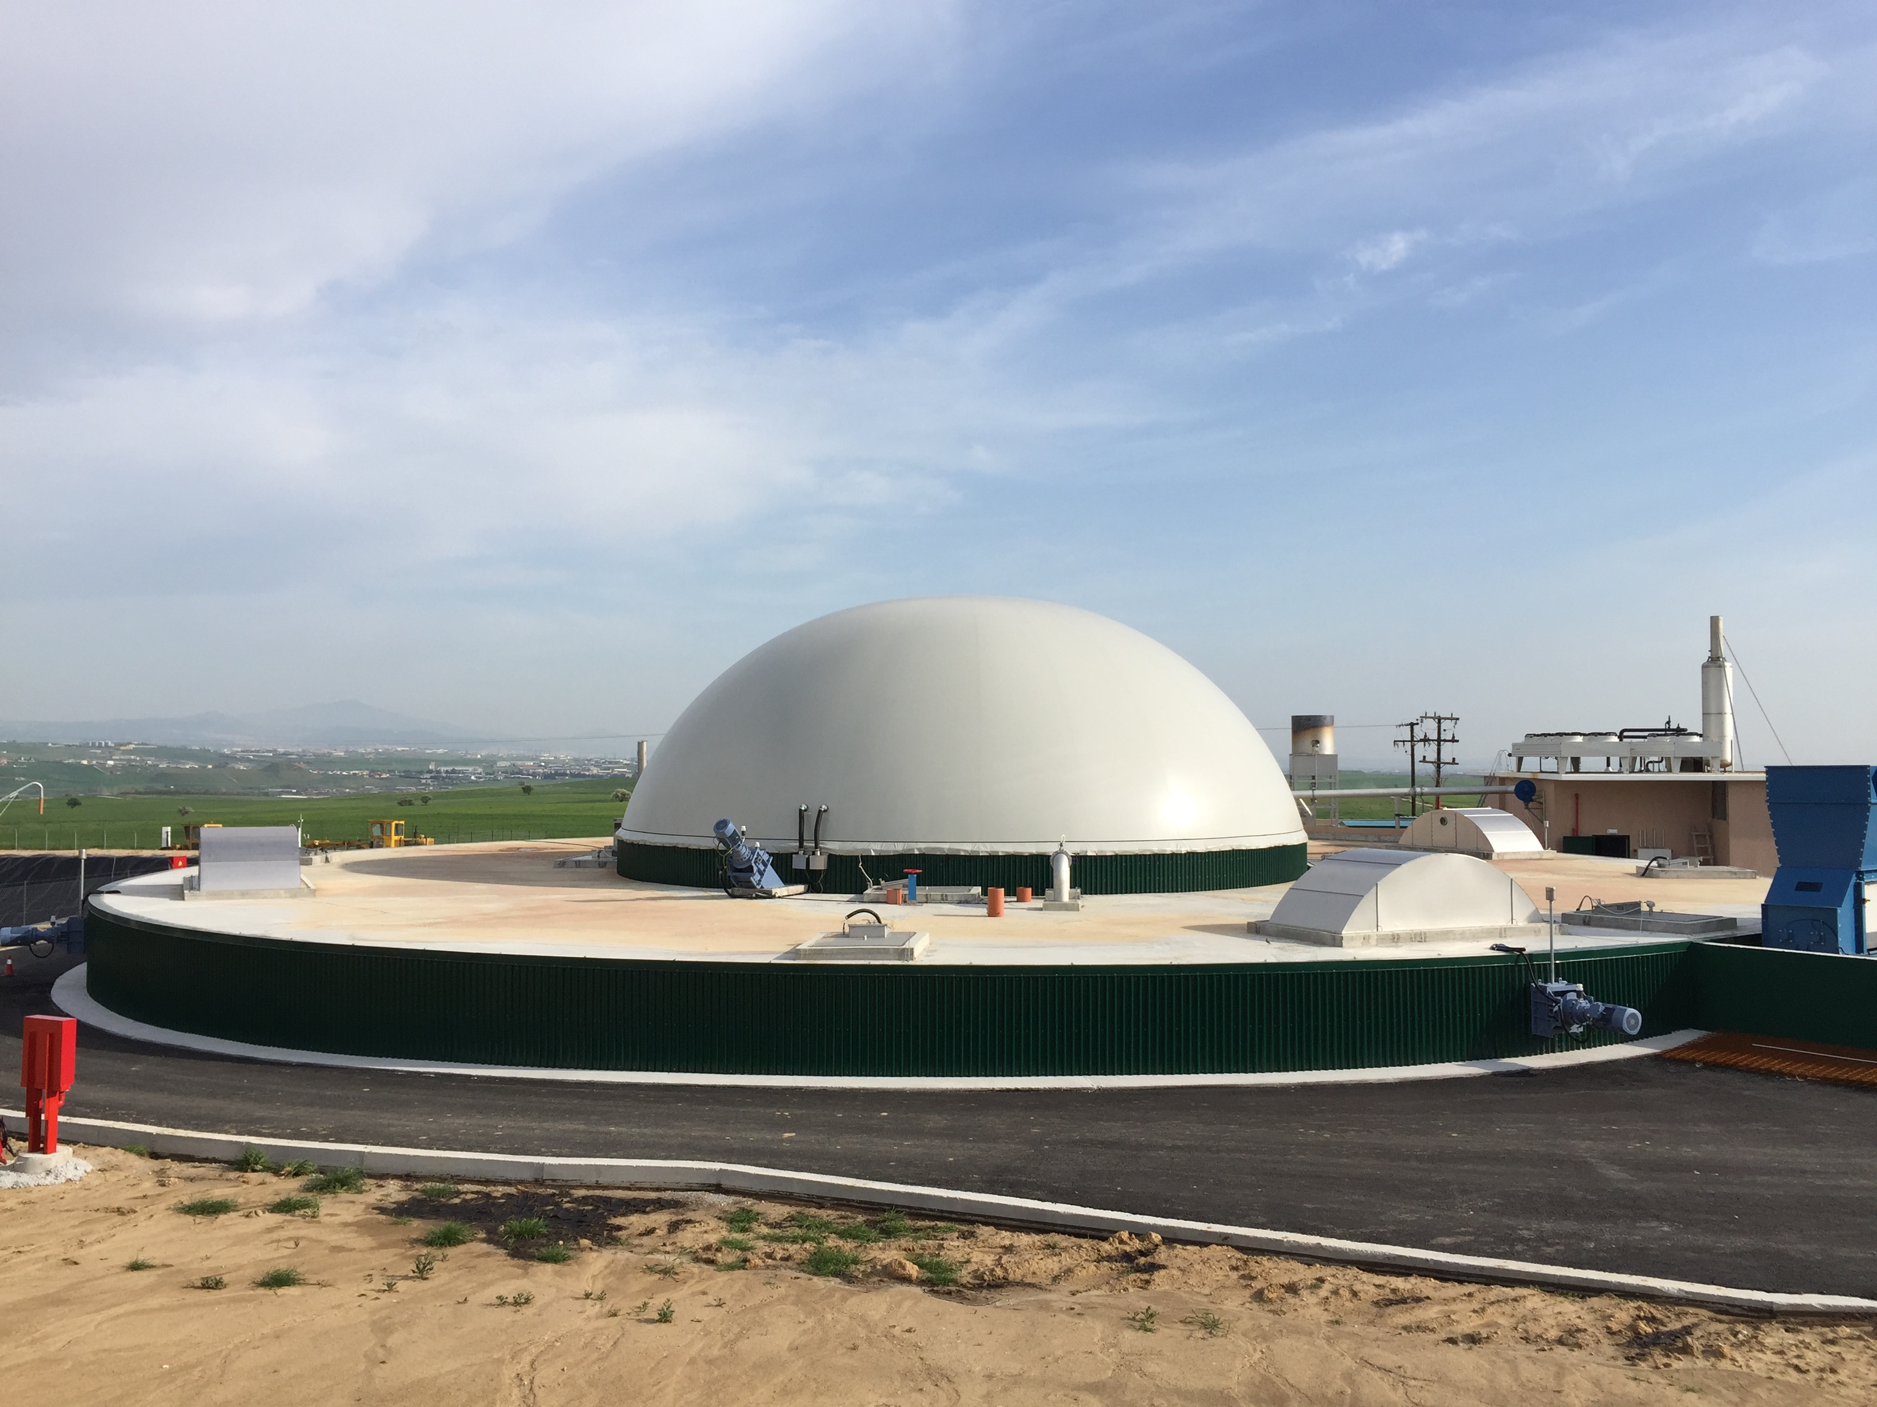
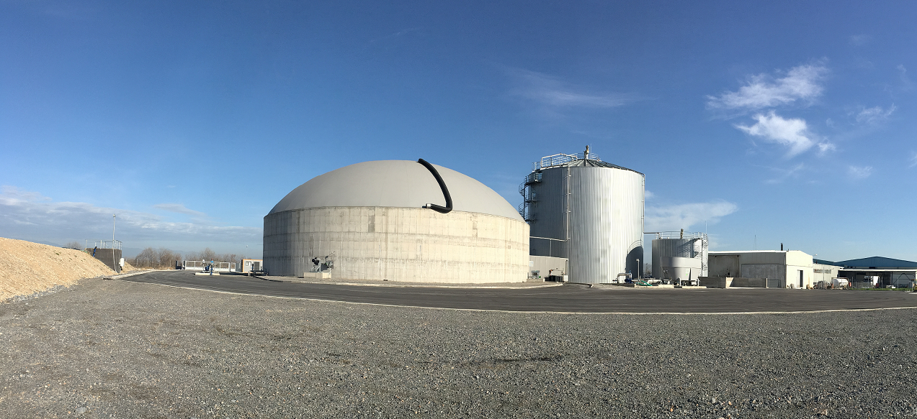
Supporting Growth and Sustainability in the Greek Economy – Biogas Market Case
04
4.2
The Story
The Status
The Benefits
Waste-to-energy projects with increased environmental and socio-economic benefits for rural areas.
Until very recently the penetration of biogas plants in the country was almost nil.
Piraeus Bank provided an organized and comprehensive approach in financing this type of investments also leveraging funds from EU Financial Instruments.
Four units already in operation ~4ΜWe
Five units under construction ~10MWe
Largest unit in Europe currently under construction 5,252MWe
An existing backlog of over 10 more units to be financed by end-2017
Mobilization of local constructors previously idle
New jobs in deprived areas
Dissemination of technology and know-how in the local market
Education of livestock owners and farmers in environmental treatment of wastes
A clear and beneficial alternative to uncontrolled disposals

Slide 15
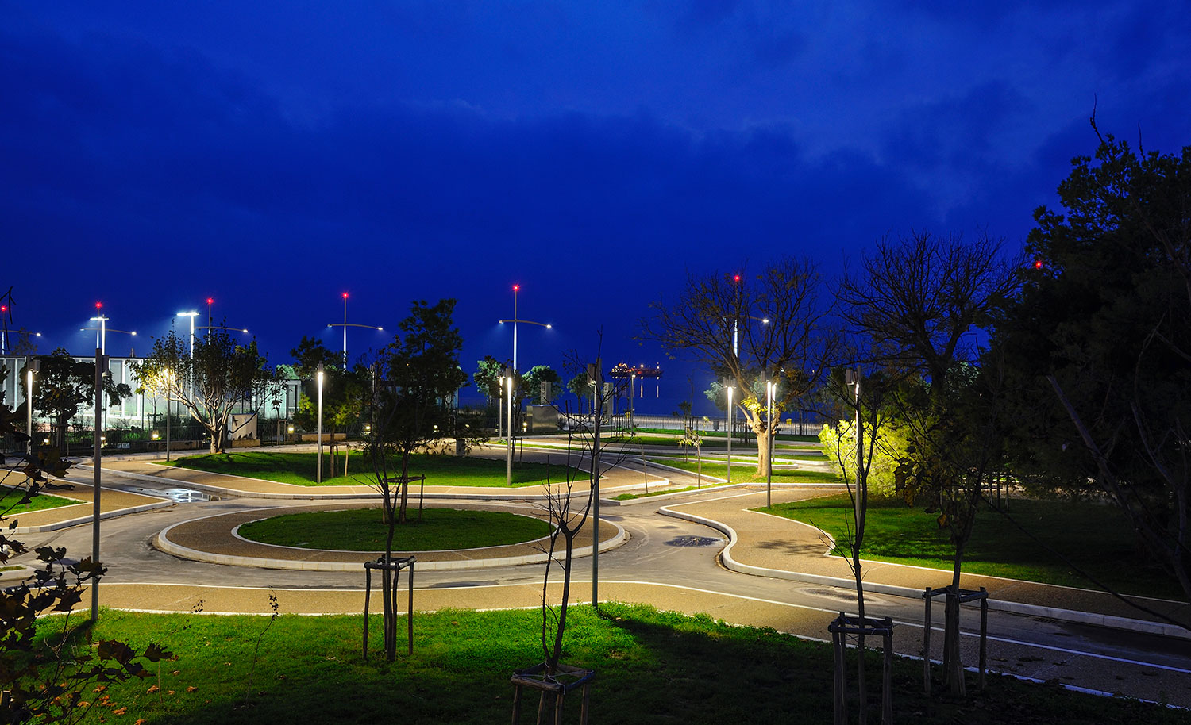
Supporting Growth and Sustainability in the Greek Economy - Street Lighting Case
04
4.3
Background
The First Breakthrough
There is a big appetite for energy efficiency / street lighting projects in Greece
Energy savings around 50-70% with the usage of newer technologies making the investments a win-win for both the sponsors and the financing parties
Significant opportunities for street lighting projects implemented by municipalities
Many efforts face constraints by the multiple approval procedures and steps until a project is actually tendered and awarded.
After a lengthy period for securing financing approvals and CoA clearance on the financing agreements, the Municipality of Thessaloniki singed the Financing Agreements with Piraeus Bank.
The project is financed under the JESSICA initiative.
It is the first project of this size (ca. €6mln) tendered in Greece
It encompasses the replacement of 2.294 bulbs and installation of 459 lighting masts and lighting tele-management system tables
The experience from this project opens a clear path for future similar projects to be implemented in the country
Its success will help overcome financing constraints because of the credit profile of municipalities via the pledge of the duties that the citizens are paying for street lighting

Slide 16
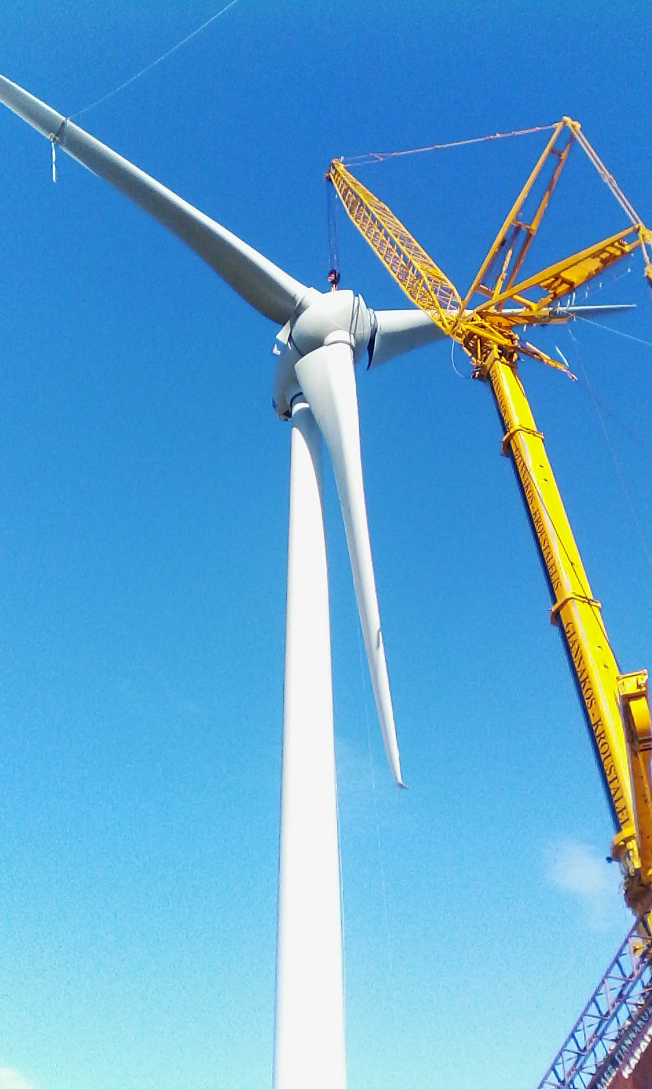

Development Banking – Focal point
04
4.4
“Development Banking” is the new, comprehensive corporate banking model sponsored by Piraeus Bank for the financing of viable investment plans and projects with multiple socio-economic benefits, which will constitute the springboard for restarting the Greek economy int.
Its central idea is the concentration and coordination of all simultaneous actions required and the activation of the appropriate tools in order to ‘turn the idea into action.’
One of the main three criteria for eligibility of investment plans in Development Banking is the contribution of investment plans to the economic and social development of the country, in terms of employment increase, environmental protection, promotion of competitiveness and the improvement of the living standards in the country.
Development Banking refers to investment plans, focusing on the following sectors of the economy:
Energy and energy efficiency
Climate change
Sustainable development
Infrastructure
Tourism
Agri-food industry
Production extroversion
Innovation and technology

Slide 17
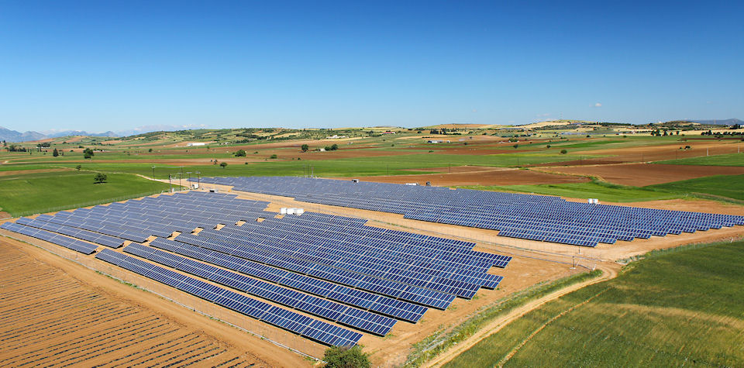
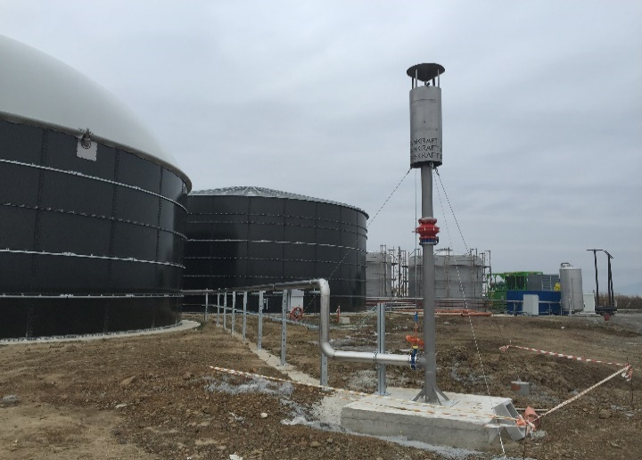
Development Banking – Four Pillars
04
4.5
Specialised Financing Solutions
European Financing Instruments
Project Finance
Real Estate Finance
Tailor-Made Financing Products
Guarantee Facilities
Project Bonds
JESSICA initiative
JEREMIE program
Global Lending Instruments (e.g. EIB Grouped Loans, IFG)
Anticipated Financial Instruments for the period 2014-2020
EFSI
Investment Funds
Consulting Services
Access to Domestic and International Investment Funds
Piraeus Bank Group Investment Initiatives (e.g. Piraeus Clean Energy Fund investing in RES)
Funds Deriving from the Domestic Market
International Investment Funds
Attracting Participation from IFIs
Financial Advisory Services
- Strategic Business Advisory
- Transaction Advisory
- Infrastructure Advisory
Technical Advisory Services
Project Management Services

Slide 18
Piraeus Bank Sustainability Statement
05
5.1
“We will also support and finance companies, institutions, organizations and projects which offer added value and which benefit people and the environment by supporting deposit account holders and investors wishing to promote individual and corporate social responsibility in a sustainable society.
We want economic development to contribute to quality of life and to focus on human dignity without jeopardizing future environmental and social indices.”
Piraeus Bank Group Executive Committee, 7 June 2010
THANK YOU FOR YOUR ATTENTION !

