Slide 1
European Banking Supervision:
The First 18 Months
Dirk Schoenmaker
Bank of Greece
Athens, 14 July 2016

Slide 2
Agenda
New system
Functioning of SSM
Euro area banking market
Assessment
3 core criteria: effectiveness, toughness and fairness
2 other criteria: efficiency and market integration
In sum: compelling start, lingering challenges
9 country reports show major differences
The Netherlands

Slide 3
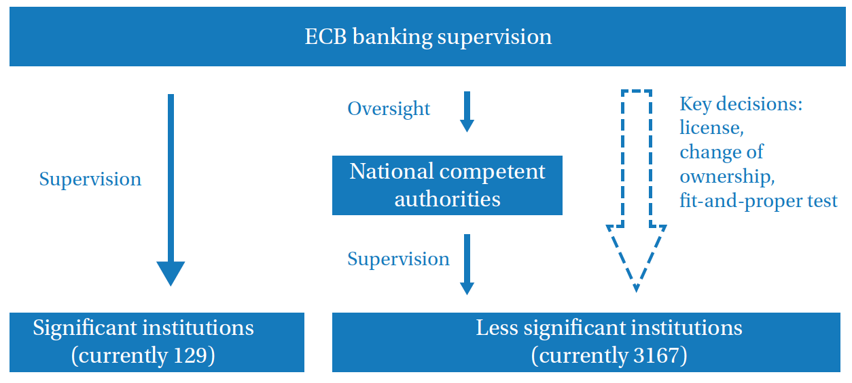
The new system

Slide 4
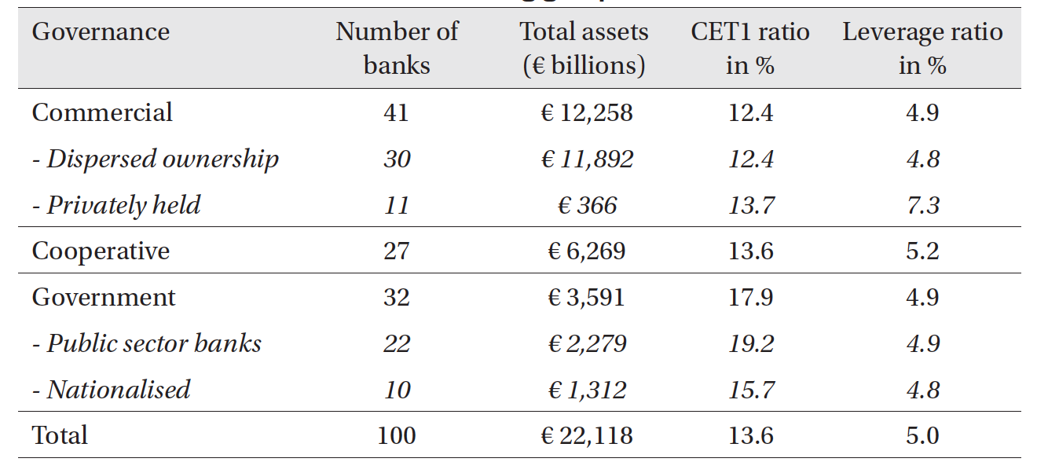
Governance of the 100 significant banks

Slide 5
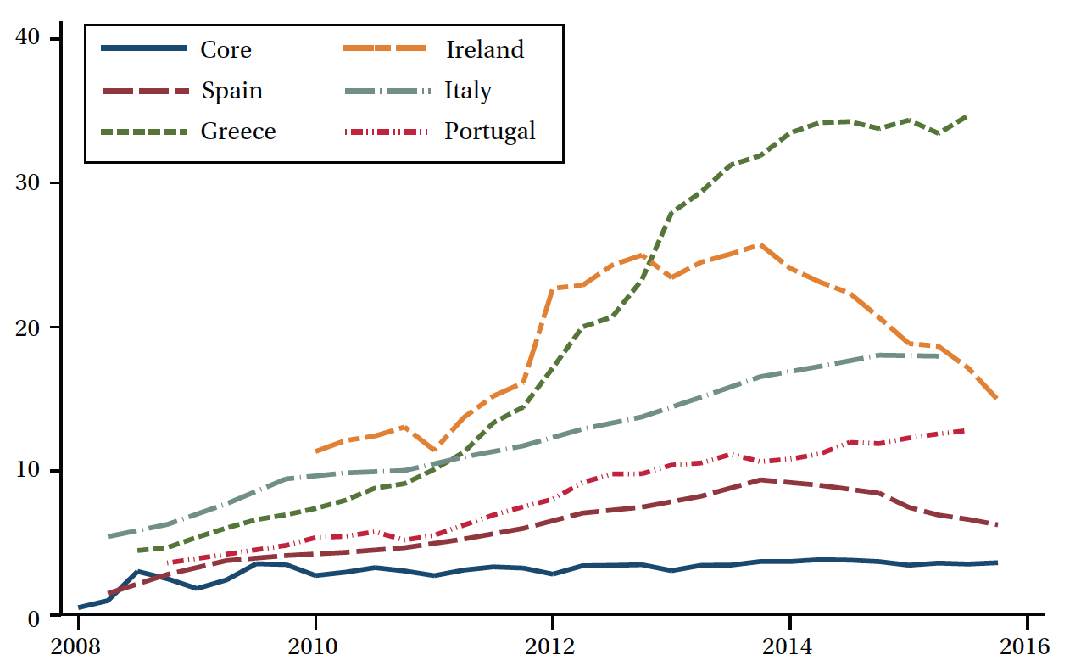
What do non-performing loans tell us?

Slide 6
1. Effective
Joint Supervisory Teams overcome previous home-host squabbles -> clear line of command
But conflict of interest: loyal to ECB or NCA boss?
Joined-up / consolidated view of banks at euro-area level
So far: banking supervision not been softened by loose monetary policy

Slide 7
2. Tough
More intrusive + less capture/political intervention
Supervisory coordinator at a distance in Frankfurt
Actions speak louder than words: more capital
higher SREP scores (pillar 2)
also tough with recap in Greece over summer 2015
but determination of SREP scores is black box

Slide 8
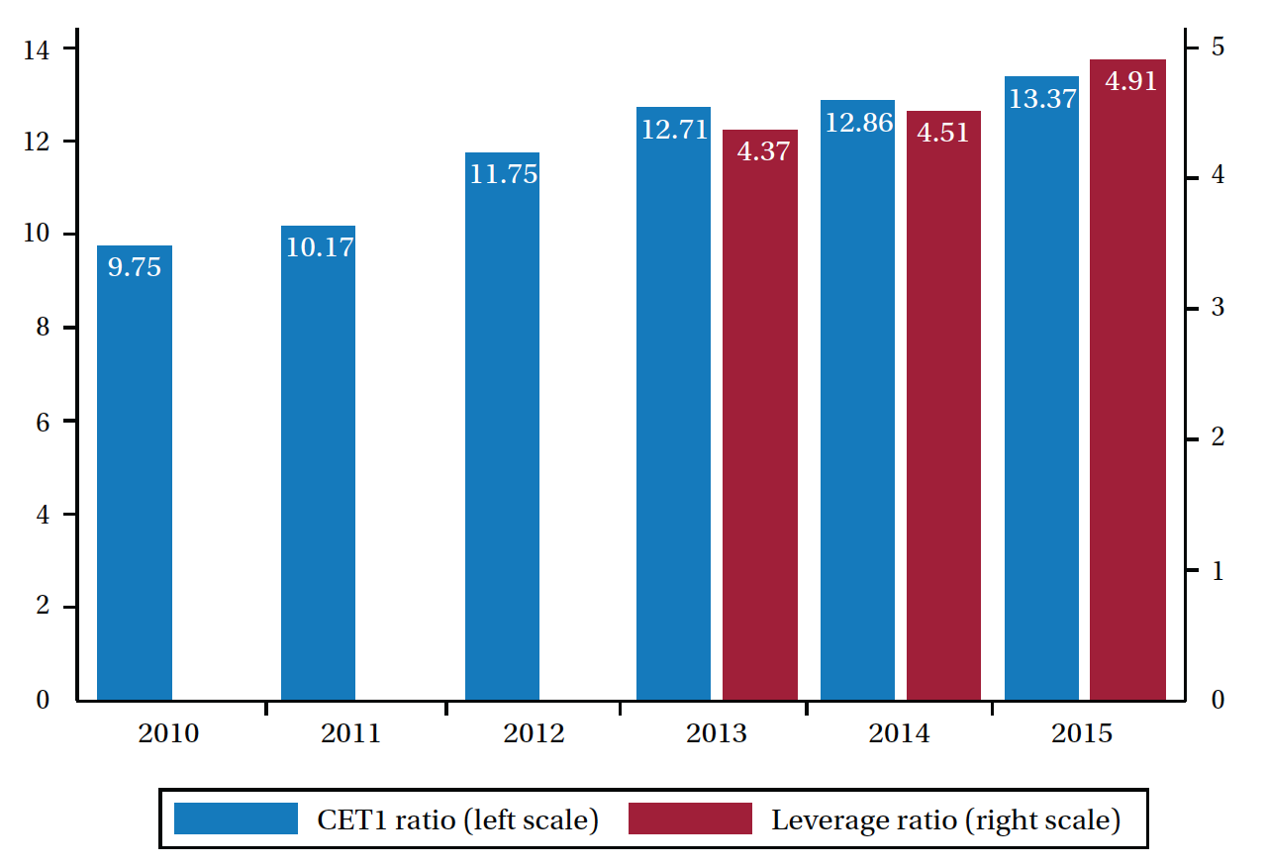

Slide 9
3. Fair
No country- or institution specific pattern at ECB
But differences in size systemic risk buffers applied by NCAs

Slide 10
4. Efficiency: areas for improvement
Bureaucratic: all decisions in Supervisory Board
Example: major delays for fit-and-proper tests
Solution: more use of delegation
Data driven: multiple and overlapping data requests
Independence requires transparency and accountability
Lack of transparancy over supervised banks
Accountability: limited access European Court of Auditors

Slide 11
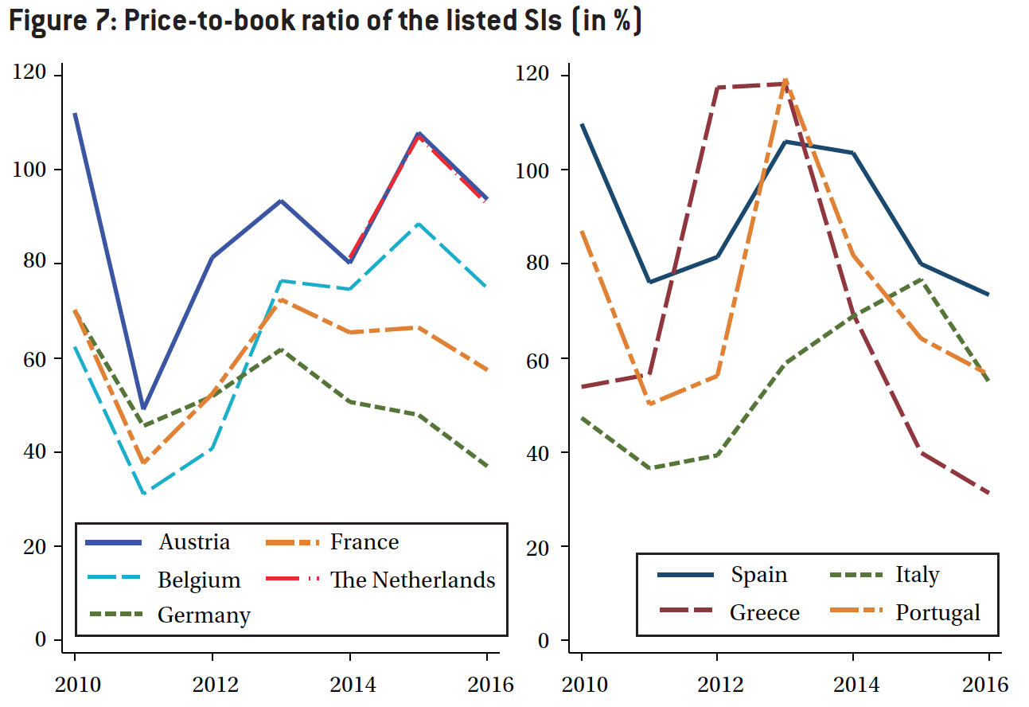
Work in progress

Slide 12
5. Single Banking Market?
Aim of Banking Union to break bank-sovereign loop
Decoupling should lead to integrated market
Unrealistic to eliminate all bank-sov links in short term
End geographical ring-fencing
Both ECB and NCAs still impose intra-€A constraints
Banks may convert subs into branches
Prospects for cross-border M&A
Need to complete Banking Union
Risk sharing: European Deposit Insurance Scheme
‘‘Risk reduction’’: limits on sovereign exposures (and stop counting deferred tax credits as capital)

Slide 13
Country-level experience
Diversity of structures/experiences/perceptions
Examples
Countries with many small banks (Austria, Germany, Italy) vs concentrated systems (e.g. France, NL)
Home (e.g. France, Germany, Italy, Spain) vs Host (e.g. Belgium, possibly Greece & Portugal in near future)
Ongoing sector-wide fragility challenges
especially Italy and Portugal

Slide 14
Thank you for your attention

