Slide 1
European Banking Supervision in Greece:
The First 18 Months
Miranda Xafa, CIGI
Bank of Greece Seminar
July 14, 2016
Notes:
1

Slide 2
Rapid consolidation in Greek banking sector since onset of crisis in 2010
Alpha
Emporiki (Crédit Agricole)
Eurobank
Postal Savings Bank
Smaller Greek banks
NBG
Piraeus
Geniki (SocGen),
Millennium (Millennium Group)
Greek branches of Cypriot banks
“Healthy” Agricultural Bank
Smaller Greek banks/cooperative banks

Slide 3
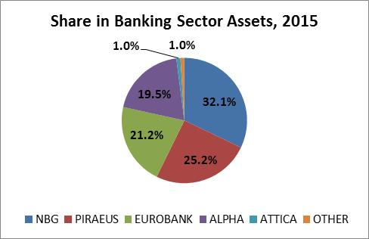
Following a wave of consolidation, the four systemic banks account for 98% of assets
Source: Banks’ annual reports

Slide 4
Events leading up to the 2015 bank recapitalization
Oct 2014: Soon after the SSM Comprehensive Assessment, political developments trigger large deposit withdrawals, funding pressures, and a rise in NPLs.
Jan 25, 2015: Radical left wins election on a defiant platform, rejecting austerity and MOU.
Feb 4, 2015: ECB withdraws waiver that permitted access to ECB funding, due to lack of credible program implementation; ELA peaks at €88bn in July.
June 26, 2015: Referendum announced for July 5; three-week bank holiday announced, capital controls imposed; ELA frozen.
July 12, 2015: After a 5-month standoff, government agrees to a third bailout funded with €86bn, o/w €25bn set aside for bank recap.

Slide 5
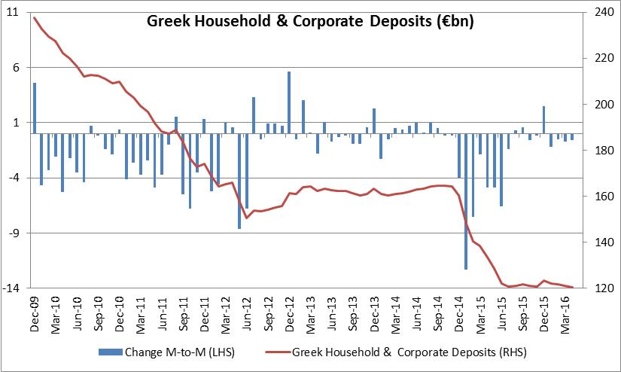
Bank deposits have halved from €240bn to €120bn during the crisis
Source: Bank of Greece
Notes:
1/3 of loss took place in 2015

Slide 6
ECB acted throughout on assumption that Greece would remain in the Euro area
“I don't want to underplay the difficulty that the ECB and the Governing Council of the ECB had in the last few weeks about having to take decisions between making sure the payment system continued to work, liquidity provision, monetary policy and not to amass excessive risk for the euro system all at the same time” (ECB Press Conference, July 16, 2015).
Draghi: ECB had to walk a tightrope between ensuring sufficient liquidity for Greek banks and putting the Euro area’s financial stability at risk.
Notes:
Conflict between monetary policy and fin stability would exist whether the two functions separate or not.

Slide 7
Whether Greek banks were still solvent in mid-2015 is debatable
“However, [...given] the enormous influence that the quality of the government paper has on the solvency of the banks, well, you question their solvency in prospective terms. [Looking] at the quality of the government paper*, but also at the quality of the overall banks' balance sheets after such a protracted recession, and therefore with a foreseeable increase in non-performing loans [...] an overall envelope of €25bn, out of a program of €86bn, was earmarked for the Greek banking system”.
On a static basis, banks fulfilled min. requirement of a CET1 capital of 4.5% and a total capital ratio of 8%, but on a forward-looking basis Greek banks were “failing or likely to fail”.
* Direct exposure to the sovereign is low (≈7% of assets), but DTAs and DTCs constitute 50% of banks’ Tier 1 capital.

Slide 8
The 2015 bank recapitalization
All parties agreed that recap should be concluded before the BRRD’s bail-in rules took effect on Jan 1, 2016 to avoid haircutting corporate deposits; aggressive timeline required rapid conclusion of AQR and stress tests.
Oct 2015: SSM found that systemic banks needed €14.4bn of additional capital (o/w €4.4bn under baseline plus €10bn under adverse scenario).
Banks managed to raise private funds to cover the baseline shortfall, thus avoiding resolution. But requiring all banks to raise capital simultaneously, in a risk-off market environment, could only be achieved at fire-sale prices (P/B = 0.30-35).

Slide 9
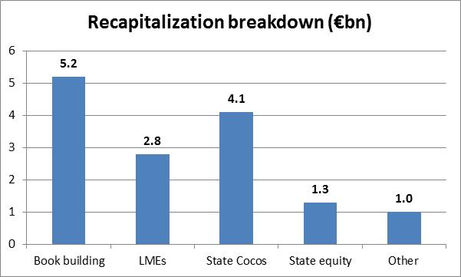
Banks raised €9bn from private investors through new equity, bail-in, asset sales
Source: HFSF; “other” refers mainly to asset sales
Notes:
Greek state contributed remaining 5.5bn through CoCos and common equity. Use of Cocos helped minimize state shareholding in the banks.

Slide 10
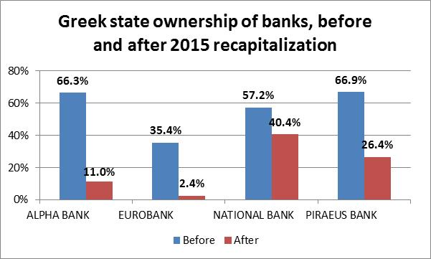
The state’s share has been diluted to minority stakes in all systemic banks
Source: HFSF

Slide 11
Minimizing the Greek state’s equity stake was a key objective
Greek state’s share diluted to minority stakes in all four banks.
MOU states that “the recapitalization framework will be developed with a view to preserving private management of recapitalized banks”; maximizing the capital raised from private investors was key objective, even if it implied massive dilution of existing shareholders (including the Greek state).
Announcement of a €25bn buffer took markets by surprise, but ultimately provided comfort that adequate backstop available.
Uncertainty (outlook, MOU implementation) explains why SSM required higher capital ratios in Greece than under 2014 pan-European assessment: 9.5% for baseline (vs. 8.0%), 8.0% for adverse (vs. 5.5%); higher Pillar-2 SREP ratios.
Notes:
Pillar-2 SREP ratios are higher, reflecting exposure to Greek sovereign risk and high level of NPLs (Supervisory Review & Evaluation Process).

Slide 12
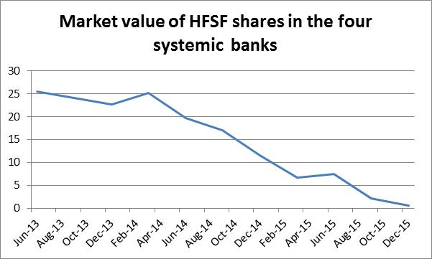
The bank shares acquired by the Greek state in 2013 are worth near-zero today
Source: HFSF
Notes:
Greek state’s share

Slide 13
NPLs at record-high level
NPEs (NPLs + performing restructured loans) amount to about 50% of loans, by far the highest in the Euro area; in mid-2015 provisions covered 40-45% of NPEs.
Unusually high level results from 8 years of recession, fears of Grexit, and erosion of payment culture.
NPEs broad-based across all sectors, rather than focused on real estate as in Ireland and Spain.
Asset quality deteriorated in 2015, as NPEs rose by 9% to €117bn.
Long-overdue legislation passed in May enabled banks to sell loans to service companies and distressed debt funds.

Slide 14
Governance
Program conditionality imposed strict criteria for the selection of bank managers, beyond the SSM’s “fit and proper” requirements, to avoid government interference in management decisions.
Ongoing assessment process of bank management and boards to signal the end of state involvement in the banking sector.

Slide 15
The case of Attica bank
Attica bank, majority-owned by engineers’ pension fund, failed to raise the full amount of additional capital requirements (€0.8bn under adverse scenario).
State-controlled enterprises were strong-armed to participate in the offering, against the effort to break the link between banks and their sovereigns.
Attica’s bank recap concluded at P/B of 0.82, far above the 0.30-0.35 range for the systemic banks.
Discussions between European supervisors and bank management ongoing regarding corporate governance and the bank’s business model.
Attica may end up in resolution; if so, earlier action would have been desirable (before capital increase, bail-in).
Notes:
P-to-B of 0.82: Presumably to avoid near-full dillution of the equity holdings of the engineers’ fund in Attica bank.

Slide 16
Conclusion
Overall, SSM viewed as justifiably strict by Greek bankers and supervisors; “tough but fair”.
SSM handled well challenges arising from 2015 Greek crisis; closely monitored situation and acted quickly to assess capital requirements.
Though size and modalities of recap can be questioned ex post, eminently sensible ex ante in view of uncertainties, need to minimize taxpayer funding and state’s equity stake.
ECB may have been too slow to take over supervision of Attica bank from BoG.

Slide 17
Thank you!

