Slide 1
The future of productivity: what can policy do?
Joint IOBE– Bank of Greece Seminar
Solving the Productivity Conundrum
Athens, 25 April 2016
Giuseppe Nicoletti
Structural Policy Analysis Division, Economics Department, OECD

Slide 2
The OECD report
Available at:
http://www.oecd.org/economy/the-future-of-productivity.htm
Book + 5 page policy note + technical papers + videos and ppt
Authors:
Müge Adalet McGowan
Dan Andrews
Chiara Criscuolo
Giuseppe Nicoletti

Slide 3
The four OECD papers I will mainly summarise here (and later developments)
"Productivity spillovers from the global frontier and public policy: Industry-level evidence", by Saia, A., D. Andrews and S. Albrizio (2015)
Frontier firms, technology diffusion and public policy: Micro evidence from OECD countries, by Dan Andrews, Chiara Criscuolo and Peter N. Gal (2015)
"Labour market mismatch and labour productivity: Evidence from PIAAC Data", by Adalet McGowan, M. and D. Andrews (2015)
"Skill mismatch and public policy in OECD countries", by Adalet McGowan, M. and D. Andrews (2015)

Slide 4
Roadmap
Why bother about productivity?
  Slowdown seems structural and is driven by MFP
Where is the problem?
  The debate and our approach
  Broken diffusion machine
  Resource misallocation
What is role of structural reform?
Conjectures and work ahead
Take aways

Slide 5
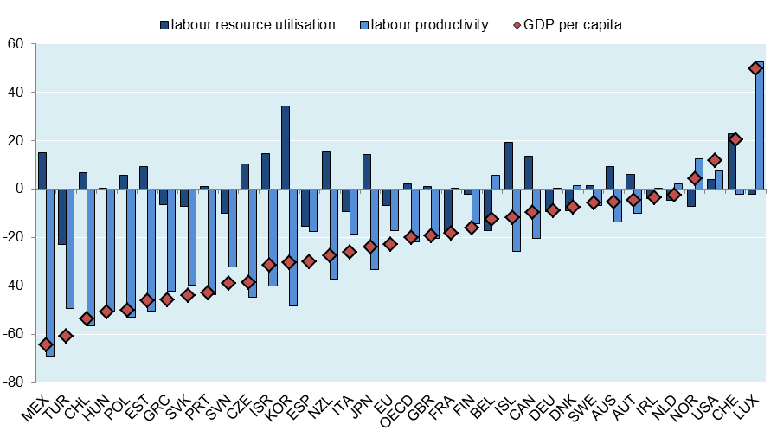
Differences in GDP per capita mostly reflect labour productivity gaps
Percentage differences compared with the upper half of OECD countries, 2013
Source: OECD Going for Growth Database.

Slide 6
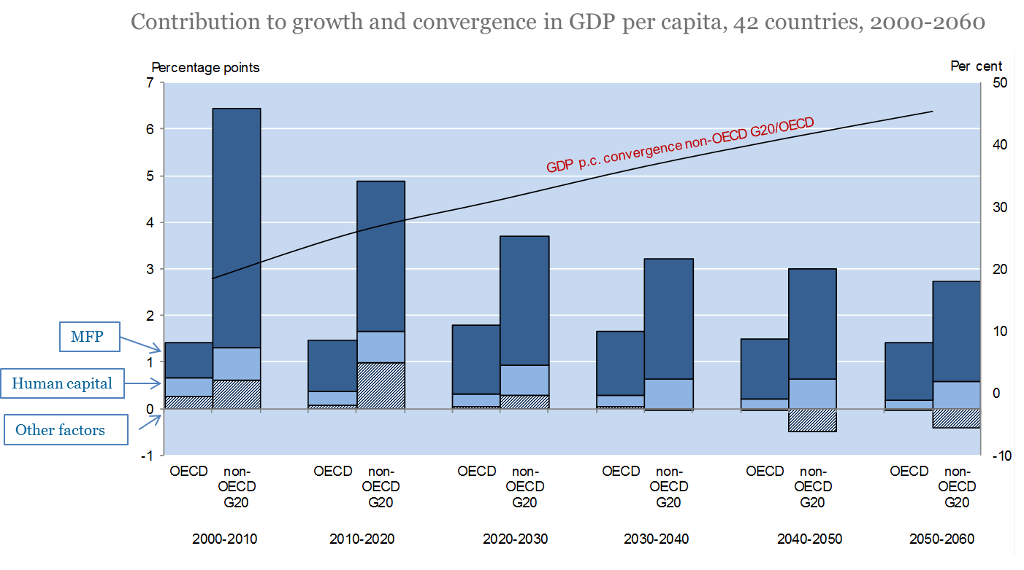
Productivity is likely to be the key driver of future growth
GDP per capita, 2000-2060
Source: Policy Challenges for the Next 50 Years, H. Braconier, G. Nicoletti and B. Westmore (2013) .

Slide 7
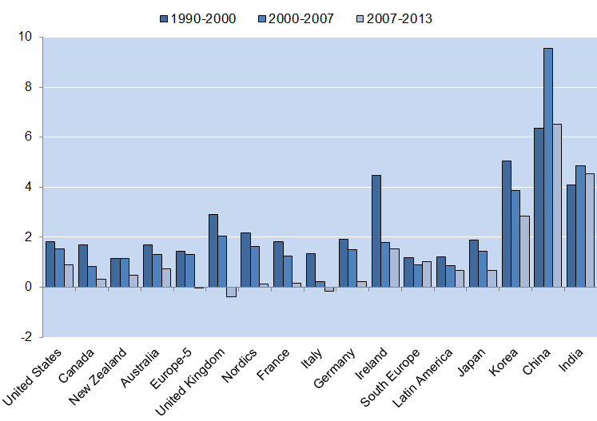
But aggregate labour productivity growth slowed, even before the crisis…
Labour productivity growth since 1990
GDP per hour worked (China and India refer to GDP per worker)
OECD calculations based on The Conference Board (2015)

Slide 8
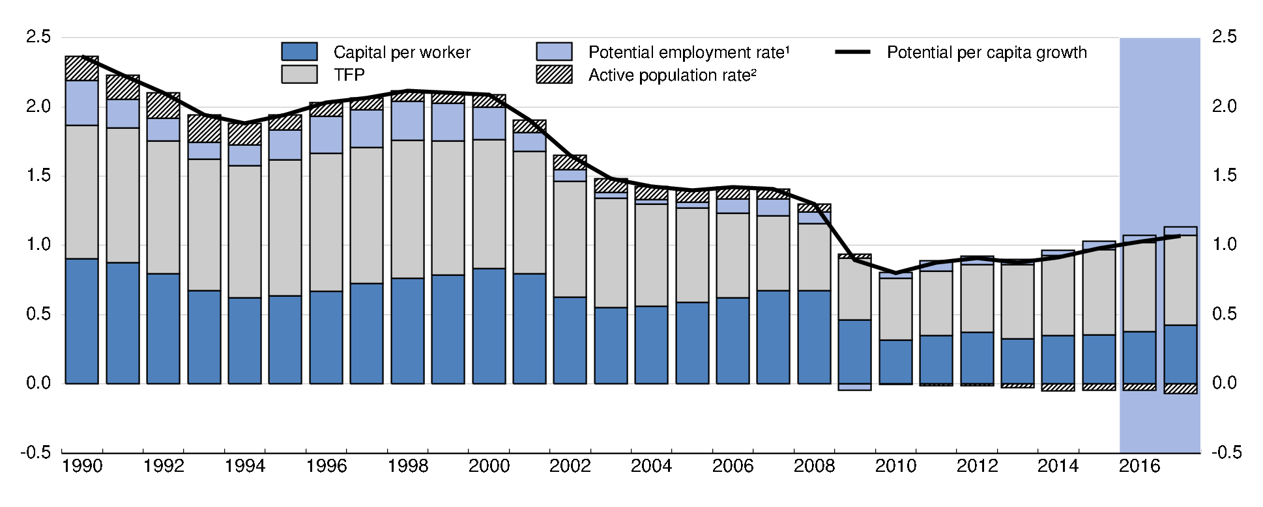
…driving the decline in potential output…
Contributions to potential per capita growth (OECD average)
Source: OECD Economic Outlook n. 98.

Slide 9
… with MFP declining pre-crisis and capital deepening weakening post-crisis…
Contributions to trend labour productivity growth in percentage points

Slide 10
Why focus on decline in MFP growth?
Decline in capital deepening is worrying but at least partly cyclical
  Gap between current and steady state levels of investment ratios around 2.5 points of GDP in a third of OECD countries (7 points in Greece)
Moreover:
  Capital has diminishing returns, ideas do not
  The very extent of steady state capital deepening depends on developments in MFP
  It is not only the sheer amount of capital and labour that matters for growth but the way it is allocated, which affects MFP
There are signs that the decline in MFP growth may be structural

Slide 11
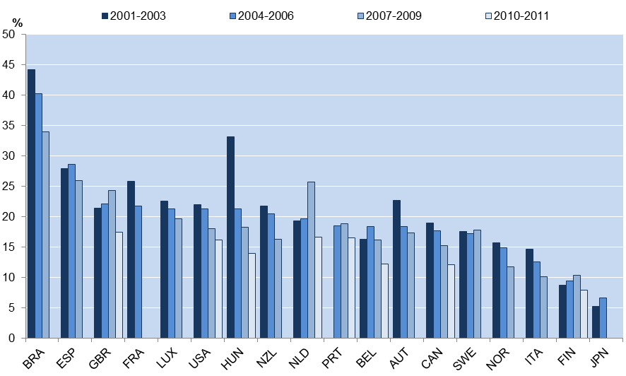
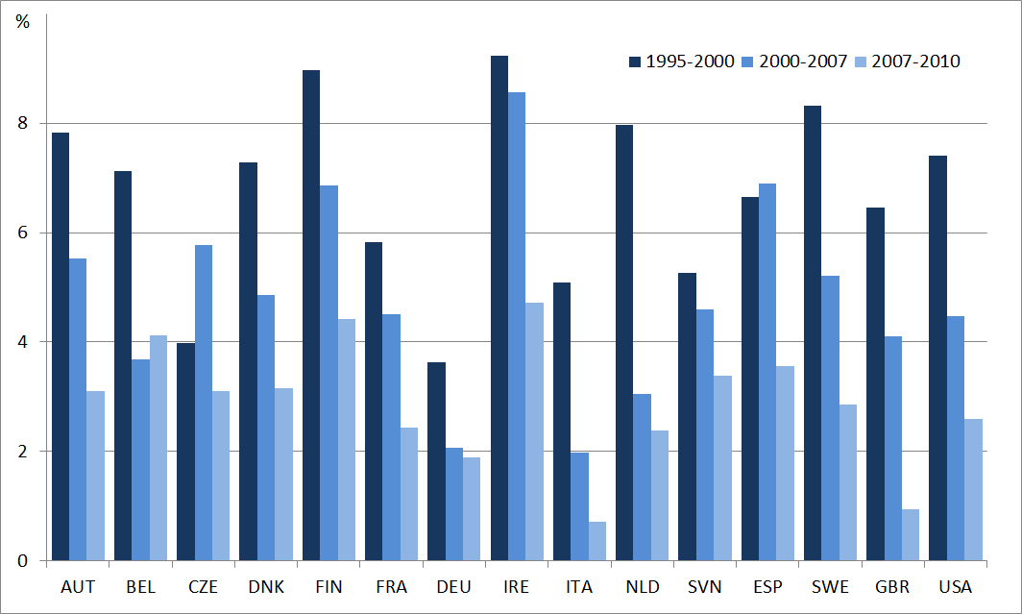
There are signs that the slowdown is structural
Start-up rates have been declining
Average annual growth
Source: C. Criscuolo, P. N. Gal and C. Menon (2014), “The Dynamics of Employment Growth: New Evidence from 18 Countries”, OECD Science, Technology and Industry Policy Papers, No. 14.
Investment in KBC has slowed down significantly
Source: OECD calculations based on Corrado et al., (2012).

Slide 12




The debate is not settled…
Pessimists:
Gordon
Fernald
Cowen (?)
…
Optimists:
Brynjolffson/McAfee
Mokyr
Jovanovic
…

Slide 13
…and there are alternative explanations
Technological factors
  Adoption and diffusion of GPT (Griliches, 1957; David, 1991; Jovanovic and Rousseau, 2005)
A “return to normal” effect …after nearly a decade of exceptional IT-fueled gains (Fernald, 2014)
Transitional productivity growth dynamics due to rising resource misallocation (Gopinath et al., 2015):
Cyclical factors – e.g. demand conditions and monetary policy (Anzoategui,et al., 2016)
Measurement (Byrne, Fernald et al., 2016; Syverson, 2016)? (…or not)
Given this uncertainty, policy-makers need to find sources of productivity growth where there is large and sure scope for improvement.

Slide 14
The sources of MFP growth
Three key sources of aggregate productivity growth:
  Innovation
  Diffusion (spillovers from frontier and catch up)
  Resource reallocation (capital, labour and skills)
Effective diffusion and reallocation are also key for encouraging innovation
Within-firm gains in productivity are magnified in the aggregate by effective resource reallocation towards high-productivity firms
All these factors are strongly influenced by policy

Slide 15
A simplified framework
Aggregate productivity growth
Innovation
Within-firm or sector gains
Within-firm or sector gains
Across-firm or sector reallocation
Across-firm or sector reallocation
Innovation spillovers from frontier
Diffusion
Catch up to the frontier via adoption
Entry and exit
Entry and exit
Structural factors
Policies and institutions

Slide 16
The issues
Using the framework, did aggregate productivity slow because:
  Slowing growth at the global productivity frontier?
  Stalling diffusion: slowing productivity convergence to the global frontier?
  Rising resource misallocation? (ongoing work)
We are focusing on obstacles to diffusion and reallocation because:
  They are closely related to widespread observed heterogeneity in firm performance
  They offer the largest scope for improving aggregate productivity
  They are most influenced by domestic policies
  If improved they also give incentives for innovation
  They have a link with inclusion (evidence of rising cross-firm wage inequality)

Slide 17
Work-horse models to investigate diffusion and reallocation issues
A spillovers from and catch-up to frontier specification
Regressing MFP growth on growth at the frontier and the distance from frontier (Griffith et al 2004; Nicoletti and Scarpetta, 2003; Bourles et al 2013; Andrews et al. 2015)
The gap terms capture the distance from the frontier:
Policy effects are captured by adding interaction and Rajan-Zingales terms
Using an Olley-Pakes decomposition of aggregate productivity
Regressing the gaps in O-P terms on interaction between policies and exposure Rajan-Zingales terms)
Using the Haltiwanger dynamic approach to the efficiency of reallocation
Regressing changes in firm size on their initial level of MFP (ongoing work)

Slide 18
First issue: what’s happening at the global frontier?
Innovation is implemented by a special kind of firm but we know little about global frontier firms
What are the characteristics of firms at the global productivity frontier?
How has the productivity performance of global frontier firms evolved over time?
Have characteristics of global frontier firms changed over time?

Slide 19
The globally most productive firms – who are they?
Source: Andrews, D. C. Criscuolo and P. Gal (2015), “Frontier firms, technology diffusion and public policy: micro evidence from OECD countries”, OECD.
“Frontier firms” corresponds to the average of the 100 globally most productive (Solow MFP) firms in each 2-digit sector. “Non-frontier firms” is the average of all other firms.

Slide 20
The globally most productive firms – who are they?
Mean characteristics: frontier and non-frontier firms, Multi Factor Productivity
Selected OECD Countries, 2005 (unless otherwise noted)
 | Global Frontier Firms |  | Non-Frontier Firms |  | Difference in means
 | Mean | Std Dev | Mean | Std Dev
 | Manufacturing
MFP | 3.73 | 0.87 | 2.35 | 0.79 | 1.4 | ***
Employment | 414 | 4996 | 231 | 2006 | 183 | *
Capital stock (€m) | 32 | 376 | 17 | 187 | 15 | *
Turnover (€m) | 308 | 2192 | 66 | 745 | 241 | ***
Profit rate | 0.57 | 0.30 | 0.13 | 8.54 | 0.45 | ***
Age | 24.4 | 21.5 | 24.9 | 20.1 | -0.5
MNE status* | 0.467 | 0.499 | 0.272 | 0.445 | 0.195 | ***
Probability
Depreciated patent stock | 2.23 | 23.26 | 1.28 | 53.16 | 0.9 | *
 | Services
Labour Productivity | 4.57 | 1.05 | 2.61 | 1.01 | 2.0 | ***
Employment | 171 | 677 | 263 | 5655 | -92 | ***
Capital stock (€m) | 31 | 345 | 19 | 322 | 11
Turnover (€m) | 152 | 657 | 60 | 848 | 92 | ***
Profit rate | 0.57 | 0.37 | 0.12 | 5.16 | 0.45 | ***
Age | 17.4 | 17.2 | 21.8 | 17.8 | -4.4 | ***
MNE status* | 0.478 | 0.5 | 0.312 | 0.463 | 0.166 | ***
Probability
Depreciated patent stock | 2.21 | 33.95 | 0.12 | 5.74 | 2.1 | **
Note: Frontier: 100 globally most productive firms within each 2-digit sector MFP definition based on Solow-residual using industry-specific but country- and time-invariant factor shares. N = 297,688. Source: see previous slide

Slide 21
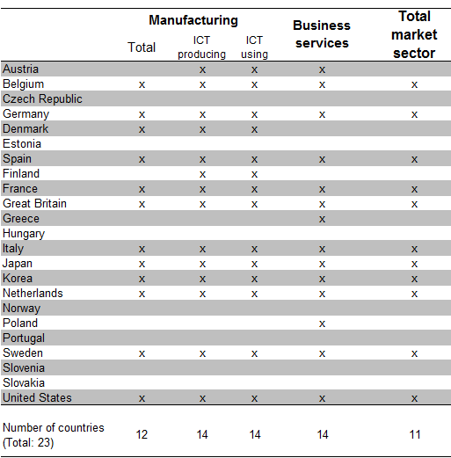
The globally most productive firms
-- coming from various countries
Source: Andrews, D. C. Criscuolo and P. Gal (2015), “Frontier firms, technology diffusion and public policy: micro evidence from OECD countries”, OECD Productivity Working Paper No. 2.

Slide 22
The globally most productive firms
-- other characteristics
Frontier firms belong to a variety of industries
Selection at frontier is harsh (less than 1/5 of them stay at the frontier after 4 years)
Frontier firms are getting older (consistent with decline in startups)
Frontier firms are getting larger (consistent with increasing market concentration)

Slide 23
Second issue: Is the diffusion machine sputtering?
Productivity research emphasizes widespread heterogeneity within narrowly-defined sectors (Syverson, 2004).
How do frontier productivity gains spread out?
Have non-frontier firms kept pace with the global frontier?
What factors might explain productivity divergence over time? (ongoing work)

Slide 24
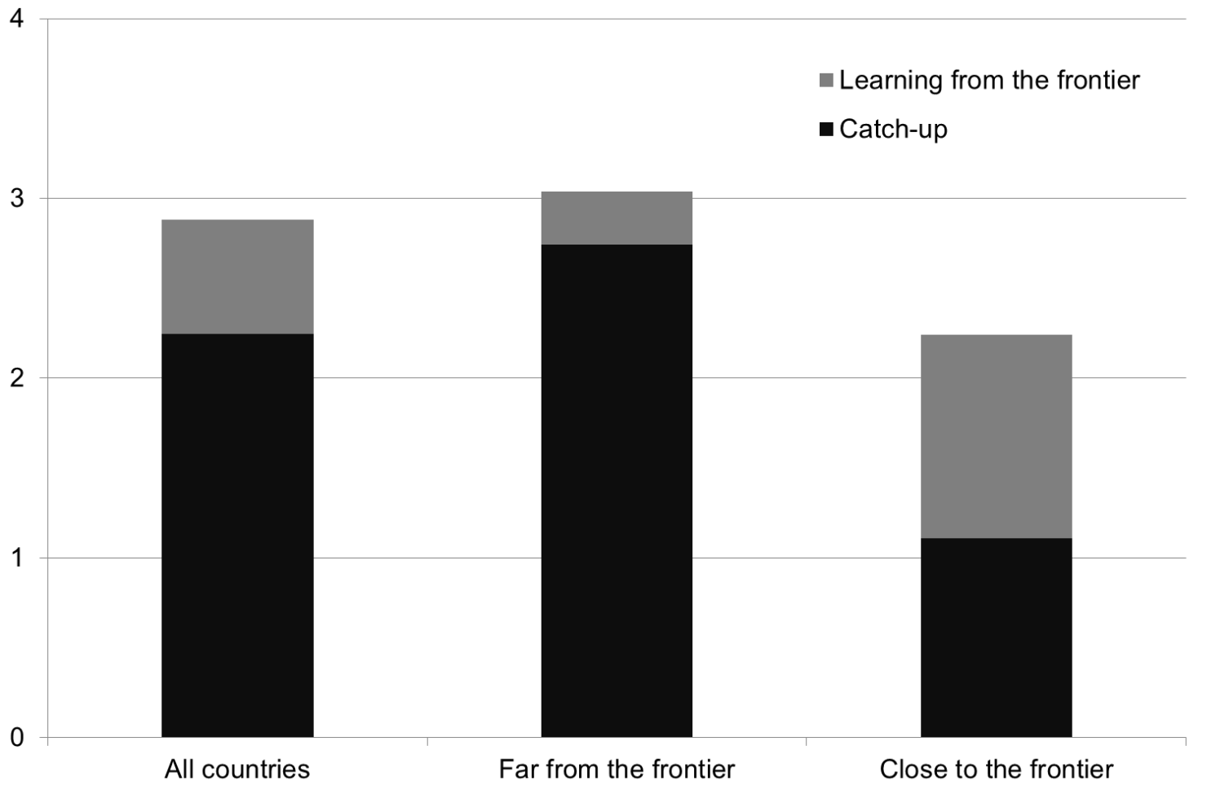
Learning from the frontier is a more important source of growth closer to the frontier
Average contribution of catch-up and learning to average annual growth in labour productivity, 1950-2013
Notes: The figure shows how the average contribution from catch-up and learning from the frontier varies with an economy’s distance from the frontier. Close to the frontier is defined as those country*year observations in the bottom quartile of the distance from the frontier distribution, while Far from the frontier refers to all other country*year observations. The estimates are calculated from a regression of growth in labour productivity on frontier growth and lagged distance from the frontier, where the United States is the frontier economy and is thus excluded from the regression. The data are averages over 5-year intervals and the regression also controls for country fixed effects and 5-year time fixed effects. The estimation is based on an unbalanced panel of 60 countries over the period 1950-2013.
Source: Saia, A., D. Andrews and S. Albrizio (2015)

Slide 25
The pull of the global frontier is less than that of the national one
Regressing MFP growth on the distance from the national and global frontier
Source: Andrews, D. C. Criscuolo and P. Gal (2015), “Frontier firms, technology diffusion and public policy: micro evidence from OECD countries”, OECD Productivity Working Paper No. 2.

Slide 26
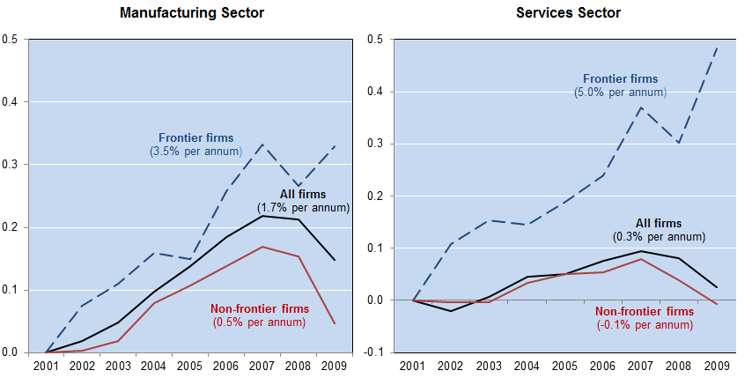
The breakdown of the diffusion machine
The global frontier has kept growing but spillovers to other firms declined
Labour productivity; index 2001=0
Source: Andrews, D. C. Criscuolo and P. Gal (2015), “Frontier firms, technology diffusion and public policy: micro evidence from OECD countries”, forthcoming OECD.
“Frontier firms” corresponds to the average labour productivity (value added per worker) of the 100 globally most productive firms in each 2-digit sector in 2001. “Non-frontier firms” is the average of all other firms. “All firms” is the sector total. Robust to: i) using different measures of productivity (e.g. TFP); ii) following a fixed group of frontier firms over time; and iii) excluding firms that are part of a multi-national group (i.e. headquarters or subsidiaries) where profit shifting activity may be relevant.

Slide 27
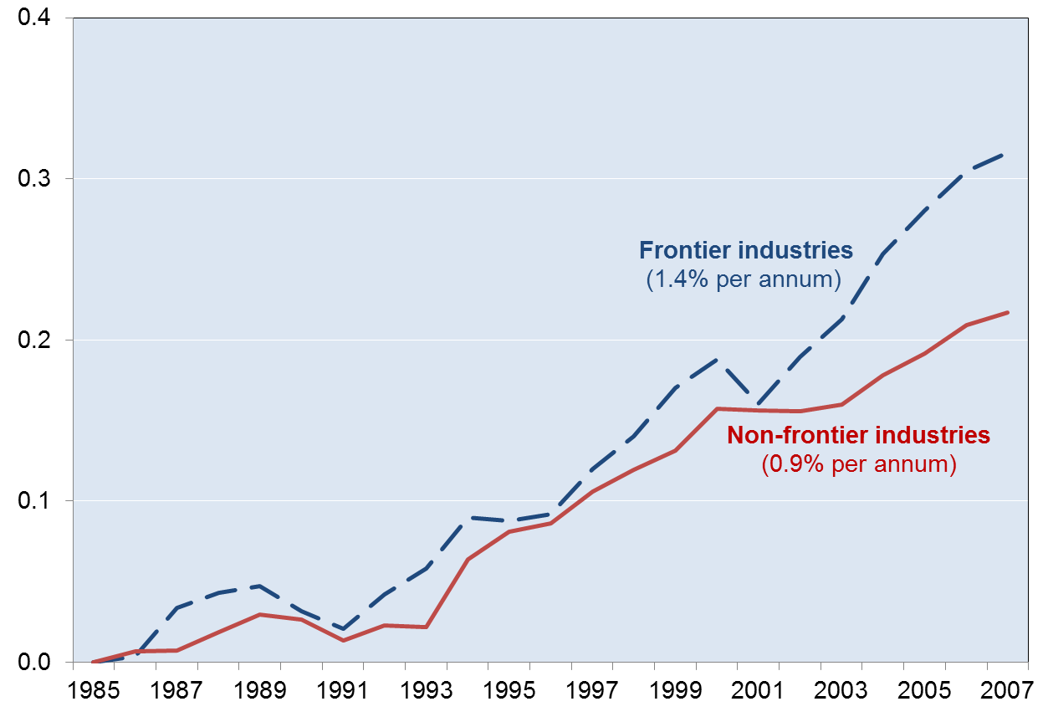
Industry-level data also show divergence from early 2000s
Unweighted average of TFP in the non-farm business sector; index 1985=0
Source: OECD calculations based on Bourles et al (2013) dataset.

Slide 28
Diffusion comes easier to some economies than others
Three major structural factors were identified by OECD research:
  Connectedness to markets where frontier firms operate, via trade
  Efficiency of the reallocation mechanism
  Quantity and quality of the knowledge-based capital stock (e.g. managerial capital, R&D stock)
Each of these factors increases significantly the ability to benefit from frontier growth

Slide 29
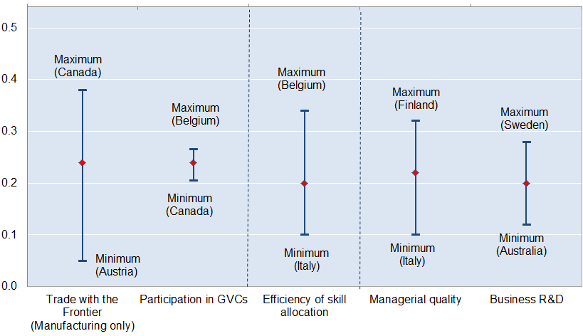
Diffusion comes easier to some economies than others
Estimated frontier spillover (% pa) associated with a 2% point increase in MFP growth at the global productivity frontier
Globalisation
Reallocation
Knowledge-Based Capital
Source: Saia, A., D. Andrews and S. Albrizio (2015), “Public Policy and Spillovers From the Global Productivity Frontier: Industry Level Evidence”, OECD Economics Department Working Papers, No. 1238.

Slide 30
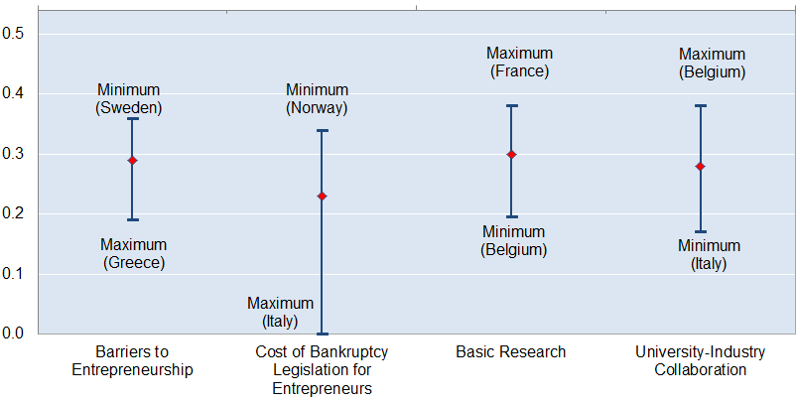
…and policies help explain why
Estimated frontier spillover (% pa) associated with a 2% point increase in MFP growth at the global productivity frontier
Entry and Exit
Innovation policies
Source: Saia, A., D. Andrews and S. Albrizio (2015), “Public Policy and Spillovers From the Global Productivity Frontier: Industry Level Evidence”, OECD Economics Department Working Papers, No. 1238.

Slide 31
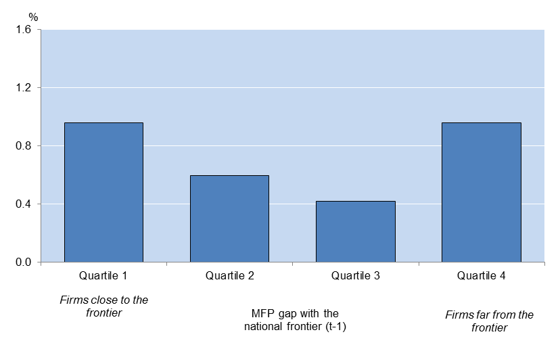
Much scope for national policies to influence catch-up
Catch-up to the national frontier is easier in countries with less stringent product market regulations (PMR) and higher business-university collaboration.
Impact of policy reforms on the MFP growth of laggard firms, 2005
Reducing PMR from high level in Greece to the OECD average
% difference between industries with high and low firm churning
Source: Andrews, D. C. Criscuolo and P. Gal (2015), “Frontier firms, technology diffusion and public policy: micro evidence from OECD countries”, OECD Productivity Working Paper No. 2.

Slide 32
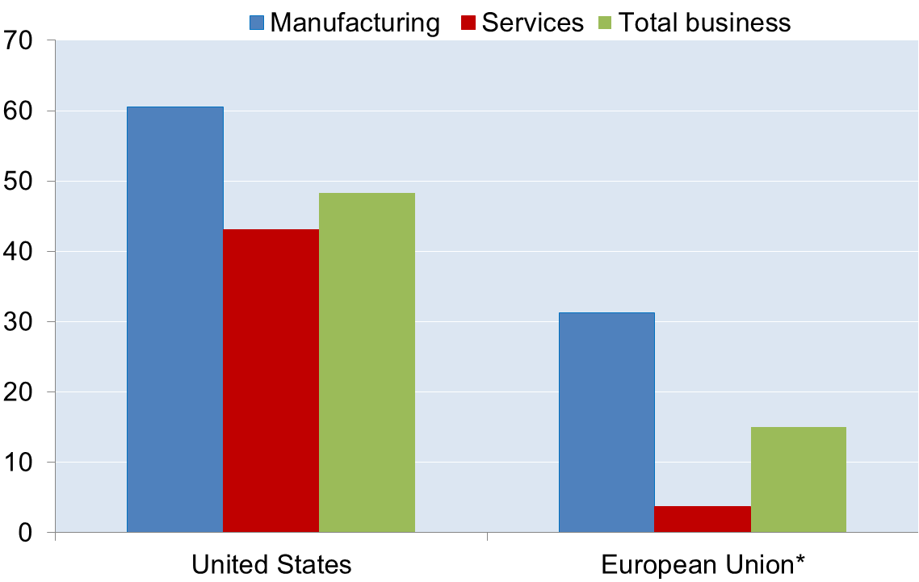
Third issue: What is the role of misallocation?
Contribution of the allocation of employment across firms
to the level of labour productivity; per cent
Europe does a poor job at channelling resources to more productive firms, esp. in market services
Source: Andrews, D. and F. Cingano (2014), “Public Policy and Resource Allocation: Evidence from Firms in OECD Countries”, Economic Policy, No. 29(78), pp. 253-296.

Slide 33
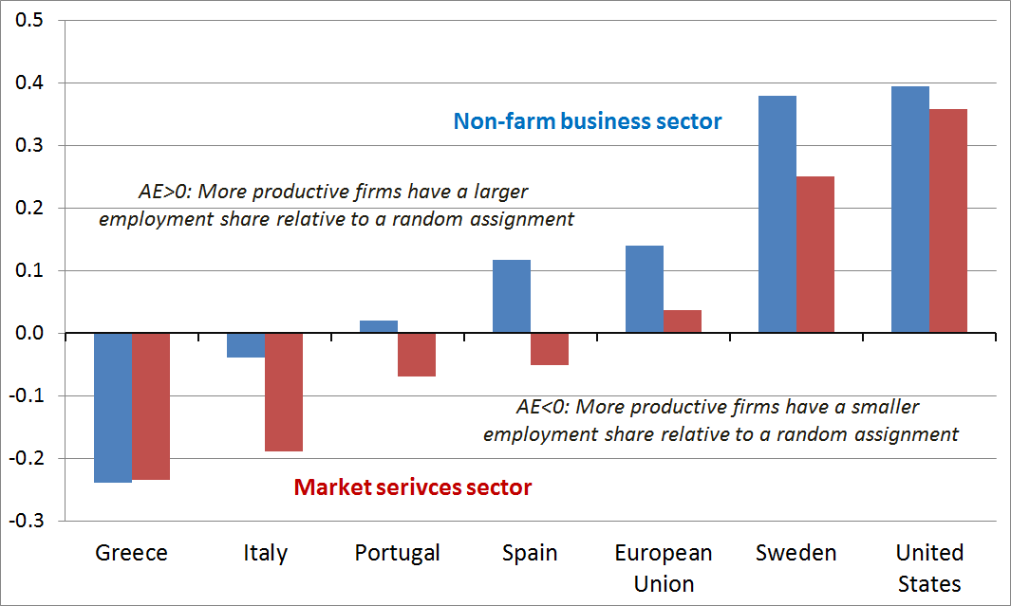
Resource misallocation is widespread in Southern Europe
Static allocative efficiency: contribution of the allocation of employment across firms to labour productivity; log points
Source: Andrews and Cingano (2014), “Public Policy and Resource Allocation”, Economic Policy 29(78), pp. 253-296.

Slide 34
Misallocation of resources may have increased since the early 2000s
Preliminary evidence from OECD and other sources suggests that the efficiency of reallocation has declined in some countries before and during the recent crisis, e.g.:
  The ability of directing investment towards the most productive firms appears to have decreased in Southern Europe (e.g. Spain, Italy)
  The “creative destruction” process has become less effective, with startups declining (see above) and the share of “zombie firms” in many OECD economies increasing over time
  The “cleansing” effect of the Great Recession has been more limited than in past recessions (e.g. US)

Slide 35
The ability of successful firms to grow differs across countries
Post-entry growth - average size of young and old firms
Source: C. Criscuolo, P. N. Gal and C. Menon (2014), “The Dynamics of Employment Growth: New Evidence from 18 Countries”, OECD Science, Technology and Industry Policy Papers, No. 14.

Slide 36
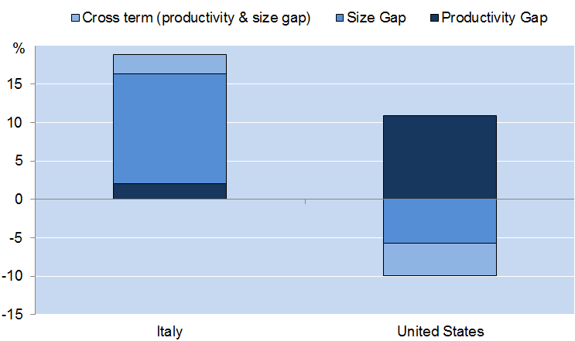
Allowing frontier firms to grow can have a strong impact on aggregate productivity
How much higher would overall manufacturing sector labour productivity
be if national frontier firms were as productive and large as GF firms?
NF firms in Italy have productivity levels close to the GF but they are relatively small
… partly because scarce resources are trapped in many small and old firms
Source: Andrews, Criscuolo and Gal (2015), “Frontier firms, technology diffusion and public policy: micro evidence from OECD countries ” OECD Mimeo.

Slide 37
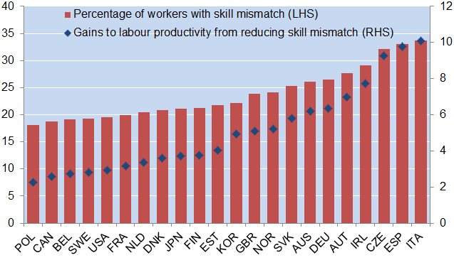
Skill mismatch constrains labour productivity
Source: Adalet McGowan, M and D. Andrews (2015), “Labour market mismatch and labour productivity: evidence from PIAAC data ” OECD Economics Department Working Paper, No. 1209.
Skill mismatch, particularly over-skilling, is harmful for productivity because it
constrains the ability of innovative firms to attract skilled workers and grow

Slide 38
Reallocation efficiency is influenced by policy…
Contribution of the allocation of employment across firms
to the level of labour productivity; per cent
More than ½ of the US-EU gap is due
to differences in market regulation
Andrews, D. and F. Cingano (2014), “Public Policy and Resource Allocation: Evidence from Firms in OECD Countries”, Economic Policy, No. 29(78), pp. 253-296.

Slide 39
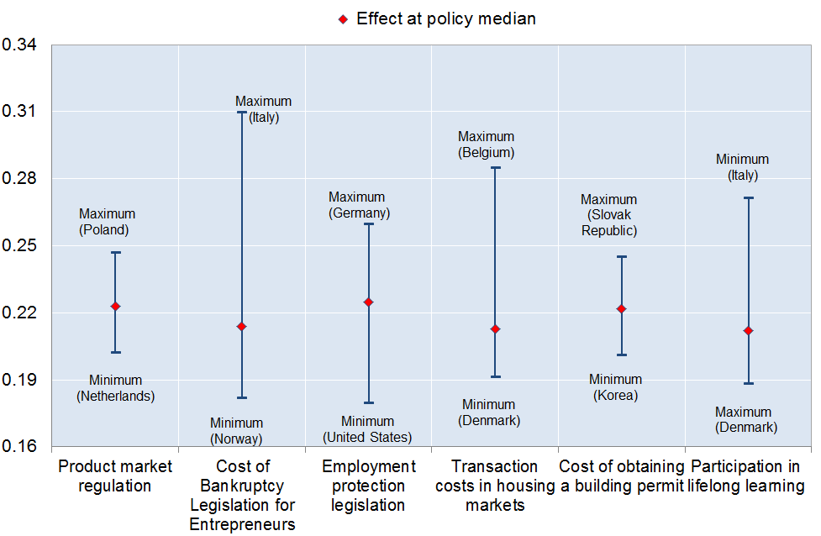
… as is the degree of skill mismatch
The probability of skill mismatch and public policies
Entry and Exit
Labour mobility
Education
Source: Adalet McGowan, M and D. Andrews (2015), “Skill mismatch and public policy in OECD countries” OECD Economics Department Working Paper, No. 1210.

Slide 40
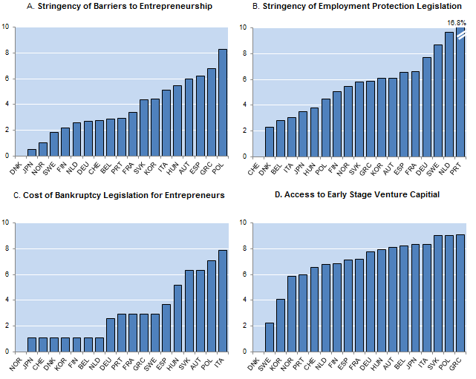
Policy reforms that facilitate the growth of national frontier firms
Impact of policy reform to best practice on level of industry productivity
% difference between industries with high and low exposure to the policy
Source: Andrews, Criscuolo and Gal (2015), “Frontier firms, technology diffusion and public policy: micro evidence from OECD countries ” OECD Mimeo.

Slide 41
Work ahead and some conjectures
More accurate data and more work is needed to explore the evolution of diffusion and reallocation and the role of structural and policy factors
Why would productivity spillovers and the efficiency of resource reallocation decline over the past decade or so?
  Technology-related factors?
    “Winner takes all”
    Replication and diffusion of the “magic bundle” (tech+skills) more difficult
  Incentives and opportunities thwarted by inadequate institutions?
    Inappropriate design of IPRs
    Obsolete regulations and barriers to entry, especially in services, especially in Europe
    Market size a limiting factor in some areas, e.g. EU internal market for services
  Vested interests and lobbies resisted the penetration of new business models using new technologies, especially in services
  Easy credit, bank forbearance (linked to NPLs) and inappropriate insolvency regimes contributed to capital misallocation and the survival of zombie firms
  Declining competitive pressures in the most dynamic sectors

Slide 42
Take aways
The productivity slowdown is a serious structural issue that deserves the attention of researchers and policy-makers
There are signs that slowing diffusion and rising misallocation of resources have played a role and may have been aggravated by the crisis
As the causes and drivers of the slowdown are multifaceted, a panoply of structural (and perhaps macro) policies are needed
There is evidence that a number of structural policies can help reverse the slowdown, independent of its precise causes
But better understanding the nature and sources of the slowdown as well as the specific weaknesses in each country via a granular approach is essential to identify the most effective mix of policies

Slide 43
Other related and relevant OECD papers
"Public policy and resource allocation: Evidence from firms in OECD countries" by Andrews, D. and F. Cingano (2012)
"Do resources flow to patenting firms? Cross-country evidence from firm level data" by Andrews, D., C. Criscuolo and C. Menon (2014)
“Cross-country Evidence on Start-Up Dynamics” by Calvino, F., C. Criscuolo and C. Menon (2015)
“The Dynamics of Employment Growth: New Evidence from 18 Countries” by Criscuolo, C., P. Gal and C. Menon (2014)
"Knowledge-based capital, innovation and resource allocation" by Andrews, D. and C. Criscuolo (2013)

Slide 44
Spares

Slide 45
Current investment-GDP ratios are below what is needed to resume pre-crisis potential growth
Current and required steady-state levels of investment ratios
Non-residential investment as a percentage of potential GDP
Source: OECD Economic Outlook 97 database; Lewis et al. (2014); and OECD calculations
The gap is more than 2.5 points of GDP in a third of OECD countries
The rising role of fast-depreciating intangibles would require even stronger investment ratios
And so would do raising potential growth above pre-crisis rates

Slide 46
Data (I)
Cross-country firm-level data Orbis
The only source with a wide coverage
  23 OECD countries, 2001-2009
  Both manufacturing and services, large and small firms
  Balance sheets and income statements
  Matched with patenting data and ownership linkages
Limitation: coverage varies across countries and over time
  Developed EU countries generally more complete
  20+ employees subsample to alleviate this
  Extensive robustness checks
  (sample, measurement, etc.)
Ongoing work using updated data from circa 1997-2014

Slide 47
ORBIS coverage
Peter N. Gal (2013), Measuring Total Factor Productivity at the Firm Level using OECD-ORBIS, OECD Economics Department Working Papers No. 1049

Slide 48
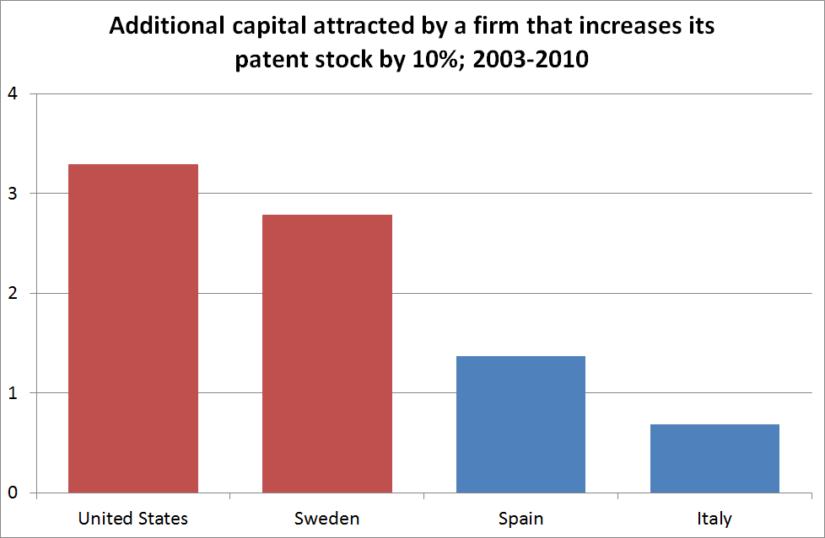
Capital reallocation to innovative firms
Source: Andrews D, C Criscuolo and C Menon (2014), ‘Do Resources Flow to Patenting Firms? Cross-country Evidence from Firm Level Data’, OECD Economics Department Working Papers No 1127.

Slide 49
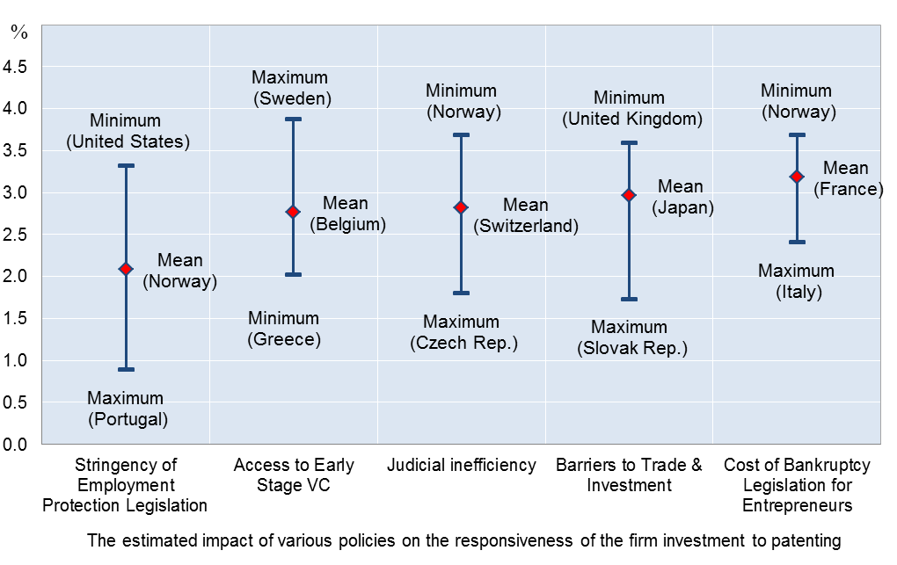
Policy reforms and dynamic capital reallocation
Additional capital attracted by a firm that increases its patent stock by 10%
Source: Andrews D, C Criscuolo and C Menon (2014), ‘Do Resources Flow to Patenting Firms? Cross-country Evidence from Firm Level Data’, OECD Economics Department Working Papers No 1127.

