Slide 1
Post-crisis Challenges for the Serbian Economy

Slide 2
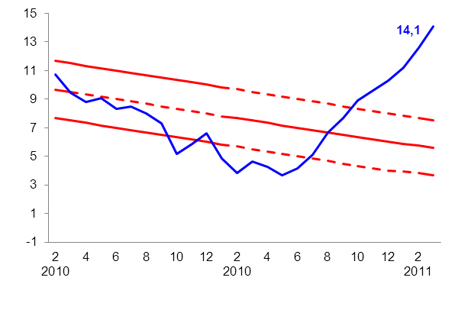
Inflationary Pressures from H2 2010
Rolled Over to 2011
Inflation rose in March 2011,
as pressures from food prices persisted
Though expected to go up in the next couple of months, annual inflation should fall back towards the target band by the end of 2011
Chart 1 CPI Developments
(y-o-y rates, in %)
Chart 2 Inflation Projection
(y-o-y rates, in %)
Source: February Inflation Report
In March 2011, inflation measured 14.1% y-o-y, which is above the upper bound of the target.
Core inflation (CPI net of administered prices, fruits & vegetables and oil products prices) came at 13.2% y-o-y.
Prices of fruits and vegetables increased by 39.3% y-o-y.
Administered prices rose 10.4% y-o-y.
We expect y-o-y inflation rates to remain high throughout H1 2011.
Key inflationary factors in H1 expected to come from a rise in regulated prices and strong pressures from food and oil prices.
On the other hand, low demand and restrictive monetary policy will tend to bring inflation towards the goal in H2 2011 and 2012.

Slide 3
Slow but Sustainable Recovery Based on Growth in Net Exports and Investments to Continue in 2011
After a drop in Q4 2010, we expect net export led GDP growth in Q1 2011
GDP expected to grow faster in 2011 and 2012
Chart 3 GDP Developments
(seasonally adjusted, Q1 2006=100)
Chart 4 GDP Growth Projection
(y-o-y rates, in %)
Source: February Inflation Report
In Q4 2010 seasonally adjusted GDP declined by 1.0%.
GDP growth in 2010 is 1.7% (contributions: C -1.2, I +1.7, G -0.6, (X-M) +1.8 pp).
Based on current movements of economic activity indicators, we expect GDP recovery in Q1 2011 ((3.0%, y-o-y), led by private investments..
Past depreciation of dinar against euro (together with rising world prices of base metals and food) should continue to boost export led growth as the economic recovery of Serbia’s export partners gathers pace.
We also expect significant contribution from capital investments in years to come.
GDP growth in 2011 estimated at around 3%, and further acceleration is expected in 2012.

Slide 4
Current Account Deficit Narrowed due to a Stronger Growth in Export
After the 2008 crisis, export is recovering faster than import
Current account deficit in 2010 was three times lower than in 2008
Chart 7 Export and Import
(seasonally adjusted, 2008=100)
Chart 8 Current Account Deficit and Remittances
(% share in GDP)
In 2010, export and import in EUR grew by around 23.8% and 9.7%, respectively.
Coverage of imports by exports has risen from app. 45% prior to the 2008 crisis to around 60% in 2010.
In February 2011, export regained pace, while import declined.
At the moment, export is 19% above its pre-crisis level, whereas import is 19% below.
Strained access to external financing and depreciation of dinar caused a drop in trade deficit. Together with record high remittances (€3.2bn) this resulted in a sharp decline of the current account deficit (CAD) in 2009.
In 2010, CAD was around €2.1bn (7.2% of GDP), and in 2011 is expected to be contained at around €1.9bn (6.1% of GDP).

Slide 5
High Country Risk Premium Influenced Exchange Rate and Real Interest Rate
Following a 9% nominal depreciation in 2010, dinar has been appreciating in early 2011
After a year and a half, NBS starts raising its key policy rate in August 2010
Chart 13 Exchange Rate Developments
(RSD/EUR, monthly average)
Chart 14 Interest Rates
(y-o-y rates, in %)
FX market developments in 2010 were driven by a decline in capital inflows and a relatively stable corporate demand.
Current appreciation pressures (5,6% since December) stem from the increase in NBS repo rate, falling country risk premium and issuance of dinar denominated T- bills.
FX reserves of €10.0bn are at or above optimum level, judging by all standard criteria, and are enough to cover around 7.5 months of imports.
From January 2009 to May 2010, key policy rate has been substantially lowered – by 9.75 pp (from 17.75% to 8.0%).
Since August 2010, NBS Repo rate has been raised by 4.5 pp to keep the medium-term inflation on target.
Interest rates on corporate and household loans broadly reflected the movement of the key policy rate.

Slide 6
After a Very Low 2010 Level,
FDI Inflow to Recover in 2011
From 2005, Serbia has attracted around
€10.5bn of FDI
Brownfield investments were the dominant part of FDI
Chart 11 Net FDI
(EUR bn)
Chart 12 FDI Composition
(EUR bn)
Average annual net FDI inflow to Serbia was around €2.1bn (app. 7% of GDP) from 2005 to 2008.
Financial crisis of 2008 has significantly reduced capital inflows in the past two years.
Expected FDI inflow in 2011 (targeting financial sector, telecommunications and manufacturing) is around €2.4bn, third of which should come from the privatization of Telekom (app. €850mln).
Share of greenfield investments throughout the period was low.
Since 2006, privatization revenue has been significantly reduced (with the exception of NIS in 2009).
In 2010, bank recapitalization inflows and investments in manufacturing have continued.

Slide 7
Responsible Fiscal Policy and a
Sustainable Deficit, Financed Increasingly from Domestic Sources
Fiscal deficit to GDP ratio remains under control
Government debt is rising, but still remains below worrisome levels
Chart 17 Fiscal Revenues, Expenditures and Result
(RSD bn)
Chart 18 Public Debt
(EUR bn)
Public finance consolidation measures are yielding results. Budget expenditure has been adjusted to match the reduced revenue, resulting in a relatively low budget deficit.
Budget deficit to GDP ratio is expected to be around 4.5% and 4.1% in 2010 and 2011, respectively.
Budget deficit is financed increasingly by borrowing domestically.
Despite an upward trend, public debt is still at a relatively low level.
Its sustainability should be guaranteed by the announced public finance management measures (including the adoption of the Fiscal Responsibility Act and Council).

Slide 8
Banking Sector Stability Achieved without Government Interventions
High banking sector capitalisation, owed to restrictive monetary policy (pre-crisis) and strict prudential and supervisory measures
After a slowdown in 2009, growth rates of bank lending are taking pace again
Chart 19 Capitalization of Serbian Banks
(CAR, in %)
Chart 20 Banks' Lending to Private Sector
(real growth, y-o-y rates, in %)
At end-Q4 2010, capital adequacy ratio is estimated at around 20%, significantly above Basel standards (8.0%).
Stress tests conducted in collaboration with the IMF showed that Serbian banks are highly resilient to potential negative shocks.
Credit activity (mainly in corporate sector) gathered pace in Q4 2010, with quarterly real growth of 4.8%.
Subsidised segment of the loan market records decline in activity. As crisis effects begin to fade out, borrowing under market conditions is expected to regain its dominance in 2011.
The number of dinar loans, with no foreign clause, is constantly on the rise.

Slide 9
Growth in Domestic Credit Activity and Modest Dinarisation in 2010
Financial crisis caused private sector to shift more towards domestic sources of finance
From the beginning of 2010, share of
FX-indexed loans has been declining
Chart 23 Private Sector Debt in GDP
(share in GDP)
Chart 24 FX-Indexed Receivables from Private Sector
(share in total receivables from private sector)
Unlike most neighbouring countries, that recorded a real decline in lending, Serbia saw continued real lending growth, albeit at a slower pace than before the crisis.
Enterprises are repaying their foreign debt, but this is compensated by a rise in loans taken from domestic banks.
Banking sector balance sheet continued to rise even during the crisis.
During the last 12 months, the share of banks’ FX-indexed receivables in total receivables from households and enterprises fell from 75% to 68% (-6.9 pp).
This is partly due to subsidized dinar loans, provided by the government to cushion the effects of crisis, and partly due to NBS’s efforts to dinarise Serbian economy.

Slide 10
Strong GDP Growth Before, and Mild Recovery After Crisis
Average GDP growth rate over 2005-2008 was 5.8% and was driven mainly by consumption, but the trend reversed during the crisis
GDP composition has been correcting towards less consumption and more net export
Chart 21 Contributions to Real GDP Growth
(y-o-y rates, pp)
Chart 22 GDP Composition
(share in GDP)
In 2010, GDP growth (1.7%), driven by net export, will be above average for SEE countries.
In 2011, GDP is projected to grow around 3.0%. Most significant contribution should come from investments.
Consumption makes up the largest part of GDP and prior to the crisis it was stimulated by capital inflows.
As a result of the crisis, the share of consumption and investment in GDP declined somewhat, while net export increased.

Slide 11
The basic goals and presumptions for the dynamic economic growth until 2020
The world economic crises showed that the previous model of economic growth and development of Serbia is not sustainable and have to be changed.
Actually, that model was based on faster growth of domestic demand than GDP growth due to growing share of current account deficit in GDP.
Because of over-drying privatization revenues and limited possibilities for further over-borrowing abroad Serbian economy has to implement the new model of economic growth and development that is pro-investment and export oriented.
Due to previous, the main scenario of future development in the period 2011-2020 is that the dominance of growth of consumption have to be replaced with the dominance of investment growth.
The basic scenario for the period until 2020 involves, the award of the EU candidate country status, and finally the status of EU member of course using the full capacity of economic benefits that this political development would bring.
Note: The source for the graphs in the text that follows is document Serbian post-crisis economic growth and development model 2011-2020.

Slide 12
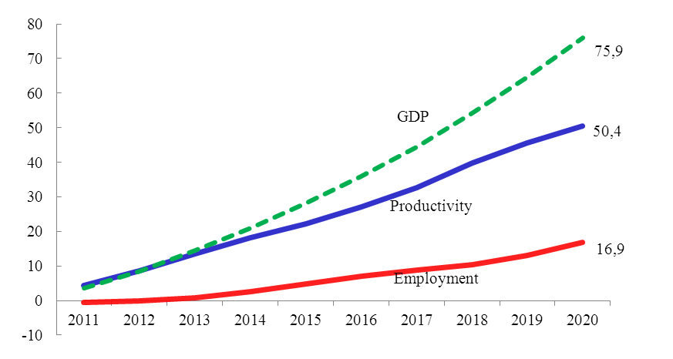
The basic goals and presumptions for the dynamic economic growth until 2020
Cumulative growth of GDP, productivity and employment,
2010-2020 (in %)
The average annual real GDP growth would be 5,8%, and growth of domestic demand would be 4,7%.
The value of GDP in 2020 would reach 52,7 billion euros, or about 7,5 thousand euros per capita.
Also, in mention period (2010 – 2020) productivity would be cumulatively increased by 50,4% and employment by 16,9% what is equivalent to number of 440 thousand new jobs.
In order to ensure sustainability of external debt the internal demand has to grow slower than GDP.

Slide 13
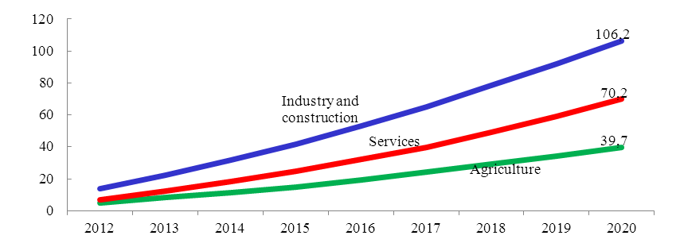
The basic goals and presumptions for the dynamic economic growth until 2020
The manufacturing structure of GDP, cumulative growth
2011-2020 (in %)
The projected annual growth of industry is 6,9%, construction 9,7% and services 5,5% create the conditions for changing the economic structure.
The share of exchangeable products in GDP would increase from 30,7% in 2009 to 33,1% in 2020.
The share of industry and construction in GDP taken together would increase from 21,1% in 2009 to 25,5% in 2020 until share of services would drop from 55,3% to 52,9%.
Also, the share of agriculture in GDP would decline from 9,6% in 2009 to 7,6% in 2020.
The share in GDP

Slide 14
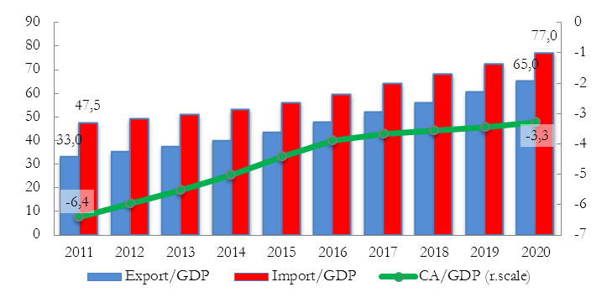
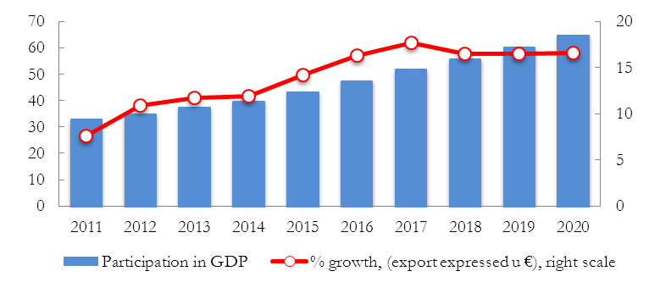
Target parameters in the basic development scenario
Export of goods and services 2001 - 2020
Raising the share of fixed investment to 25% in 2015 and to 28% in 2020 (with an average annual growth rate of 9.7%).
Reduction of the state expenditure share in the GDP from 20.5% in 2009 to 12.4% in 2020.
Raising the share of exports of goods and services in GDP, from 27.6% in 2009 to 65% in 2020.
Significantly narrowing the current account deficit in balance of payments from 7.1% in 2010 to 3.3% of GDP in 2020.
Inflation in the period 2011-2012 is projected at 5%, at 4% in 2013 and 2014 and at 3% in all the years until 2020.
The dinar exchange rate would depreciate about 2% per year until 2015, after which it would be neutral (the growth of the euro would be equal to inflation growth in Serbia and the euro zone).
Share of Export, Import and Current account in GDP

Slide 15
Employment projections and trends on the labor market
Projections of trends in the labor market by 2020 were based on macroeconomic projections of GDP growth by economic sectors and the respective sector estimates of employment elasticity in relation to GDP by approximately corresponding elasticity in the successful countries of Central and Eastern Europe.
Total employment will return to pre-crisis level but not before 2013, and will begin to steadily grow a an average pace of over 50.000 persons per year.
At the end of the period (2020) total employment will be close to 3 million, which will be about 440.000 employees more than in 2010.
On the other side total unemployment will mildly decrease until 2013 so the number of unemployed will be approximately 340.000.
Analysis of the projected changes in the structure of employment shows that they occur in the expected and desired direction, although their intensity is not going to be very strong.
The employment rate in EU and Serbia in 2010 and 2020

Slide 16
Fiscal adjustment and economic growth in Serbia
Serbia should immediately begin with credible medium-term fiscal adjustment, i.e. reduction of the fiscal deficit, primarily (relative) reduction of the current public expenditure in order to ensure sustainable of medium term growth.
The fiscal deficit of almost 5% of GDP in 2010 should be reduced to slightly above 1% in 2015.
An important prerequisite for this is that the state should carry out the fiscal consolidation - reduce the deficit, limit the growth of public debt, achieve relatively reduced public spending by its restructuring followed by appropriate reforms, etc
Serbia, in terms of fiscal policy and adjustments, is going to face the two different periods: first, the fiscal consolidation, i.e. significant reduction of the deficit and control of the public debt growth (until 2015), and then maintenance of the prudent fiscal position and policy.
As additional anchors for reduction of the deficit is control of wages and pensions so that they should grow more slowly than GDP.
The Fiscal Council, as an independent institution from government, is usually introduced along with the prescribing the fiscal rules, and it should be done in Serbia. It should provide an independent and credible assessment for the general population of the fiscal policy, control the implementation of legally defined fiscal rules, encourage public discussion on fiscal policy, thus raising knowledge and awareness of it.

Slide 17
Reform of the public sector
The most important is to improve investment and business environment in order to reduce costs and risks of doing business in Serbia.
Key activities are to improve the regulatory functions of the state and the modernization and construction of transport, energy, utilities and telecommunications infrastructure .
Another direction of reforms is the reduction of public spending to about 40% of the GDP and fiscal deficit to about 1% of the GDP in the medium term.
The third direction of reform is the change in the structure of public expenditure and the structure of the tax system in the direction of stimulating investment, employment and growth. In the case of public spending that means increasing the share of public investment, and reducing the current consumption, while in the case of taxes, it means reducing the tax burden of labor and increase of tax on consumption.
The fourth direction of reforms is the improvement of efficiency of all segments of the public sector: education, health, justice, customs and tax administration, local administration etc.
Finally, improving the efficiency of the republic, local and provincial public enterprises the continued liberalization of infrastructure and utilities, as well as the partial privatization of public enterprises are an important component of public sector reform.

Slide 18
Reindustrialization
Designed share of sectors and industries in the GDP and growth rates
Industry of Serbia has not made a significant contribution to the transitional economic growth.
Industrial production in 2009 was just 2,9% hired than in 2001.
The main aggravating circumstances for the industry in previous period were: lack of investments in modernization of equipment and technology, unfinished privatization and lack of effective process of liquidation.
Activities that may encourage reindustrialization and which can achieve the stated goals are classified into three groups: improving the business environment, direct and indirect state measures.
Share in GDP

Slide 19
Assumptions for the sustainability of the new economic model
First, adjustment in the economic system, macroeconomic policy and sector policies, the concept of accelerating economic growth based on replacement of consumer scenario with the pro-investment model of development and shifting the focus of investment towards the exchangeable goods. A special place in this sense is held by a public sector reform. Deviation from these assumptions, especially bearing in mind the upcoming election cycle, is one of the biggest risks for achieving the presented scenario.
The second group consists of assumptions that allow the continuity and acceleration of the EU membership process. When it comes to the economic environment of the Serbian economy, this group of assumptions has another side - the time of recovery of the world economy, on which the projected growth of our exports and economic growth depend on dramatically.
Third, the last but perhaps the most important, is the risk associated with the issue of sustainability of external debt and external liquidity. Serbia in the next five years bears the risk of higher repayment burden of private debt, and its investment cycle needs to be based on foreign direct investments, public loans, and - significant increase of the share of domestic savings in financing investment. The main risk point in the financing the balance of payment is high debt servicing rate, which for the first five years is more or less already fixed and in 2015 it would still be 38% to 39% of the value of exports of goods and services. Hence there comes the imperative to reduce the share of trade deficit and current account deficit in balance of payments in the GDP.

Slide 20
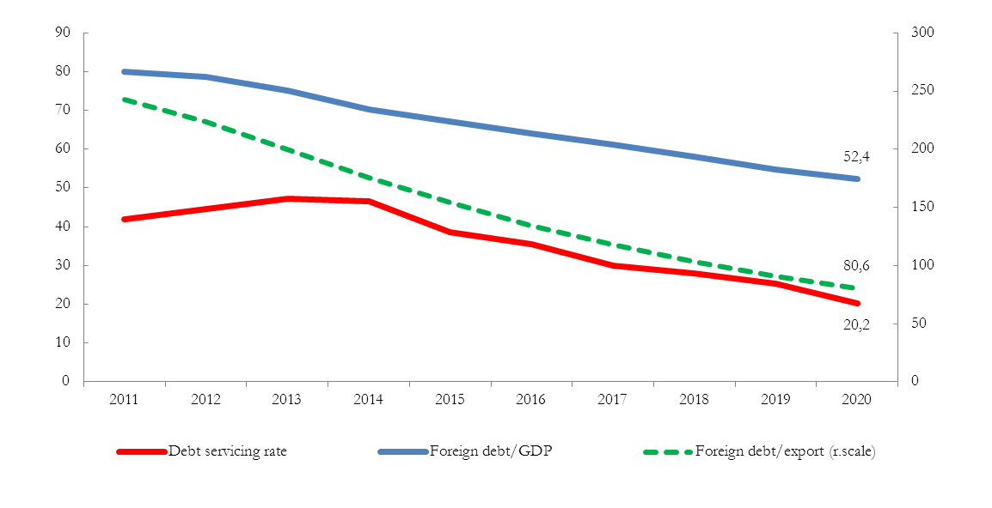
Assumptions for the sustainability of the new economic model
Indicators of external debt

Slide 21
THANK YOU FOR YOUR ATTENTION

