Slide 1
The Future of Productivity:
Comment
Dimitris Malliaropulos*
Bank of Greece
April 2016
*Chief Economist, Head of Economic Analysis and Research
Notes:
1

Slide 2
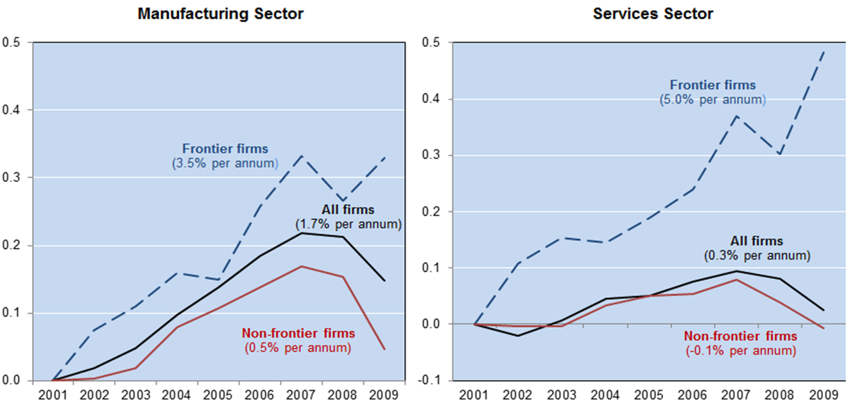
The distance to the global frontier has widened in the recession
Source: Giuseppe Nicoletti
Notes:
2

Slide 3
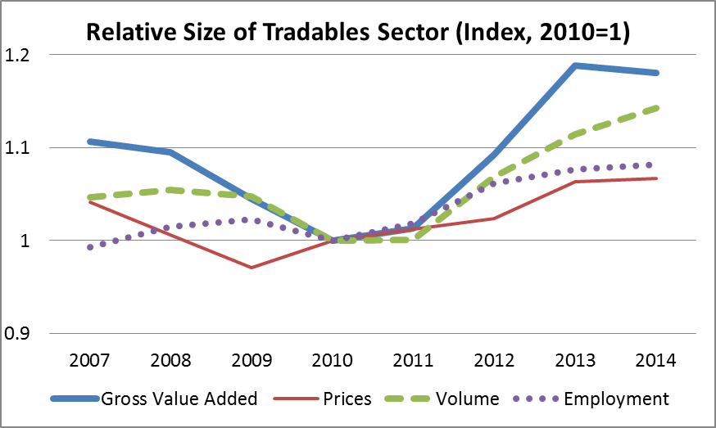
Greece: Rebalancing the economy
Tradable sector gained a higher share in the economy. Change in relative prices favours rebalancing towards tradable sector
(indices refer to tradable sector relative to non-tradable sector)
Tradables: agriculture, industry, business and financial services, telecommunications and services related to tourism (transport and accommodation and restaurants).
Non-tradables: else except public administartion and non-market services.
Source: Eurostat, Bank of Greece calculations
Notes:
3
3

Slide 4
Greece: Potential growth (accounting)
Source: Bank of Greece estimates
Notes:
4

Slide 5
Greece: GDP growth accounting
Source: Eurostat, Ameco, Bank of Greece estimates
Notes:
5

Slide 6
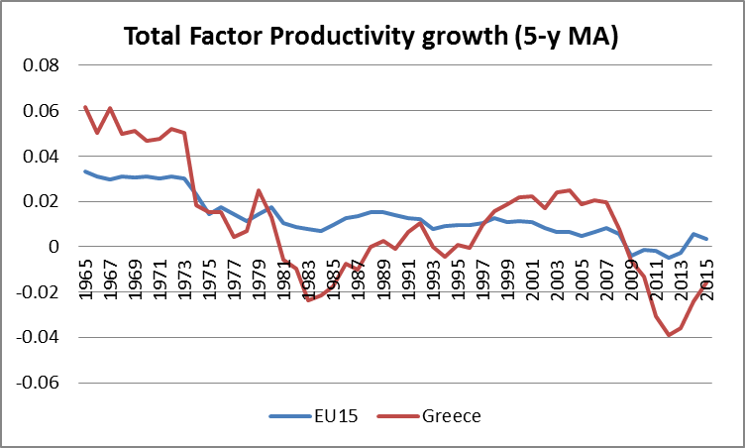
Total Factor Productivity
Average growth 1960-2008 = 1.6% pa
Source: Eurostat, Ameco
Notes:
6

